Slide 1
Systematic Review and Meta-analysis
Tadesse Awoke (PhD)
tawoke7@gmail.com
+251910173308
July 23-27, 2021

Slide 2
Content
General Overview
Review Topic Development
Protocol Development
Search Strategy
Critical appraisal
Data Extraction
Quantitative Data Synthesis
Quantitative Data Synthesis
Meta analysis
Summary
Activity 1: Review topic development
Activity 2: Protocol development
Activity 3: Searching and selecting studies
Activity 4: Critical appraisal of articles
Activity 5: Data extraction
Activity 6: Searching and selecting articles
Activity 7: Data Synthesis

Slide 3
Expected Outcomes
Basic skill and knowledge on systematic review
Qualitative synthesis
Review question:
Draft Protocol will be developed
PROSPERO registered protocol
Data extraction tool will be developed
Data will be extracted from sample articles
Basic skills and knowledge on meta analysis
Quantitative analysis
Stata application on Meta analysis

Slide 4
Expected Outcomes (Phase II)
Draft manuscript
Journal will be selected
http://jane.biosemantics.org/
Manuscript will be submitted for publication
Policy brief for the institute

Slide 5

Journal Author Name Estimator (Jane)

Slide 6

Option II
You can also use “Google scholar” to choose the best journal to submit a manuscript.
Click here
Click here

Slide 7
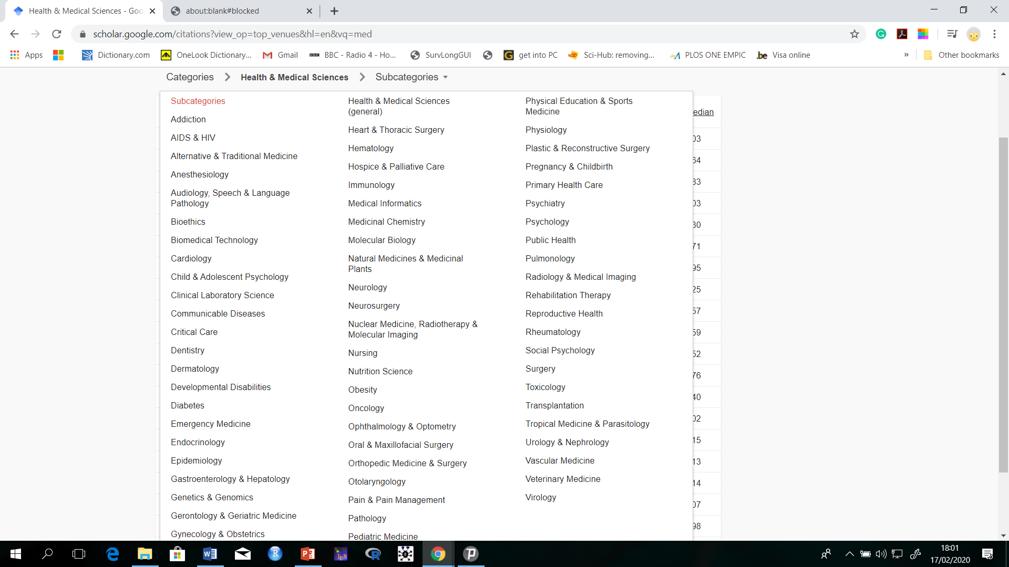
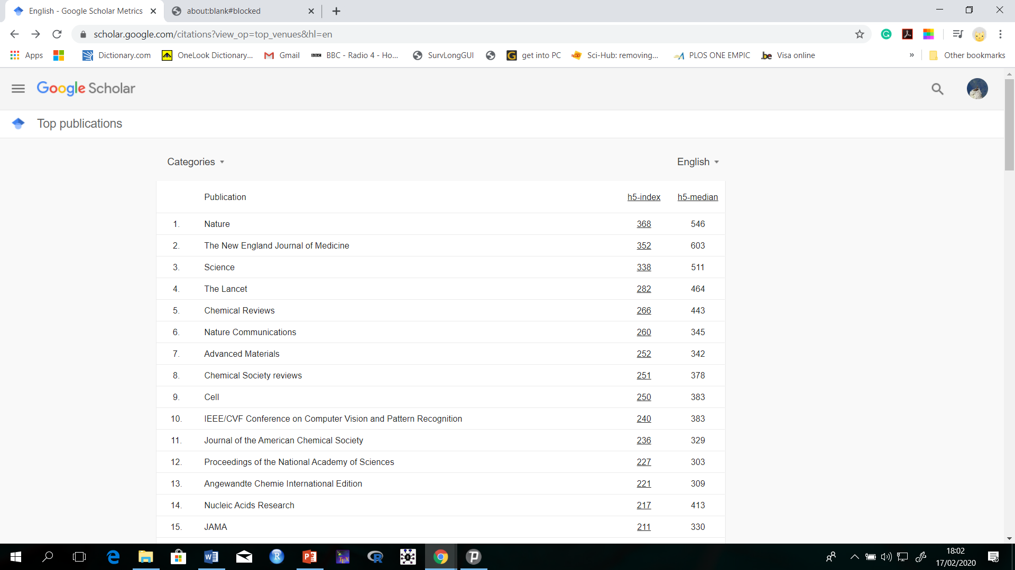
Option II
Then choose the category of your area of research

Slide 8
Academics and Research
Initiatives for publication
One of the pillar in academics
Academic promotion? Publish or Perish!
Collaboration? Scholarships?
Journals
Quality of publisher;
Impact factor (NEMJ, Nature, Lancet, …)
Indexing
Peer reviewed
Volume
…

Slide 9
Publisher
New England Journal of Medicine (79.258)
Lancet (London, England) (53.254)
JAMA (47.661)
Nature (43)
.
.
Ethiopian journal of health development (AAU)
Ethiopian journal of health and biomedical sciences (UoG)

Slide 10
Search Sources
Predatory publishing is a business model that involves charging publications fees to authors without checking articles for quality and legitimacy and without providing the other editorial and publishing services associated with legitimate journals
The University has lists of predatory journals
Check before submission a manuscript for publication

Slide 11
Science Scandals
Three types of research misconduct:
Fabrication
falsification, and
plagiarism
A Major Publisher scandals and Retracted
BMC, the publisher of over 270 peer-reviewed journals, pulled 43 papers earlier this year on account of "fabricated" peer reviews (~16%)
Three published papers
A young psychologist who studied the effects of motivation and reward on cognitive control is found to have falsified data
Altering statistical significance
A Case Western Reserve University researcher is found guilty of altering the number of samples and results
Clinical trials
A researcher working for US pharmaceutical company’s Scotland branch is sent to prison for falsifying data on experimental drugs

Slide 12
Industrial revolutions
Industrial revolutions:
The first revolution (1765):
Going from hand to machine production, the increasing use of steam and water power
Second revolution (1870)
Expansion of electricity, petroleum and steel
The third Revolution (1920)
Digital technology: Clever software, robots, and a whole range of web-based services
The fourth industrial revolution??
The row power for the fourth revolution is data
Data is the new oil!
Unlike oil, data is created by people, not geology
Can solve so many of the problem:
Health
Economy
Lifestyle, clime, ….

Slide 13

Data
Data are not just numbers, they are numbers with a context
In data analysis, context provides meaning
Context includes who collected the data, how were the data collected, why the data were collected, when and where were the data collected what exactly was collected
ETRSS

Slide 14
Data
We can think of the who, how and why question referring to
Pragmatics of data collection
is the study of language from the point of view of usage
Where and what refer to data semantics
study of meaning and is related to both philosophy and logic

Slide 15
Models
Statistics includes the process of finding out about patterns in the real world using data
When solving statistical problems it is often helpful to make models of real world situations based on;
Observed data
Assumptions about the context, and
Theoretical probability
The model can then be used to make predictions, test assumptions, and solve problems

Slide 16
Statistical Modelling
“If you torture the data long enough, it will confess." Ronald H. Coase
We use models to "torture" the data
Statistical models can be;
Deterministic
Model parameters are exact
E = mc²
The output of the model is fully determined by the parameter values and the initial conditions
Stochastic;
Models possess some inherent randomness
g(y) = β₀ + βX + ε_{ij}
Output has variation
The natural world is buffeted by stochasticity

Slide 17
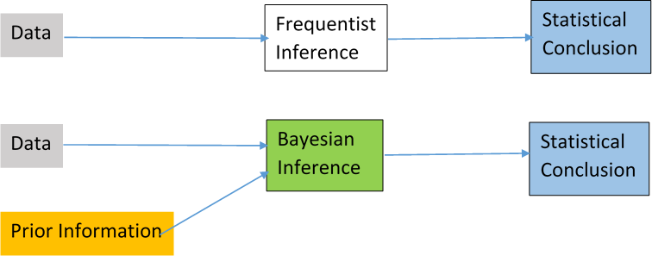
Statistical Modelling
Two Schools of thought in Statistics
Frequents
Parameters are fixed and unknown
Data is sufficient to estimate
Bayesian
Parameters are random and unknown
Data is not sufficient to estimate
Require Prior information in addition to data

Slide 18
Steps of generating evidence (Primary Study)
Problem
Research Question
Objectives
Hypothesis
Methods
Data
Information
Knowledge
Wisdom
Data collection tools
Biostatistics
Experience
Understanding

Slide 19
Steps of generating evidence (Systematic Review)
Problem
Review Question
Manuscript
Protocol development
PROSPERO reg.
Results
Search Strategy
Study location
Study selection
Appraisal
Extraction
Qualitative synthesis
Meta analysis

Slide 20
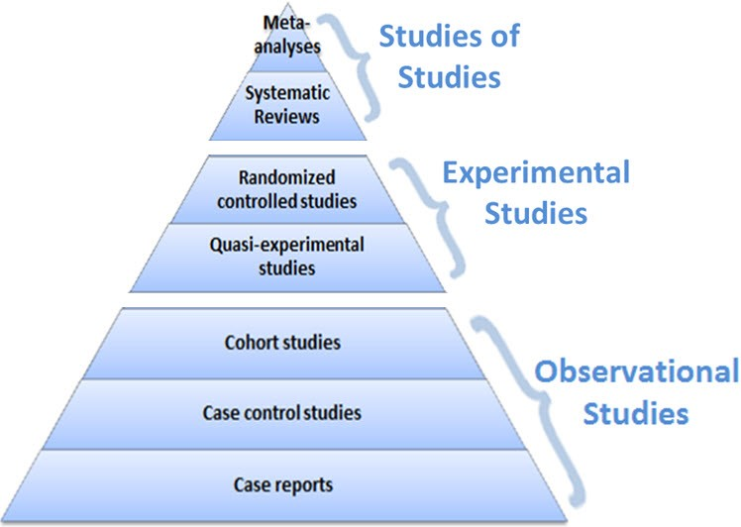
Hierarchy of Design
As we move up:
Increase strength of the evidence
Decrease the bias

Slide 21
Overview of Systematic Review
Systematic reviews aim to provide a comprehensive, unbiased synthesis of many relevant studies in a single document using rigorous and transparent methods
A systematic review does not seek to create new knowledge but rather to synthesize and summarize existing knowledge

Slide 22
Aims of Systematic Review
The aims of a systematic review:
uncover the international evidence
confirm current practice/ address any variation
identify areas for future research
investigate conflicting results
produce statements to guide decision-making

Slide 23
Steps in conducting a systematic review
Formulate review question
Define inclusion and exclusion criteria
Locate studies
Select studies
Assess study quality
Extract data
Analyse and present results
Interpret results

Slide 24
Types of Systematic Reviews
1. Effectiveness Reviews
2. Qualitative Reviews
3. Costs/Economics Reviews
4. Prevalence or Incidence Reviews
5. Diagnostic Test Accuracy Reviews
6. Etiology and Risk Reviews
9. Umbrella Reviews
Notes:
SLIDE EXPLANATION:
We have developed methodology/methods for:
Effectiveness Reviews
Qualitative Reviews
Costs/Economics Reviews
Prevalence or Incidence Reviews
Diagnostic Test Accuracy Reviews
Etiology and Risk Reviews
Textual Synthesis Reviews
Mixed Methods Reviews
Umbrella Reviews and;
Scoping Reviews
REFERENCES:
EXAMPLES:
DISCUSSION POINTS AND QUESTIONS FOR THE CLASS:

Slide 25
Effectiveness Reviews
Reviews synthesise primary studies to establish the effect of treatment
Aim to establish a causal relationship between two variables
Question Development: PICO
Population
Intervention
Comparator/control
Outcome
Notes:
SLIDE EXPLANATION:
The PICO mnemonic begins with identification of the Population, the Intervention being investigated and its Comparator and ends with a specific Outcome of interest to the review. In JBI, and in Cochrane, there is a preference for the PICO mnemonic to be used to guide question development. Additionally, PICO may be used in the systematic review process to guide concept mapping when designing the search strategy (Concept mapping is used to help identify relevant keywords and search terms for your review).
The core elements of a good question include:
Population
Intervention
Control or comparator
Outcomes to be measured
REFERENCES:
Stern C, Jordan Z & McArthur A. Developing the Review Question and Inclusion Criteria, AJN The American Journal of Nursing. 2014;114(4): 53-56.
EXAMPLES:
DISCUSSION POINTS AND QUESTIONS FOR THE CLASS:

Slide 26
Effectiveness Reviews
Example:
Are non-pharmacological interventions compared with control interventions (e.g. usual care) effective in reducing depressive symptoms of older adults with depressive disorders?
Population
Intervention
Comparison
Outcome
Notes:
SLIDE EXPLANATION:
Population = older adult with depressive disorders
Intervention = non-pharmacological interventions
Comparator = control interventions (usual care)
Outcome = depressive symptoms
Note that each element of the PICO will need clarification in the inclusion criteria which is addressed later in the program.
REFERENCES:
EXAMPLES:
DISCUSSION POINTS AND QUESTIONS FOR THE CLASS:
What were different/similar to their original responses?

Slide 27
Qualitative Reviews
Focus on analysing human experiences and cultural and social phenomena
Question Development: PICo
Population
Phenomena of Interest
Context
The phenomena of interest relates to a defined event, activity, experience or process
Context is the setting or distinct characteristics
Notes:
SLIDE EXPLANATION:
PICo (with a lowercase o) can be equally useful for qualitative reviews. The core elements of PICo are: Population, phenomena of Interest, and Context. With qualitative evidence there is no outcome or comparator to be considered. The phenomenon of interest differs from an intervention in its focus. Quantitative reviews are concerned with an intervention and seek to isolate it from the happenings and influences of study participants. Reviews containing qualitative evidence focus on the engagement between the participant and the intervention. A qualitative review may describe an intervention, but its question focuses on the perspective of the individuals experiencing it as part of a larger phenomenon.
REFERENCES:
Stern C, Jordan Z & McArthur A. Developing the Review Question and Inclusion Criteria, AJN The American Journal of Nursing. 2014;114(4): 53-56.
EXAMPLES:
DISCUSSION POINTS AND QUESTIONS FOR THE CLASS:

Slide 28
Qualitative Reviews
Example:
What is the experience of recovering from burns injuries in adult (over 18 years of age) patients during their stay in a hospital burns care unit?
Population
Phenomena of Interest
Context
Notes:
28
SLIDE EXPLANATION:
Population = Adult patients (over 18 years of age) recovering from burn injuries
Phenomena of interest = Experiences of recovering from burns injuries during a stay in a hospital burns care unit Context = Hospital burns care unit
Remember the difference between an intervention and a phenomena of interest is in where the focus lies. Experimental and non-experimental reviews focus on an intervention, and seek to isolate that intervention from the activities and influence of study participants. With qualitative reviews, it is the engagement between the participant and the intervention that is of interest. While the intervention may be described, the full question will focus on the perspective, experience or sense of being the individual experiences as part of a phenomena.
Note that each element of the PICo will need clarification in the inclusion criteria which is addressed later in the program.
REFERENCES:
EXAMPLES:
DISCUSSION POINTS AND QUESTIONS FOR THE CLASS:
What were different/similar to their original responses?

Slide 29
Costs/Economics Reviews
Reviews assessing the costs of a certain intervention, process, or procedure
Question Development: PICO
Population
Intervention
Comparator
Outcome
Context also considered
Notes:
SLIDE EXPLANATION:
In terms of question development, cost/economic reviews are an example of a quantitative review and as such follow the PICO mnemonic. That is, with identification of the Population, the Intervention being investigated and its Comparator and ends with a specific Outcome of interest to the review. Consideration should be given to whether the entire world/international population is to be considered or only a population (or sub-population) of a particular country. Details of the intervention and comparator should include the nature of services/care delivered, time period of delivery, dosage/intensity, co-interventions, and personnel undertaking delivery. The reviewer(s) should clarify whether measures of resource use, cost and/or cost effectiveness will be sought for the intervention/program implemented as a standalone, or also in addition for the intervention/program in combination with others. Finally in regards to outcomes, clarify whether the review will identify and synthesize study results only on resource usage and costs of the intervention and its comparator(s) or additionally on cost-effectiveness.
Context can also be considered in these types of questions. This section should specify the health setting(s) to be considered, for example, primary health care, community based or hospital based. If the review is focusing on a particular cultural setting or differences between two cultural settings this should be noted. If only low resource settings are to be considered this should be clarified and the concept of “low resource setting” defined.
REFERENCES:
The Joanna Briggs Institute. Joanna Briggs Institute Reviewers’ Manual: 2014 edition/Supplement. The Systematic Review of Economic Evaluation Evidence. The Joanna Briggs Institute. 2014.
EXAMPLES:
DISCUSSION POINTS AND QUESTIONS FOR THE CLASS:

Slide 30
Costs/Economics Reviews
Example:
What is the cost effectiveness of Mohs micrographic surgery compared to other surgical interventions for non-melanoma skin cancer in developed countries?
Population
Intervention
Comparison
Outcome
Context
Notes:
SLIDE EXPLANATION:
Population = Participants with non-melanoma skin cancer
Intervention = MohS micrographic surgery
Comparison = Other surgical/ablative interventions
Outcomes = Cost effectiveness
Context = Developed countries
Note that each element of the PICO will need clarification in the inclusion criteria which is addressed later in the program.
REFERENCES:
EXAMPLES:
DISCUSSION POINTS AND QUESTIONS FOR THE CLASS:
What were different/similar to their original responses?

Slide 31
Prevalence or Incidence Reviews
Measure frequency of disease
Question Development: CoCoPop
Condition
Context
Population
The variable of interest is the condition and can be a health condition, disease, symptom, event or factor
Define context or specific setting since prevalence/incidence can be impacted by environmental factors
Notes:
SLIDE EXPLANATION:
The CoCoPop framework can be used for reviews assessing prevalence or incidence data. Due to the nature of these systematic reviews the traditional PICO framework is not appropriate as they are based on epidemiological data that is derived from observational studies, which are not experimental and do not involve an intervention. The core elements of CoCoPop include: Condition, Context and Population. Condition refers to the variable of interest. Environmental factors can have a substantial impact on the prevalence or incidence of a condition so it is important that authors define the context or specific setting relevant to their review question. Like the other mnemonics the population or study subjects should be clearly defined and described in detail.
REFERENCES:
The Joanna Briggs Institute. Joanna Briggs Institute Reviewers’ Manual: 2014 edition/Supplement. The Systematic Review of Prevalence and Incidence Data. The Joanna Briggs Institute. 2014.
EXAMPLES:
DISCUSSION POINTS AND QUESTIONS FOR THE CLASS:

Slide 32
Prevalence or Incidence Reviews
Example:
What is the prevalence and incidence of peri-natal depression among women in Ethiopia?
Condition
Context
Population
Notes:
SLIDE EXPLANATION:
Condition = Peri-natal depression
Context = Australia
Population = Pregnant women or those that have recently given birth
Note that each element of the CoCoPop will need clarification in the inclusion criteria which is addressed later in the program.
REFERENCES:
EXAMPLES:
DISCUSSION POINTS AND QUESTIONS FOR THE CLASS:
What were different/similar to their original responses?

Slide 33
Diagnostic Test Accuracy Reviews
Diagnostic tests are used by clinicians to identify the presence/absence of a condition in a patient
This review provide a summary of test performance in order to determine the accuracy of the diagnostic tests they use or are considering using
Question Development: PIRD
Population
Index test
Reference test
Diagnosis of interest
Notes:
SLIDE EXPLANATION:
The mnemonic PIRD is recommended for question development for systematic reviews assessing diagnostic test accuracy. The core elements are: Population, Index test, Reference test, and Diagnosis of interest.
REFERENCES:
The Joanna Briggs Institute. Joanna Briggs Institute Reviewers’ Manual: 2014 edition/Supplement. The Systematic Review of studies of diagnostic rest accuracy. The Joanna Briggs Institute. 2014.
EXAMPLES:
DISCUSSION POINTS AND QUESTIONS FOR THE CLASS:

Slide 34
Diagnostic Test Accuracy Reviews
Example:
What is the diagnostic accuracy of currently available laboratory tests for swine flu (H1N1) compared to viral culture as a reference test amongst people presenting with suspected flu?
Diagnosis of interest
Population
Index Test
Reference Test
Notes:
SLIDE EXPLANATION:
Population = People presenting with flu symptoms
Index Test = Laboratory tests currently available
Reference Test = Viral culture
Diagnosis of Interest = Swine flu (H1N1)
Note that each element of the PIRD will need clarification in the inclusion criteria which is addressed later in the program.
REFERENCES:
EXAMPLES:
DISCUSSION POINTS AND QUESTIONS FOR THE CLASS:
What were different/similar to their original responses?

Slide 35
Etiology and Risk Reviews
Assess associations between epidemiological factors and the outcomes
The exposure of interest refers to a particular risk factor or several factors associated with a disease
Important in informing health care planning and resource allocation
Question Development: PEO
Population
Exposure of interest
Outcome or response
Notes:
SLIDE EXPLANATION:
The mnemonic PEO is recommended for question development for systematic reviews assessing etioloy and risk. The core elements are: Population, Exposure of Interest and Outcomes or response. The traditional PICO format for systematic reviews of effects does not align with questions relating to association or correlation between two variables.
The overarching objective of reviews of association (be it harm and risk data or correlation) is to determine whether and to what degree or the strength of a relationship if it exists between two or more quantifiable variables. Accordingly, the review question should outline the exposure, disease, symptom or health condition of interest, the population or groups at risk, as well as the context/location (e.g. limited to specific geographic areas), the time period (e.g. peaks at a particular season) and the length of time (e.g. the duration of a pregnancy or infancy) where relevant.
REFERENCES:
The Joanna Briggs Institute. Joanna Briggs Institute Reviewers’ Manual: 2014 edition/Supplement. Methodology for synthesizing Evidence related to Etiology and Risk. The Joanna Briggs Institute. 2016. (In press)
EXAMPLES:
DISCUSSION POINTS AND QUESTIONS FOR THE CLASS:

Slide 36
Etiology and Risk Reviews
Example:
Are children exposed to tobacco smoke (maternal smoking) during pregnancy at risk for obesity in childhood?
Population
Exposure
Outcome
Notes:
SLIDE EXPLANATION:
Population = Children
Exposure of interest = Tobacco smoke during pregnancy (maternal smoking) and childhood obesity
Outcomes = Obesity in childhood
Note that each element of the PEO will need clarification in the inclusion criteria which is addressed later in the program.
REFERENCES:
EXAMPLES:
DISCUSSION POINTS AND QUESTIONS FOR THE CLASS:
What were different/similar to their original responses?

Slide 37

Umbrella Reviews
Compare and contrast published reviews and provide an overall examination of a body of information that is available for a given topic
Example:
What are effective non-pharmacological interventions to manage aggressive behavior in elderly patients with dementia?
Intervention
Comparator
Outcome
Population
Phenomena
Context
Notes:
SLIDE EXPLANATION:
Example question:
What are effective non-pharmacological interventions to manage aggressive behavior in elderly patients with dementia? (With a focus on systematic reviews only)
REFERENCES:
EXAMPLES:
DISCUSSION POINTS AND QUESTIONS FOR THE CLASS:
Question for participants: what type of evidence is this question focussing on?
Answer: Could be both quantitative and qualitative. The question lend itself to the inclusion of systematic reviews of RCTs to inform the effectiveness of an intervention or therapy, or potentially a broader investigation of research syntheses, that not only explores effectiveness of interventions but also the experiences of patients that received these therapies and their acceptability.
Before moving to the next slide ask participants to identify elements of the PICO and PICo in the example provided

Slide 38
Summary of Question Development
Review Type | Mnemonic
Effectiveness | PICO
Qualitative | PICo
Costs/Economics | PICO
Prevalence or Incidence | CoCoPop
Diagnostic Test Accuracy | PIRD
Etiology and Risk | PEO
Umbrella | PICO or PICo or PIRD or CoCoPop or PEO
Notes:
SLIDE EXPLANATION:
To summarize, different types of reviews use different mnemonics to guide question development. PICO is used for effectiveness reviews, and cost/economic reviews. PICo (little o) is used in qualitative reviews and broadly in textual synthesis reviews. PEO is considered for etiology and risk reviews while CoCoPop is recommended for prevalence or incidence reviews. Diagnostic test accuracy reviews employ the PIRD mnemonic while scoping reviews utilize PCC. For mixed methods reviews and umbrella reviews any of the mnemonics can be used either alone or in combination.
To reiterate the mnemonics outlined in this session are just a sample of mnemonics that exist. For the purpose of this training we will only focus on those listed above.
REFERENCES:
EXAMPLES:
DISCUSSION POINTS AND QUESTIONS FOR THE CLASS:

Slide 39

Inclusion Criteria
Step 2: define inclusion and exclusion criteria
Determines which research articles will be selected
Allows the reader to understand the focus of the review
Clarity of inclusion criteria ensures replicability of the review
Consider:
Participants/population characteristics
Intervention, interest, exposure or phenomenon under investigation
Outcomes
Context
Types of studies to be included
Publication language
Time period
Notes:
SLIDE EXPLANATION:
Following on from formulating your systematic review question is step 2, defining your inclusion and exclusion criteria. Essentially this criteria determines which papers will be selected. In order for the reader to understand the focus of the review (and its limitations), the reviewers need to be precise in outlining the inclusion criteria. The clarity of the inclusion criteria also ensures the replicability of the review.
REFERENCES:
Stern C, Jordan Z & McArthur A. Developing the Review Question and Inclusion Criteria, AJN The American Journal of Nursing. 2014;114(4): 53-56.
EXAMPLES:
DISCUSSION POINTS AND QUESTIONS FOR THE CLASS:

Slide 40
Activity 1
Develop the Review Question
Define the question development
List the inclusion and exclusion criteria
Register the review topic on PROSPERO
Notes:
SLIDE EXPLANATION:
Participants now have the opportunity to develop and design a systematic review question and subsequent inclusion/exclusion criteria relevant to their area of interest. Depending on what type of systematic review they wish to undertake will dictate the appropriate mnemonic to be followed (table provided again on next page for reference). Your workbook will be used for this activity. Each participant will then present and discuss their question with the class taking note of comments that might enhance or clarify their question.
Trainers: Allow 10 minutes for participants to develop question/criteria. The trainer/s should move around the group talking briefly with each participant. Depending on the number or participants and the feedback from the trainer and other participants, reporting back should also go for around 10 minutes.
REFERENCES:
EXAMPLES:
DISCUSSION POINTS AND QUESTIONS FOR THE CLASS:

Slide 41
Protocol Development

Slide 42
Protocol Development
A protocol:
Guides the specific direction of the review
Describes inclusion criteria
Identifies the appropriate search sources and resources
Describes methods of study selection, appraisal, extraction and synthesis
Notes:
SLIDE EXPLANATION:
A review protocol provides the specific direction the review will follow and allows transparency of process, which in turn allows the reader to see how the findings and recommendations were arrived at. It provides the plan or proposal for the systematic review by explicitly describing the inclusion criteria, methods of study selection, appraisal, extraction and synthesis. The background section describes the topic, why it is important and explores key elements of the inclusion criteria. Protocols across all review methods (e.g. qualitative, textual, economic etc.) contain a series of standardised headings that are consistent with the scientific principals of apriori documentation. Protocols restrict the presence of reporting bias.
REFERENCES:
The Joanna Briggs Institute. Joanna Briggs Institute Reviewers’ Manual 2014 Edition. The Joanna Briggs Institute. 2014.
EXAMPLES:
DISCUSSION POINTS AND QUESTIONS FOR THE CLASS:

Slide 43
Protocol Structure
Title
Authors
Review question
Background
Keywords
Methods:
Inclusion criteria
Search strategy
Study selection
Critical appraisal
Data extraction
Data synthesis
Assessing confidence
Conflicts of Interest
Acknowledgements
References
Appendices
Search strategy example
Appraisal instruments
Data extraction instruments
Notes:
SLIDE EXPLANATION:
In regards to the structure of a protocol JBI recommends the following features:
Title of systematic review protocol
Authors
Review question
Background
Keywords
Methods including:
Inclusion criteria – this will vary depending on the review type but may include for example types of participants, intervention/exposure/interest, condition, comparator, phenomena of interest, context, outcomes, types of studies)
Search strategy
Study selection
Critical appraisal
Data extraction
Data synthesis
Assessing confidence
Conflict of interest
Acknowledgements
References and;
Appendices including:
a search strategy for one database
relevant appraisal instrument/s (if not cited in the protocol itself) and
data extraction instrument/s (if not cited in the protocol itself)
REFERENCES:
EXAMPLES:
DISCUSSION POINTS AND QUESTIONS FOR THE CLASS:

Slide 44
PROSPERO registration
The review topic should be registered in PROSPERO
This will avoid duplication of works
https://www.crd.york.ac.uk/prospero/

Slide 45
Activity 2
Develop the protocol
Finalize PROSPERO registration
Notes:
SLIDE EXPLANATION:
Over the course of the day you have begun planning your review and had the opportunity to enter your review question and some details into JBI SUMARI. Now you have the opportunity to develop the rest of the review protocol in JBI SUMARI. You will need to develop or refine your review question, background, inclusion criteria, search strategy and methods.
Inform the participants that on Wednesday they will be required to present a quantitative review protocol, whilst on Friday they will be asked to present a qualitative or text and opinion review protocol. For this activity each participant should present for no longer than 3-5 minutes and should only have approximately 4 slides: Title, background, objective/aims/questions, and inclusion criteria.
Trainers: allow 30 minutes for this exercise. The trainer should briefly discuss each protocol with each participant.
REFERENCES:
EXAMPLES:
DISCUSSION POINTS AND QUESTIONS FOR THE CLASS:

Slide 46
Developing a Searching Strategy
Locate studies
Select studies

Slide 47

Searching
A key characteristic of systematic reviews is a comprehensive search ➔based on search methodology
A key component in any definition of a systematic review is the attempt to locate “ALL” published and unpublished evidence relevant to a review question
General approach to conducting a comprehensive search involves:
identifying appropriate resources and sources to search
developing search strategies
searching bibliographic databases
looking for unpublished literature
Hand-searching
reference list searching
Notes:
47
SLIDE EXPLANATION:
Systematic reviews should be based on an explicit and exhaustive search methodology. It’s important that when you search for evidence, you attempt to find all eligible studies/papers and consider them for inclusion in your review.
Your search should be well described, documented and reproducible. Systematic reviews are highly sought after and often widely distributed; - it is not unlikely that, once the review has been published the author of the review will be contacted by disappointed researchers (or their colleagues) asking why their papers were not included. The exclusion may be due to either the search strategy not “turning up” the paper, the paper not meeting the inclusion criteria or not passing the critical appraisal process. It is important that reviewers are able to justify and clearly describe their methods for all of these review activities. There is no prescriptive approach to conducting a comprehensive search although it involves several standard processes, such as developing search strategies, searching across bibliographic citation databases that index healthcare research, looking for “grey,” or unpublished, literature handsearching and searching reference lists.
REFERENCES:
Aromataris E & Riitano D. Systematic Reviews: Constructing a Search Strategy and Searching for Evidence, AJN The American Journal of Nursing, 2014;114(5):49-56.
EXAMPLES:
DISCUSSION POINTS AND QUESTIONS FOR THE CLASS:

Slide 48
Search Strategy
Features of an effective search strategy:
Sensitivity – ability to identify all the relevant studies
Over sensitive search ➔ capture all necessary studies but labor-intensive
Specificity – ability to exclude irrelevant studies, also known as precision.
Over specific search ➔ yield fewer results but may omit important studies
Inverse relationship between sensitivity and specificity
Minimize bias – think about finding/including studies that are not in major databases
Efficient – look in the place you expect to have highest yield
Notes:
48
SLIDE EXPLANATION:
The search strategy should be sensitive (that is find as many studies as possible) and specific (excludes irrelevant studies, also known as precision). A search that is overly sensitive may capture all the necessary studies but may require a labor-intensive vetting of unnecessary studies at the stage of study selection. A search that is overly specific will yield fewer results but is always subject to the risk that important studies may have been omitted. There is an inverse relationship between sensitivity and specificity i.e. high sensitivity will tend to have low specificity, and this means that a large number of articles retrieved are not relevant to the review question.
The search strategy should also minimize bias and be efficient. To minimize bias, you will need to think about finding studies that are not in the major databases as some databases do not cover a broad spectrum of publications. An efficient search means looking in the places you expect to have the highest yield. You will need to develop search strategies that retrieve as much pertinent information as possible while at the same time keeping the cost and effort low, which is critical when generating evidence.
REFERENCES:
Aromataris E & Riitano D. Systematic Reviews: Constructing a Search Strategy and Searching for Evidence, AJN The American Journal of Nursing, 2014;114(5):49-56.
EXAMPLES:
DISCUSSION POINTS AND QUESTIONS FOR THE CLASS:

Slide 49
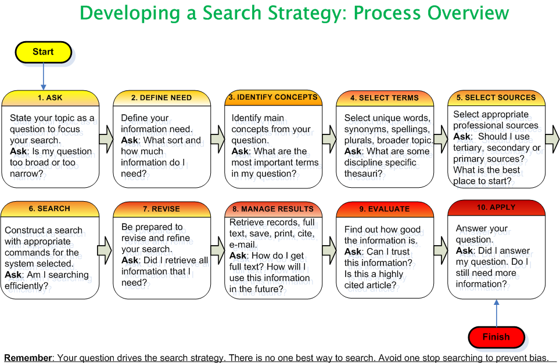

Slide 50
Example (Steps 1-4)
Ask: What health problems are associated with water pollution?
Need: scholarly primary research
Main Concepts: health, water, pollution
Select terms:
Broader terms: ‘health’, environmental degradation’, ‘agricultural management’,
Synonyms: health, illness, disease, etc.
water, rivers, lakes, sea, domestic water, etc.
pollution, ‘oil spills’, chemical, biological, toxicity, etc
Alternative spellings: none
Plurals: river(s), lake(s), disease(s)
Capitals: e.g. name of a specific lake, disease, region
Notes:
In this example, you will see numerous options for this search. Some of these options will enable you to broaden the search while others will limit it.

Slide 51
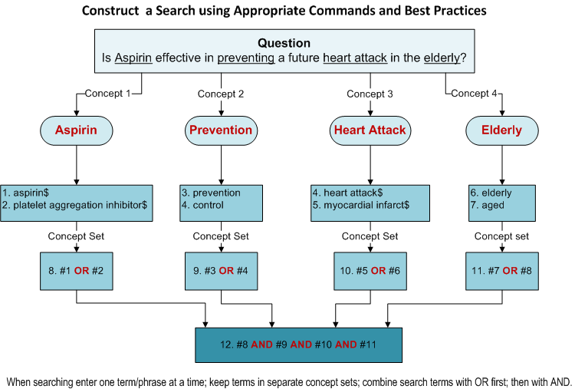
Example

Slide 52
Boolean (Search) Operators
Connect terms and locate records containing matching terms
Inserted in a search box – AND, OR, NOT
Must be in UPPERCASE when used
AND, NOT operators are processed in a left- to right sequence. These are processed first before the OR operators
OR operators are also processed from left-to-right
Notes:
Many search engines allow the use of full Boolean searching with logical operators– AND, OR, NOT between search terms.
Relevancy Ranking is the sorting of the results of the search so that the most relevant documents are listed first. Many search engines offer relevancy ranking in search results

Slide 53
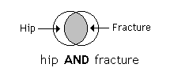
AND Operator (to combine two concepts and narrow a search)
the AND operator is used to combine two concepts e.g. hip AND fracture – in the shaded area; retrieves items containing all the search terms

Slide 54
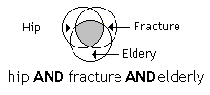
AND Operator (to combine three concepts)
the AND operator is used to combine three concepts e.g. hip AND fracture AND elderly – in the shaded area.

Slide 55
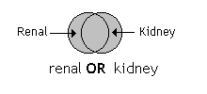
OR Operator (info containing one or other term; will broaden a search)
renal OR kidney – in the shaded area with the overlap in the middle having both search terms; retrieves items containing either search term or both search terms

Slide 56
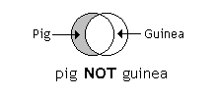
NOT Operator (in one term or the other - will narrow a search)
pig NOT guinea – in the shaded area; eliminates items in 2nd term (guinea) or both terms

Slide 57
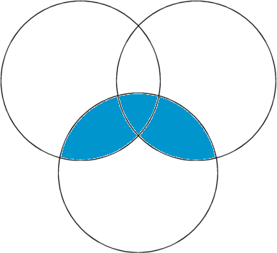
Africa AND (malaria OR tuberculosis)
malaria
tuberculosis
africa
Africa AND (malaria or tuberculosis) – in the shaded area
The (OR) operator retains items in each term and the AND operator is used to combine two concepts
Notes:
The term hybrid has its origins in Darwinian theories of evolution
Has now fully entered the language of information professionals
Is used to describe new types of library services that attempt to integrate traditional print with electronic information resources
Is seen as a halfway step towards the full digital library

Slide 58
Other search engine functions
Phrase or proximity searching: “…” or (…)
allows you to search for an exact phrase
E.g. “information literacy”
E.g. prevention and (malaria parasite)
Truncation/wildcards: *
allow you to search alternative spellings
E.g. child* for child OR childs OR children
E.g. parasite* for parasite OR parasites
Alternate spellings: ?
can be used to substitute for characters anywhere in a word
E.g. wom?n would search for “woman” and “women”

Slide 59
More Search Techniques
Field Specific Searching
author, title, journal, date, url, etc.
Language Restrictions, Humans or Animals, Gender and other limits
Relevancy Ranking
a grading that gives extra weight to a document when the search terms appear in the headline or are capitalized
every found document is calculated as 100% multiply by the angle formed by weights vector for request and weights vector for document found
Notes:
The Field Specific and Language Searching options will be discussed in the Module #4 (PubMed).
Relevancy Ranking is the sorting of the results of the search so that the most relevant documents are listed first. With the huge numbers in the Google searches, this ranking is invaluable.

Slide 60
Review Question
Soda drinks leads to obesity and overweight in children
Question development
Mnemonics
PEO
Soda drinks leads to obesity and overweight in children
Population
Exposure
Outcome

Slide 61
Logic Grid and Concept Map
Logic Grid
Concept Map
Population | Exposure | Outcome
Children | Soda | Obesity
Infant | Sugary drink | Overweigh
 | Carbonated beverage
Children
Soda
Sugary drink
Infant
Population
Carbonated
beverage
Exposure
Paediatrics
Is soda drinks associated to obesity and overweight in children?
Outcome
Obesity
Overweight

Slide 62
Documenting your Search
Important to keep an accurate record of the search and how it was performed
Numbers of titles identified by search are reported in review report
Avoids having to repeat searches
Use reference management software to document
Consider both published and unpublished studies/papers
Specify the timeframe chosen for the search and any language restrictions
Specify the databases to be searched and including the platform used to search a particular database
List the initial keywords to be used
Notes:
62
SLIDE EXPLANATION:
Documenting your search will help you avoid having to repeat searches and it will help people using your review to duplicate the search strategy. It is important to keep an accurate record of what you've searched and how you searched it as details of the number of titles identified by the search are to be reported in the systematic review report. To keep track of your searches use reference management software. It is a good idea to keep a note of which studies you have found and rejected. You may well come across them again later and it can be very frustrating to re-read irrelevant records.
REFERENCES:
EXAMPLES:
DISCUSSION POINTS AND QUESTIONS FOR THE CLASS:

Slide 63
Activity 3
For your topic of review develop search strategy

Slide 64
Searching for Studies
Types of Resources

Slide 65

Types of resources
Research4Life is the collective name for five programmes
Hinari
AGORA
OARE
ARDI and
GOALI
that provide developing countries with free or low-cost access to academic and professional peer-reviewed content online.
It is a public-private partnership of WHO, FAO, UNEP, WIPO, ILO, Cornell and Yale Universities, the International Association of Scientific, Technical & Medical Publishers and up to 155 international publishers

Slide 66
Research 4life
The goal of Research4Life is to reduce the knowledge gap between high-income countries and low- and middle-income countries by providing affordable access to scholarly, professional and research information.
Since 2002, the five programmes
Research in Health (Hinari),
Research in Agriculture (AGORA),
Research in the Environment (OARE),
Research for Development and Innovation (ARDI)
Research for Global Justice (GOALI)
have provided researchers at more than 9,000 institutions in more than 120 low- and middle-income countries with free or low-cost online access to up 100,000 leading journals and books

Slide 67

Research 4life

Slide 68

Registration
It requires user name and password to get access
Usually registration is simple by the institute
Individual will take long time
Once you have username and password, then signin

Slide 69
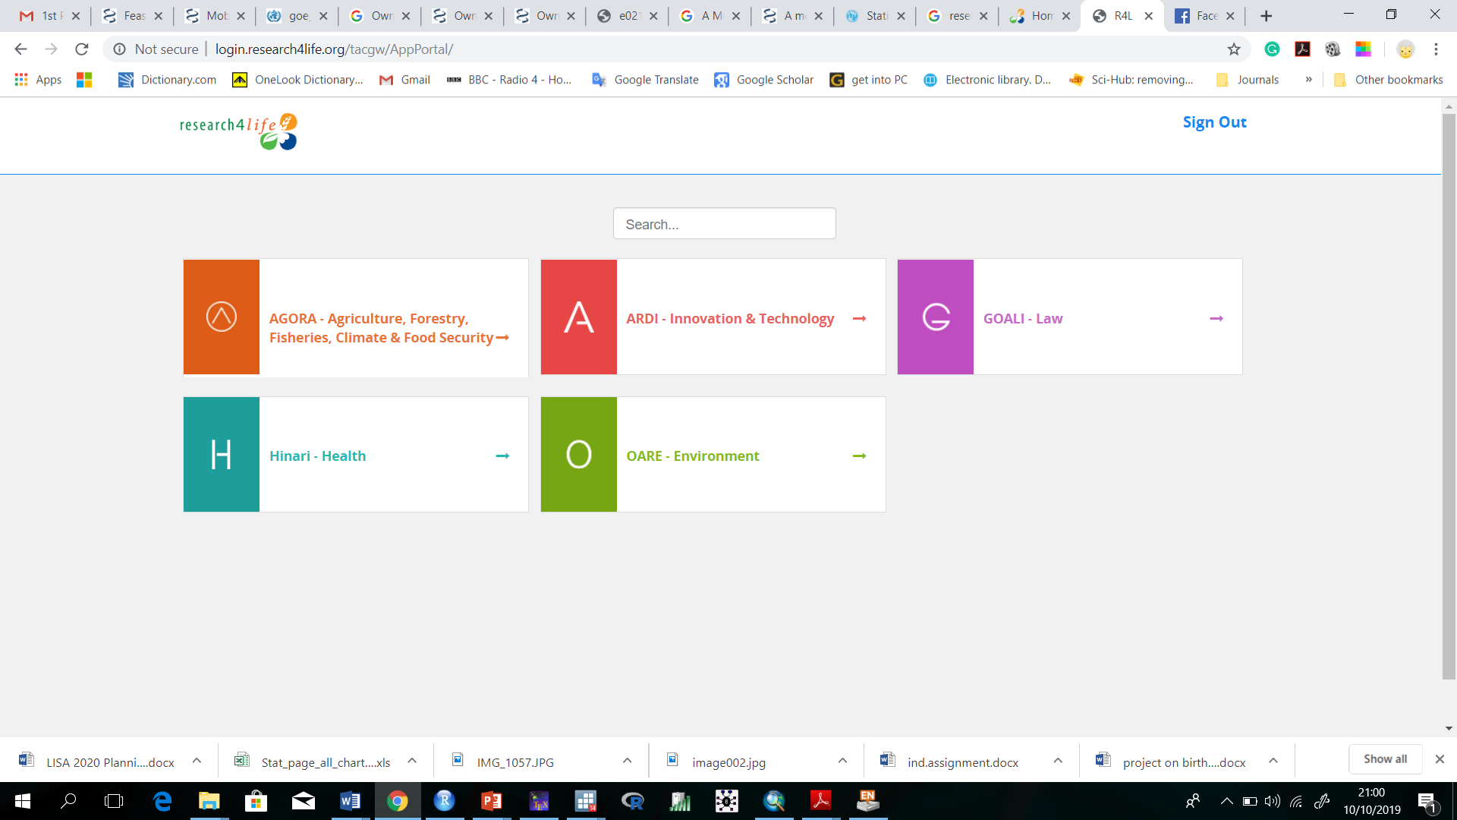
Registration

Slide 70
Medline versus Embase
Elsevier opens up Embase to Research4Life
MEDLINE | EMBASE
Over 23 million references to journal articles | Over 31 million indexed records
More than 5600 journals | More than 8500 indexed peer-reviewed journals
1946 to present with some older material | Biomedical literature from 1947 to present
Indexed with NLM Medical Subject Headings (MeSH) | Elsevier Life Science thesaurus Emtree
MeSH is updated once a year | Emtree is updated every three months
Free access via PubMed | Access-fee required

Slide 71
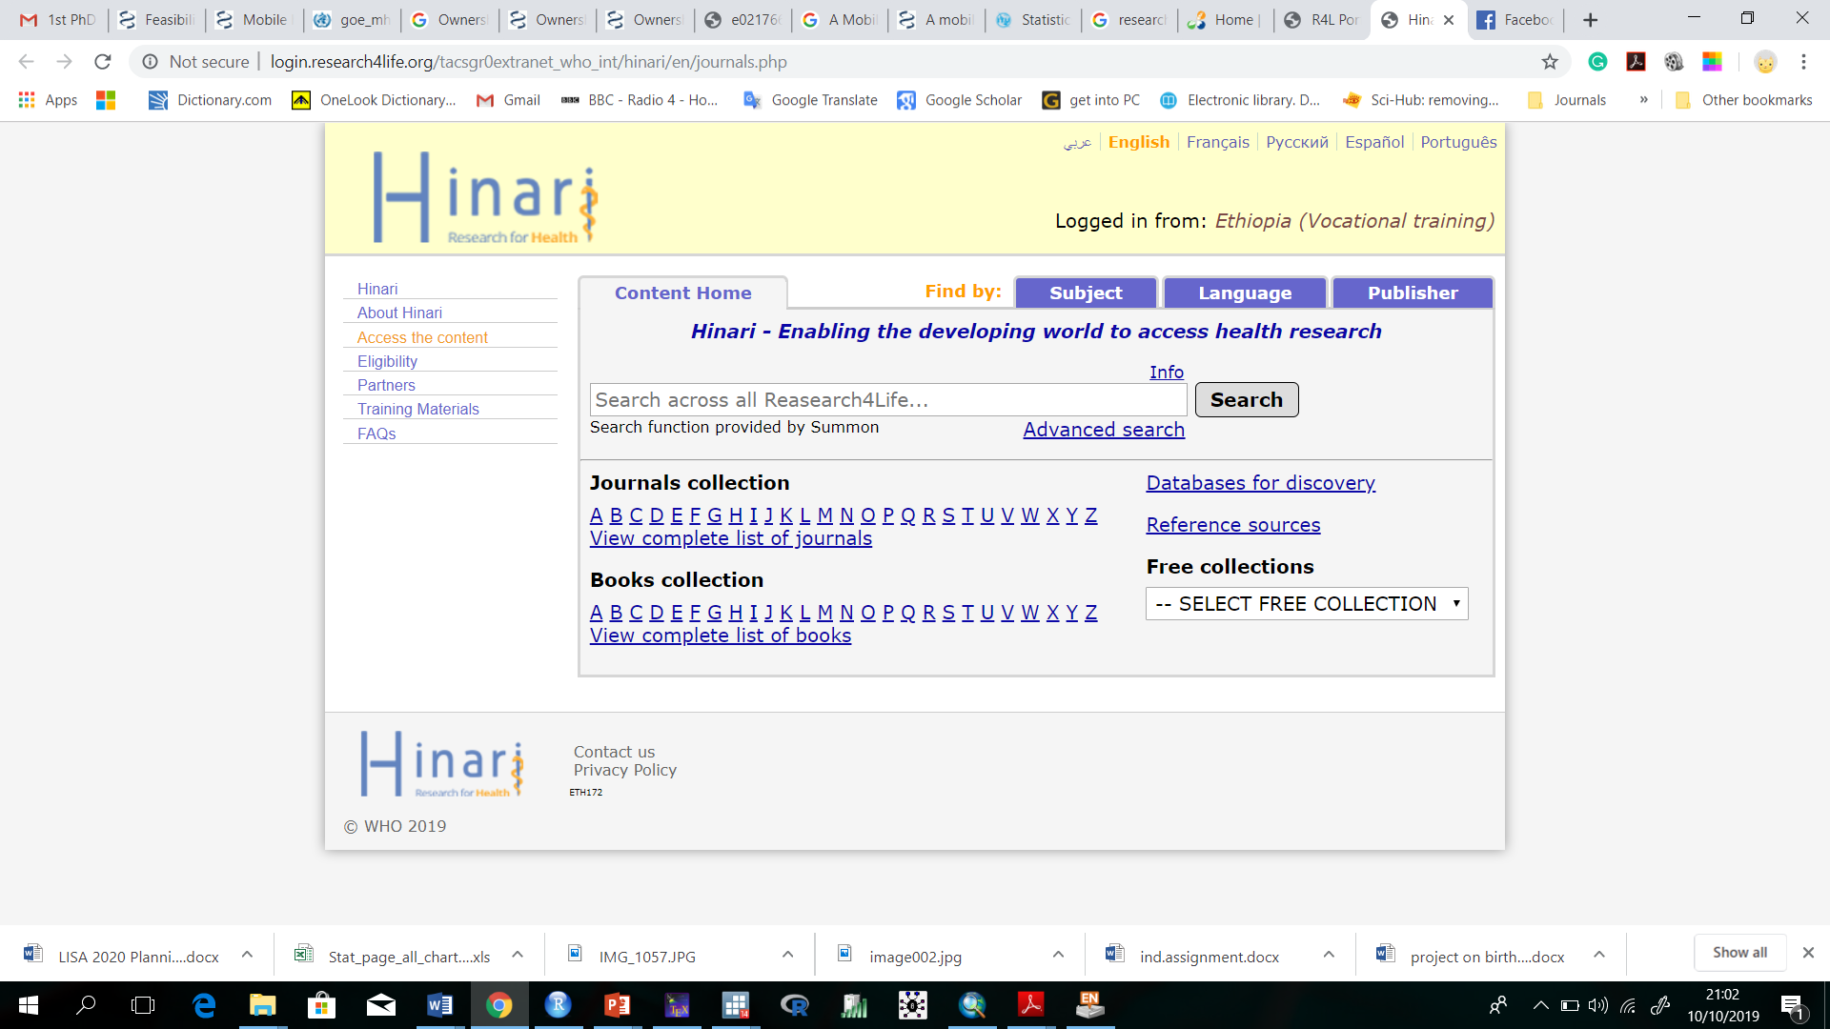
HINARI

Slide 72
Other Resources
Peer reviewed journal articles (via scientific databases, libraries, the journals themselves)
Databases
The JBI Database
The Cochrane Database
MEDLINE
EMBASE
CINAHL
ScienceDirect
Web of Science
PsycInfo
Scopus
OTseeker
PEDro
POPLINE
Proquest
+ many more…!
Grey Literature
Research and Trials Registers
Theses/Dissertations
Organizations/websites
Data – Statistics
Circulars
Reports
Notes:
SLIDE EXPLANATION:
Most reviewers will need to look for peer reviewed literature published in scientific journals and indexed in scientific databases. They may be available to you through libraries or direct access to the journals themselves.
For a JBI review you will also have to make some attempt to search for unpublished studies/papers in the form of grey literature. Grey or Gray Literature is electronic information or documentation that is usually not peer reviewed. It is information not found on the main databases like MEDLINE, EMBASE etc. It can be in the form of reports, newsletters or it can be from academic institutions, corporations, blogs, conference proceedings, census reports and non-independent research.
Research and Trials Registers are important sources to consider. Some of the main registers include The Cochrane Central Register of Controlled Trials (known as CENTRAL), Clinical trials.gov and the ISRCTN registry. PROPSERO is a register for systematic reviews.
A great deal of information and knowledge is stored in higher degree research theses. Many of these are now digitised and able to be searched beyond those at your own institution’s library. Examples include Index to Theses, ProQuest Dissertations and Theses Database and the Networked Digital Library of Theses and Dissertations.
Organizational websites (e.g. Government websites, or national or international organization websites) should not be overlooked. Depending on your question government data, such as census data may be relevant for you to search - if your question is related to epidemiology for example. Circulars or reports for organizations and government agencies can also be a valuable source of information.
Lastly contacting experts in the area of interest may also lead you to additional studies/papers.
REFERENCES:
EXAMPLES:
DISCUSSION POINTS AND QUESTIONS FOR THE CLASS:

Slide 73

Google Scholar provides a simple way to broadly search for scholarly literature. You can search across many disciplines and sources: peer-reviewed papers, theses, books, abstracts and articles, from academic publishers, professional societies, preprint repositories, universities and other scholarly organizations.
Notes:
Google Scholar helps you identify the most relevant research across the world of scholarly research. From this search engine, you can search across many disciplines and sources: peer-reviewed papers, theses, books, abstracts and articles, from academic publishers, professional societies, preprint repositories, universities and other scholarly organizations. This search tool aims to sort articles the way researchers do, weighing the full text of each article, the author, the publication in which the article appears, and how often the piece has been cited in other scholarly literature. The most relevant results will always appear on the first page.
While you will receive links to specific journal articles, you will need to LOGIN to HINARI to access articles from HINARI Partner Publishers. Other material may be freely accessible via the WWW.

Slide 74
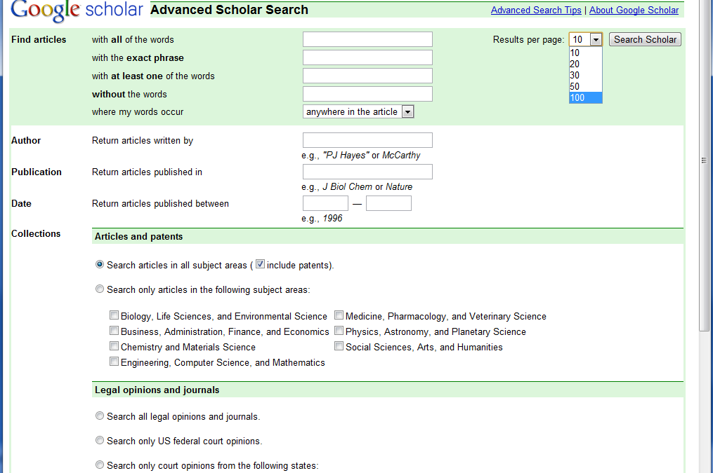
We have displayed the Advanced Scholar Search option of Google Scholar. Note the various options for refining a search and also that you can change the number of results per page.

Slide 75
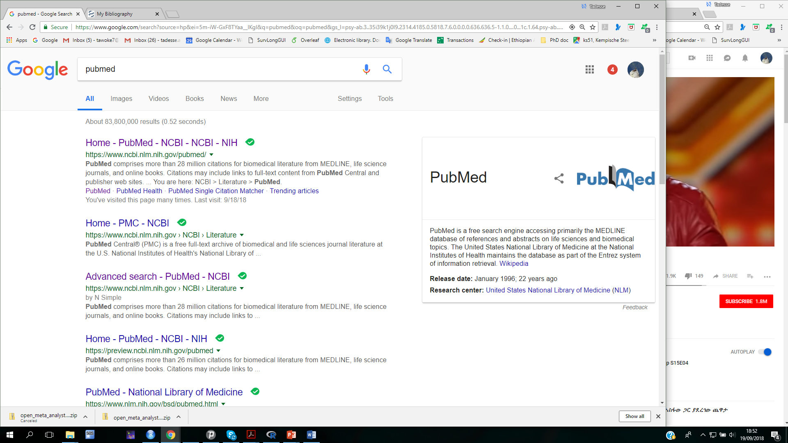
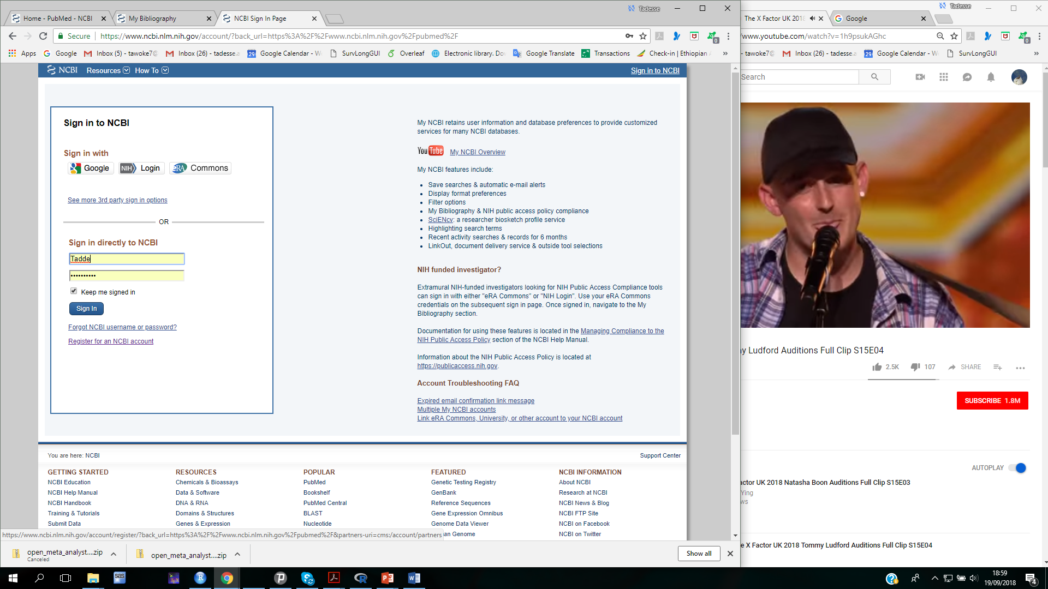
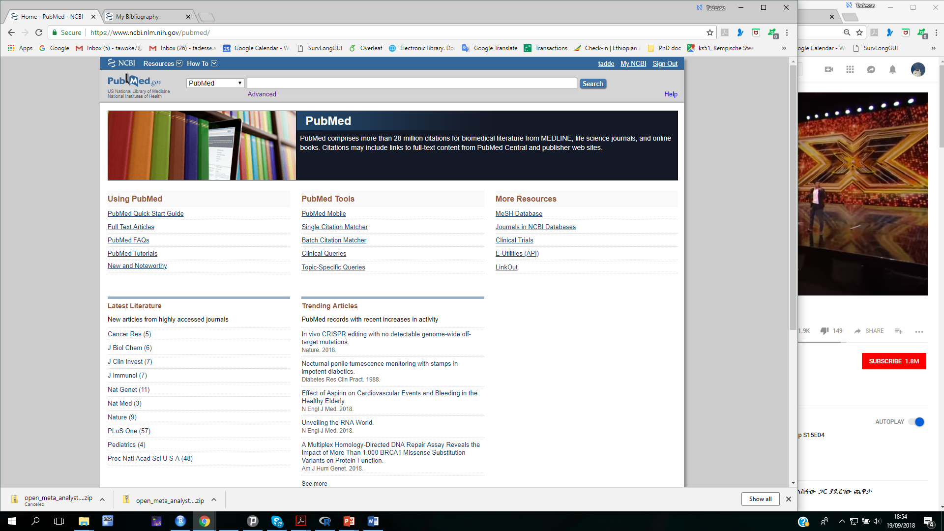
PubMed Search
Write “PubMed” on google and click Ok

Slide 76
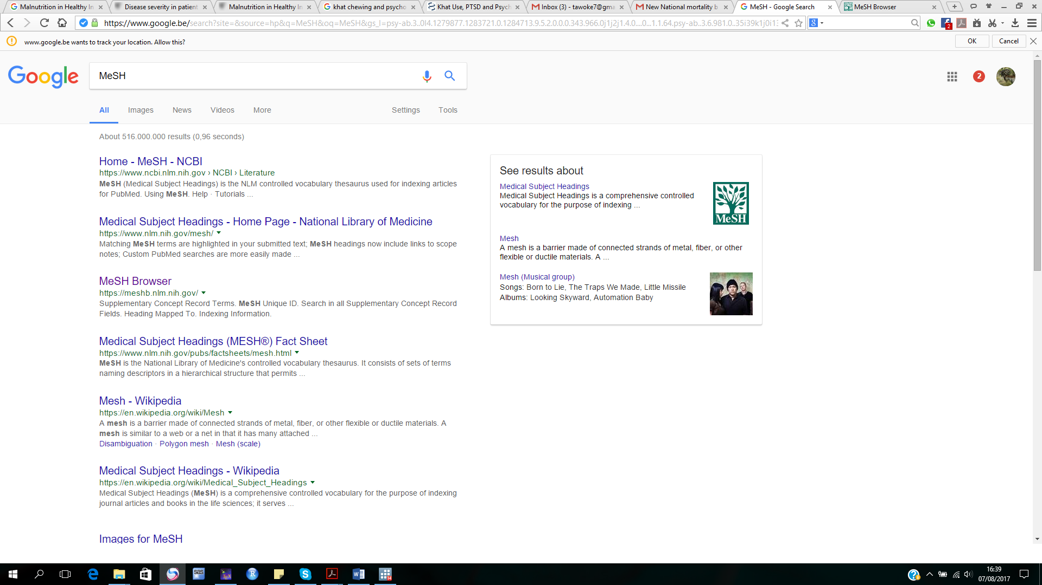
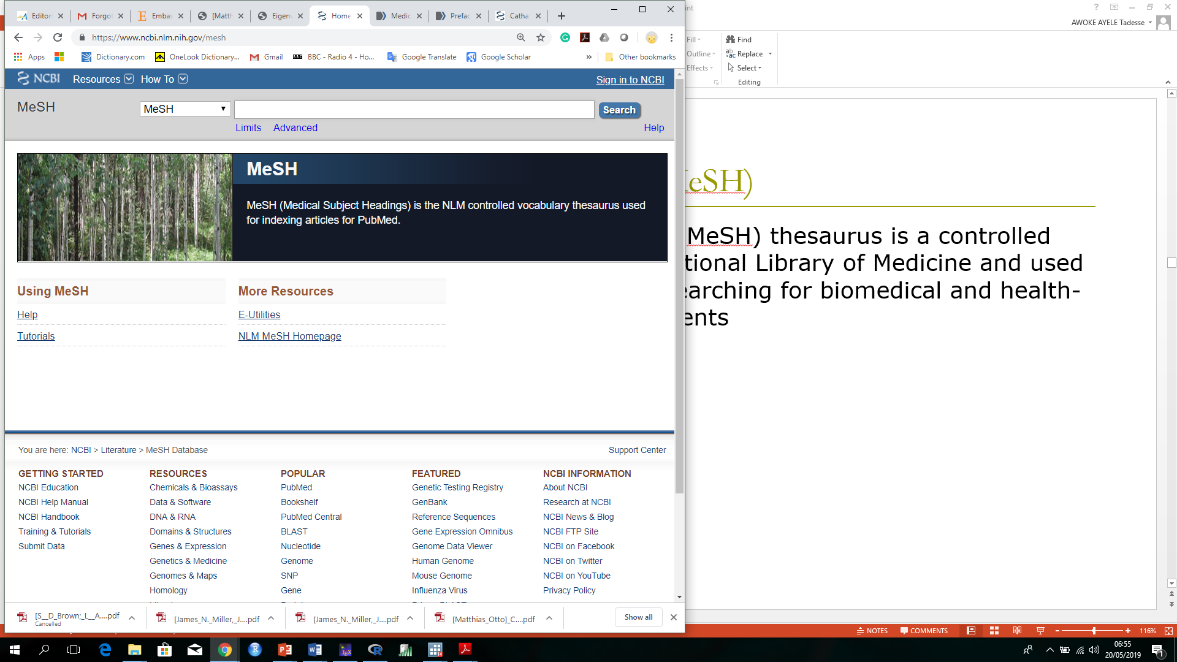

Medical Subject Headings (MeSH)
It is a controlled vocabulary produced by the National Library of Medicine
used for indexing
Cataloging
searching for biomedical and health-related information and documents
searching with the MeSH controlled vocabulary give you more precise search results
Click here

Slide 77
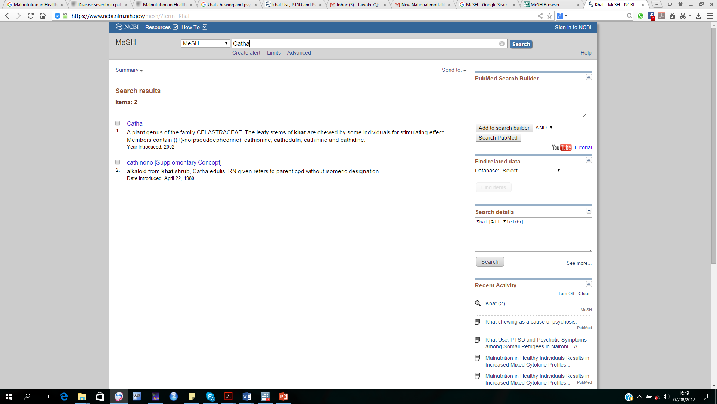
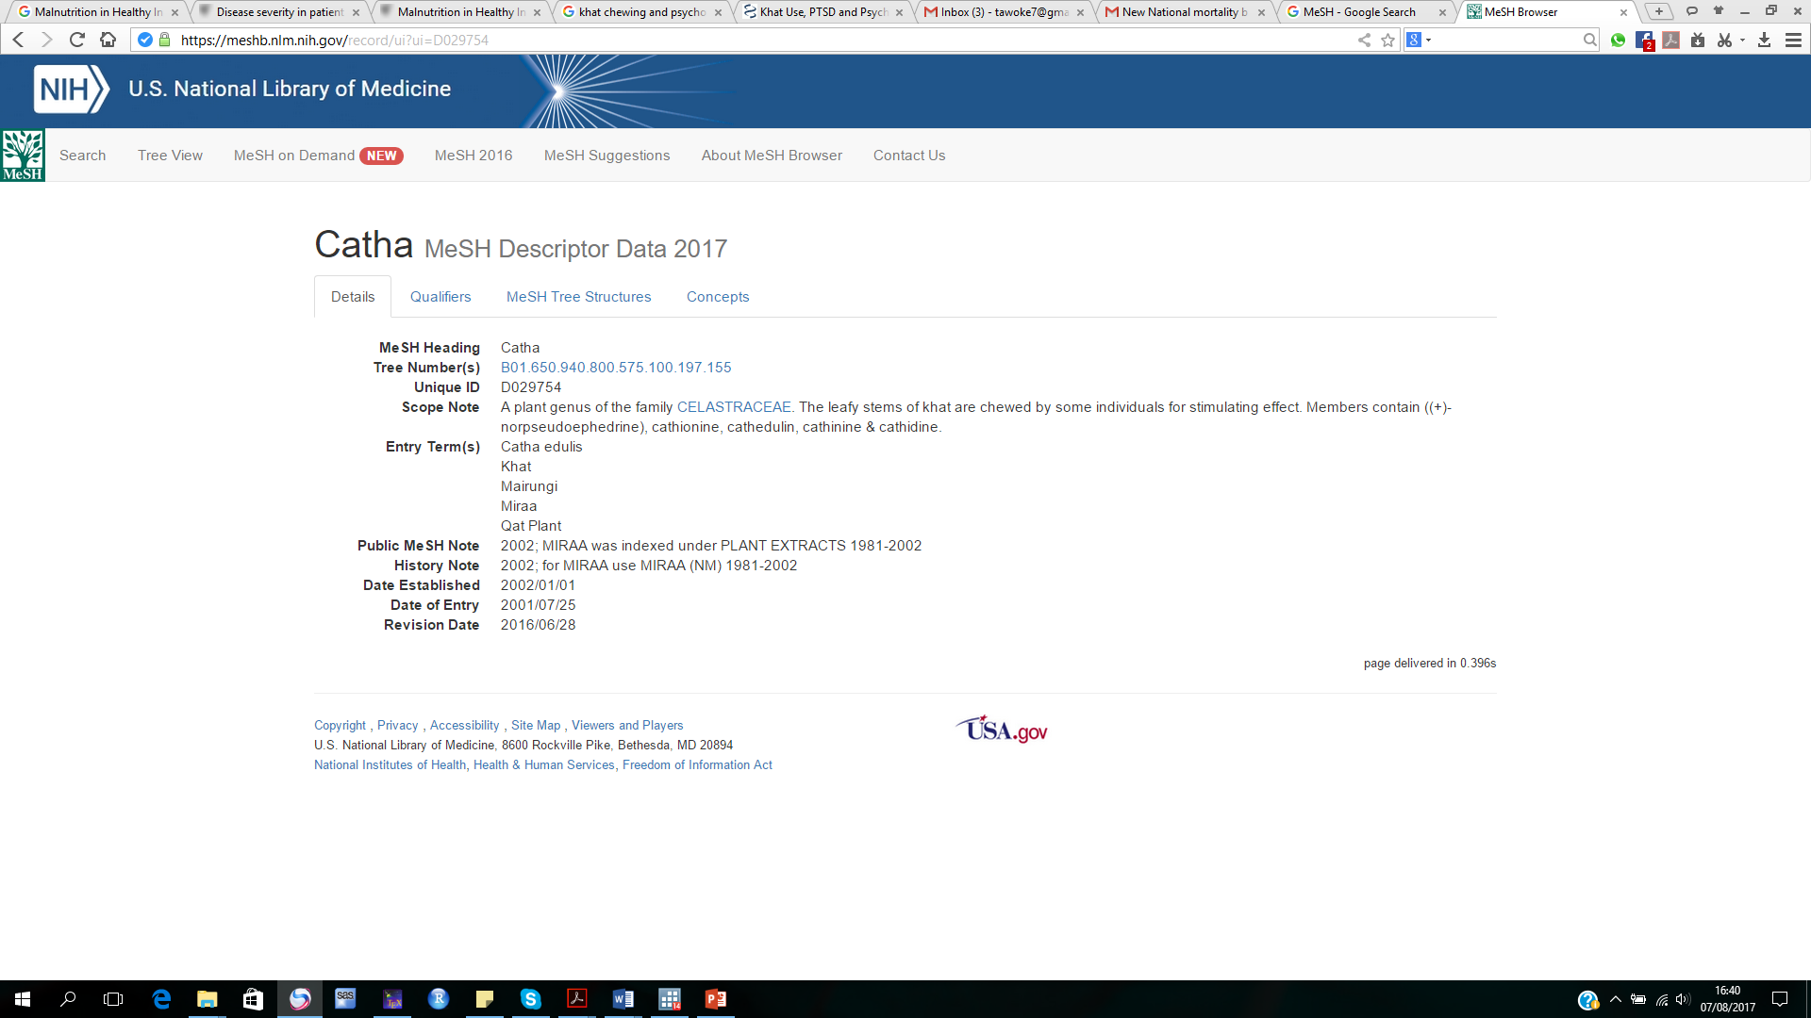
Search Terms
To find the meaning and possible terms for search term (i.e Khat)
It gives the meaning
It also gives possible names
Look for the MeSH term of Khat is available in the list
Choose “MeSH”
These terms will be combined with “OR”

Slide 78
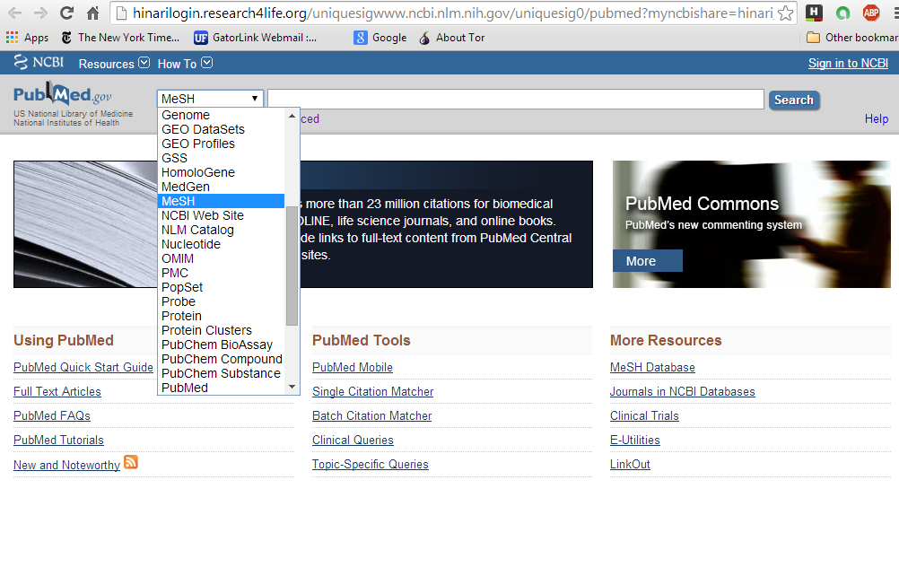
To access the MeSH Database from the PubMed homepage, click on the link from the right column of the PubMed home page. A second way to access MeSH is to open the Databases drop down menu and then to click on MeSH.

Slide 79
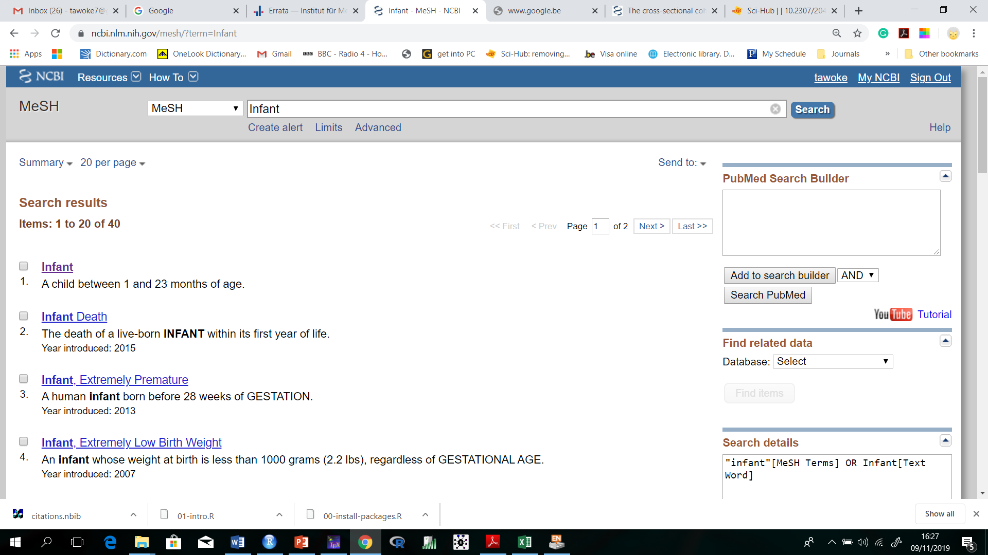
MeSH (Medical Subject Headings) is the controlled vocabulary for indexing articles in Medline – National Institute of Health’s bibliographic database of life sciences and biomedical information.
MeSH Terms are assigned as Keywords to each record that is “Indexed for MEDLINE”. In MeSH, complete search for the term Infant
From these results, note that the MeSH has listed 40 terms for infant.

Slide 80
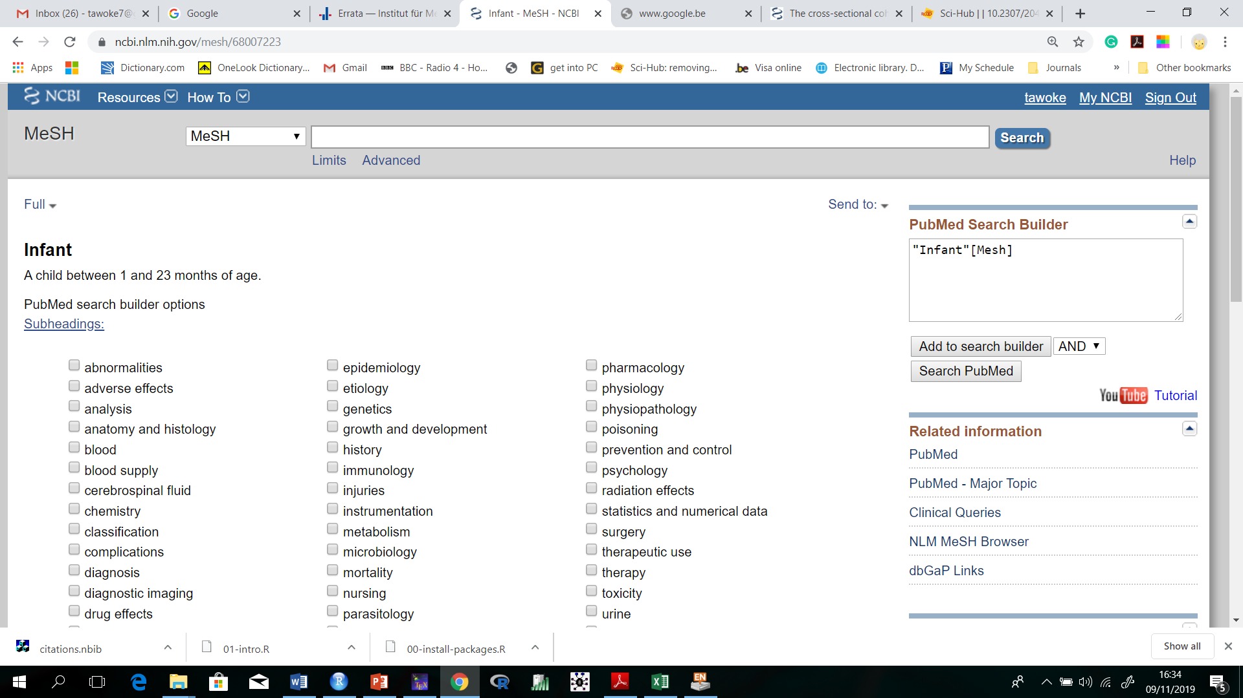
To complete a PubMed search with the Infant MeSH term, click on Add to search builder and then click on Search PubMed.
Note how “Infant[Mesh]” is displayed in the PubMed search builder box.

Slide 81
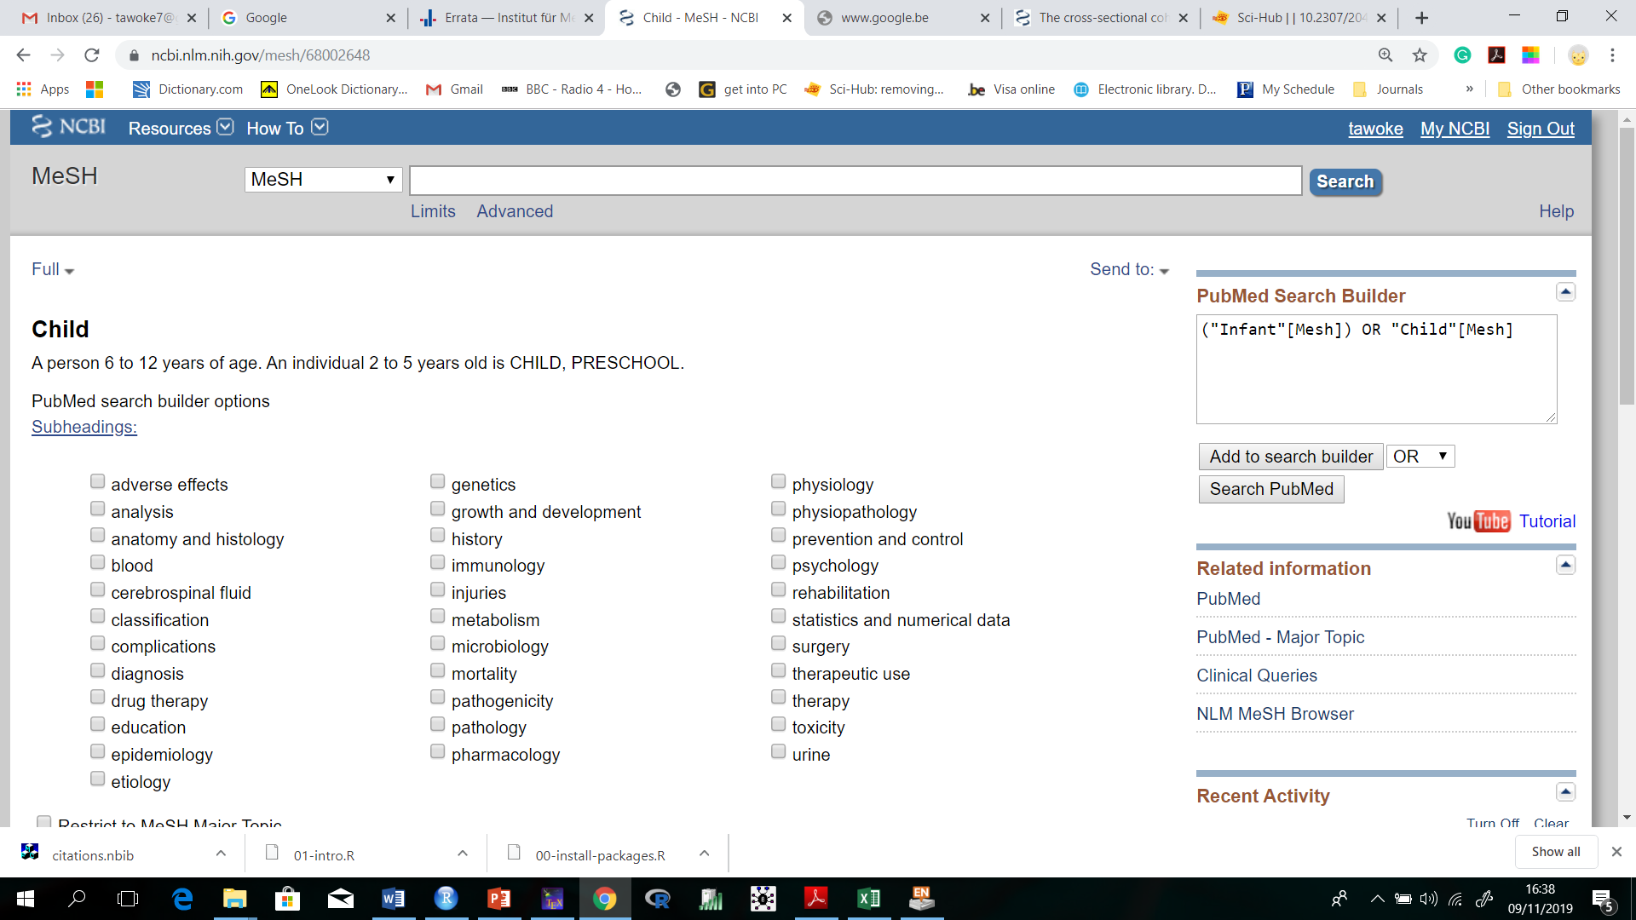
The term “children” was check for MeSH term. Infant and child were combined with OR as they are in the same mnemonics
Then click “search pubmed”

Slide 82
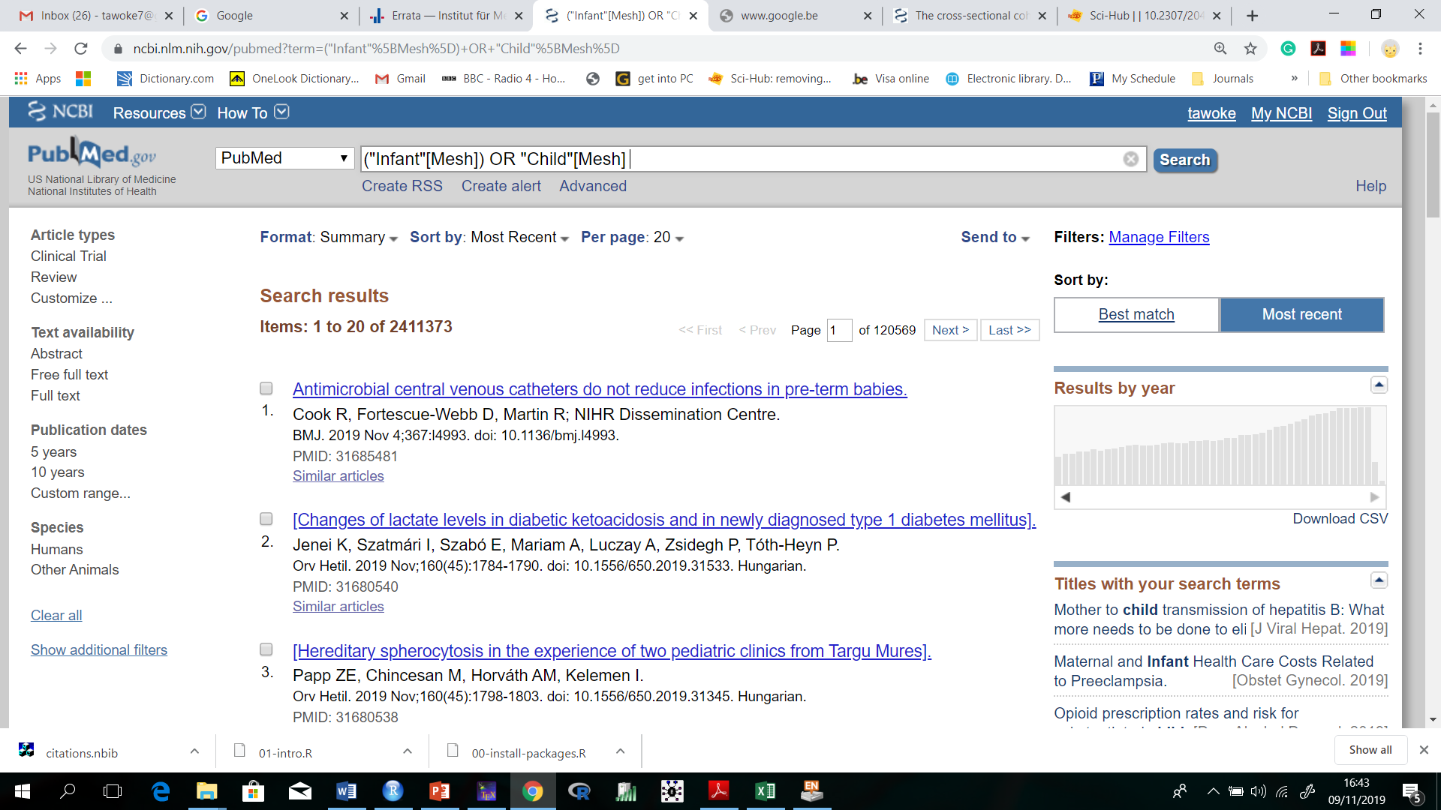
Population

Slide 83
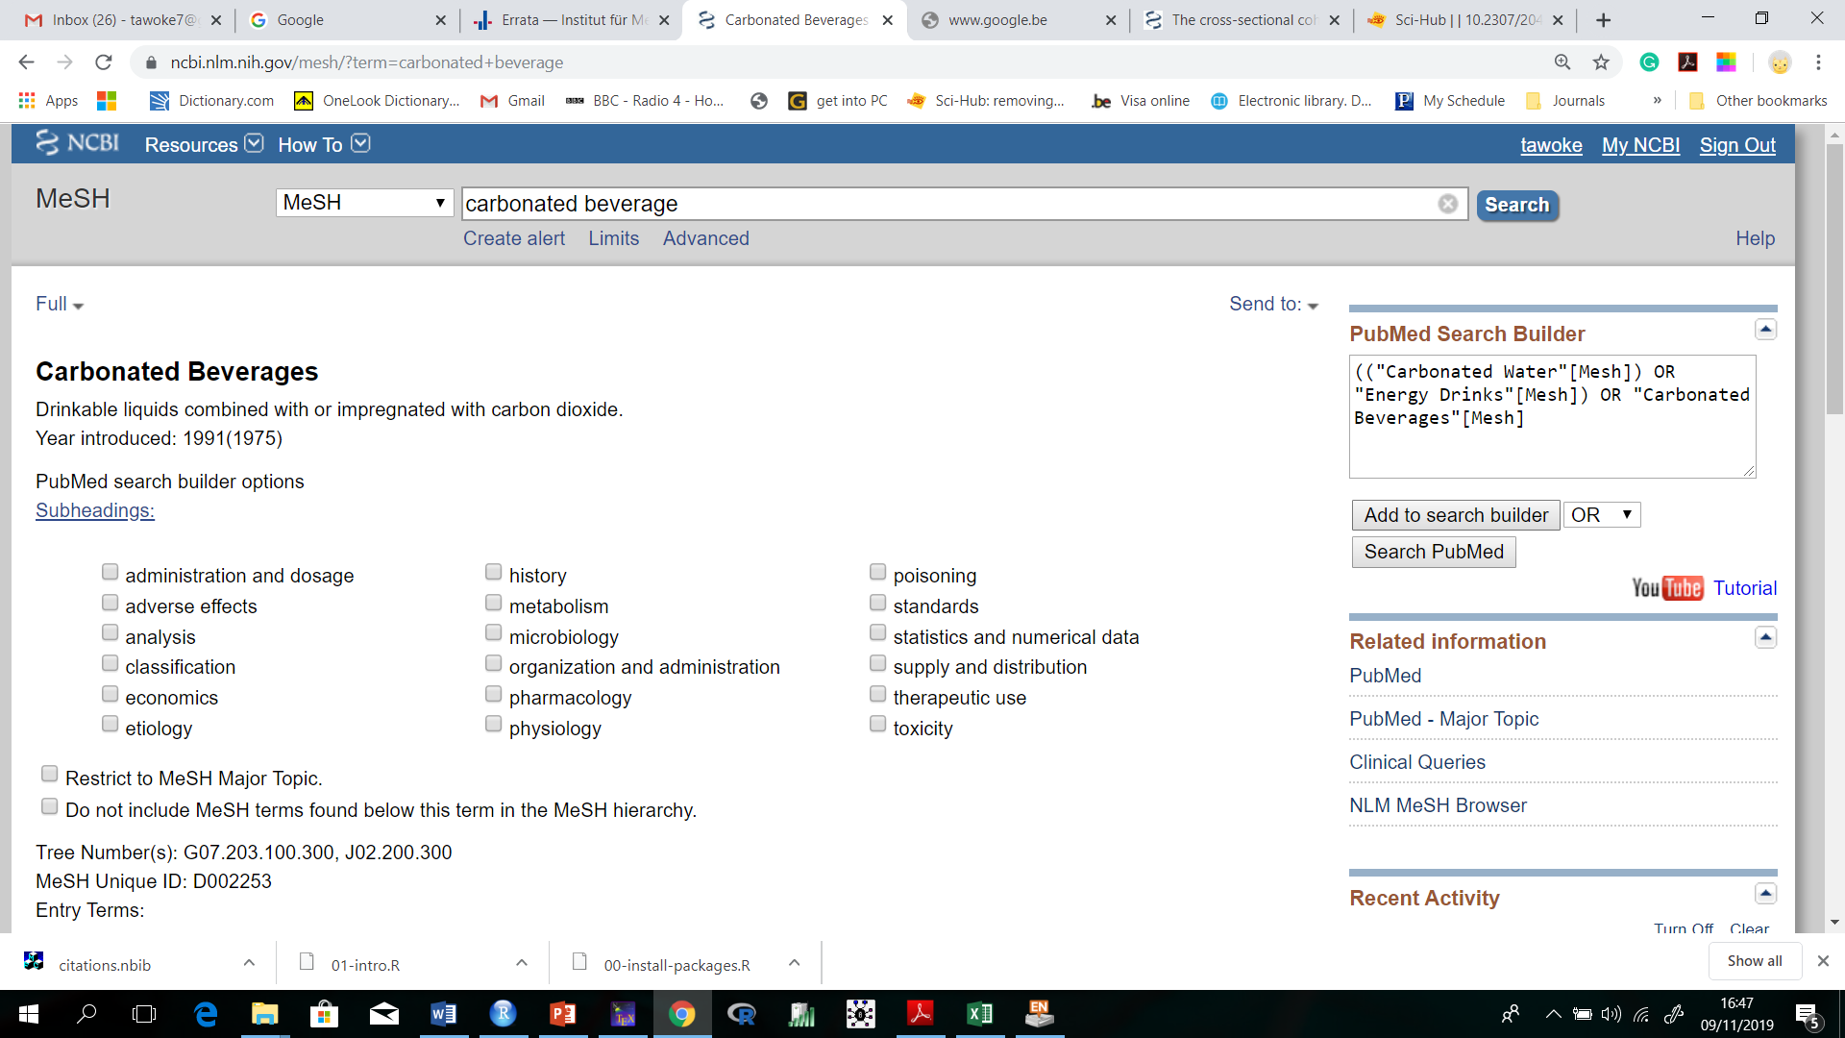
Then click “search pubmed” We build the search for Exposure

Slide 84
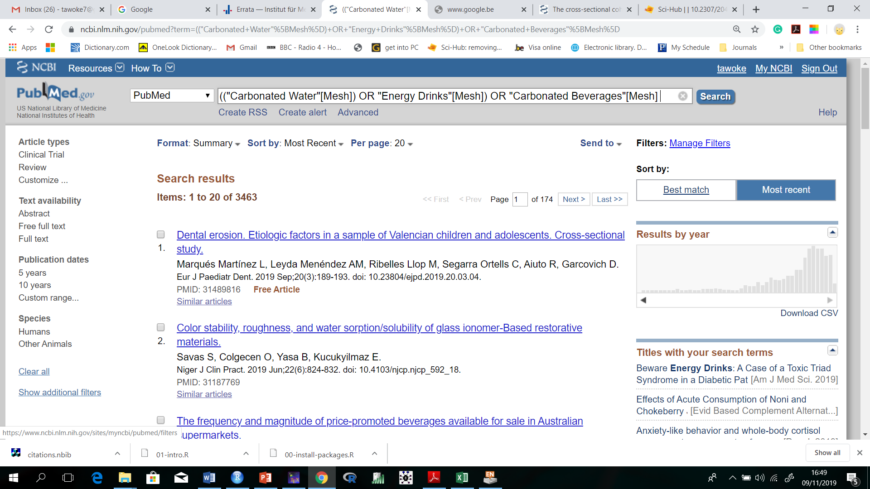
Exposure

Slide 85
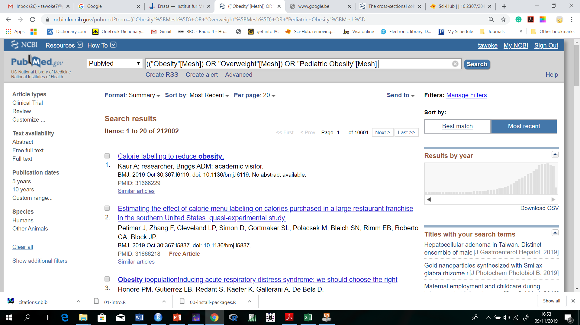
Outcome
Once you finished all the mnemonics, then click “advanced to go to history”

Slide 86
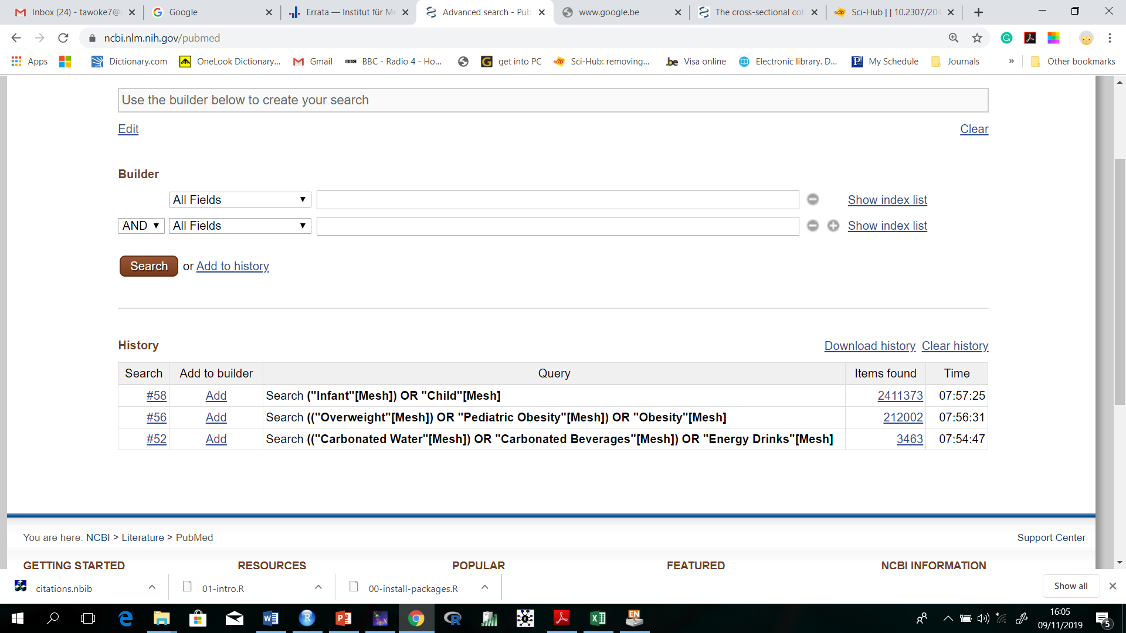
Population
Outcomes
Exposure

Slide 87
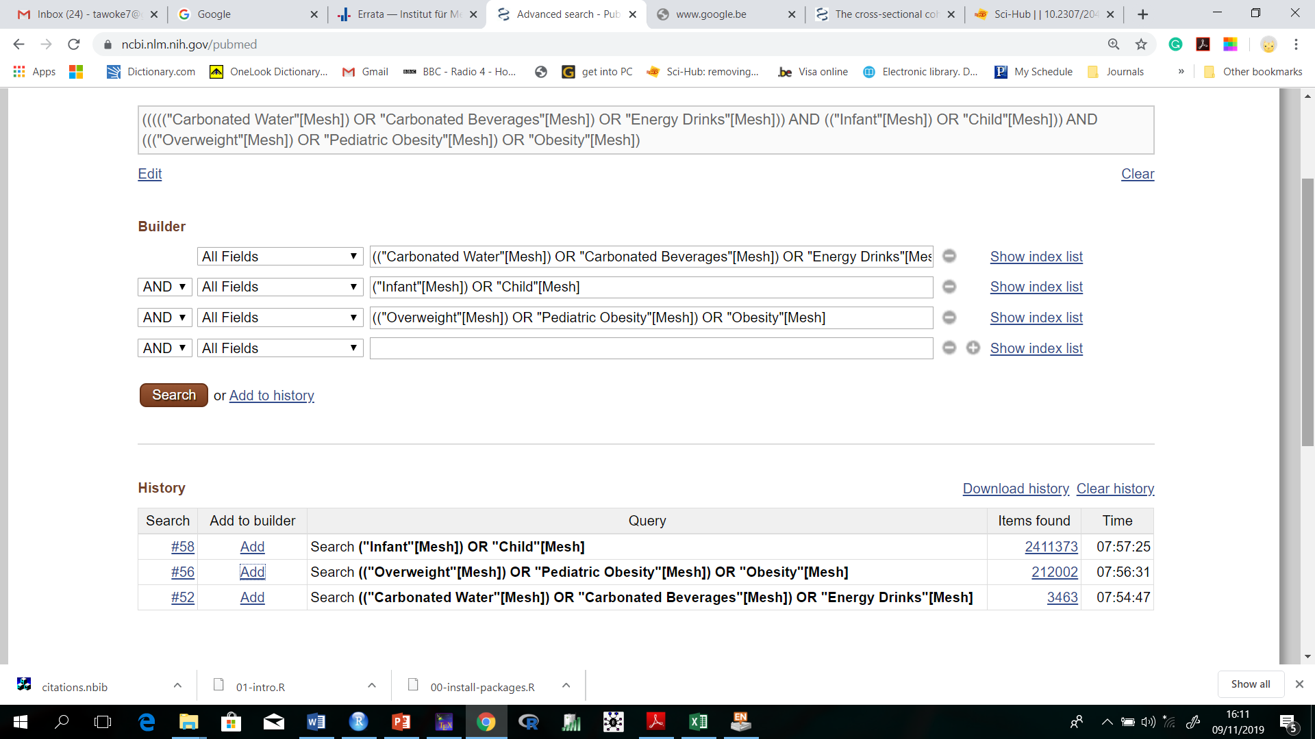
Search Terms
Click here
Click add to include in the builder

Slide 88

Results from the search
Filters

Slide 89
Subheading
Sub-headings are used with other subject headings to limit the type of articles retrieved
The sub-heading/diagnostic use can be added to names of agents, investigations, etc. to restrict the findings to those mentioning using the agent or investigation for diagnostic purposes

Slide 90
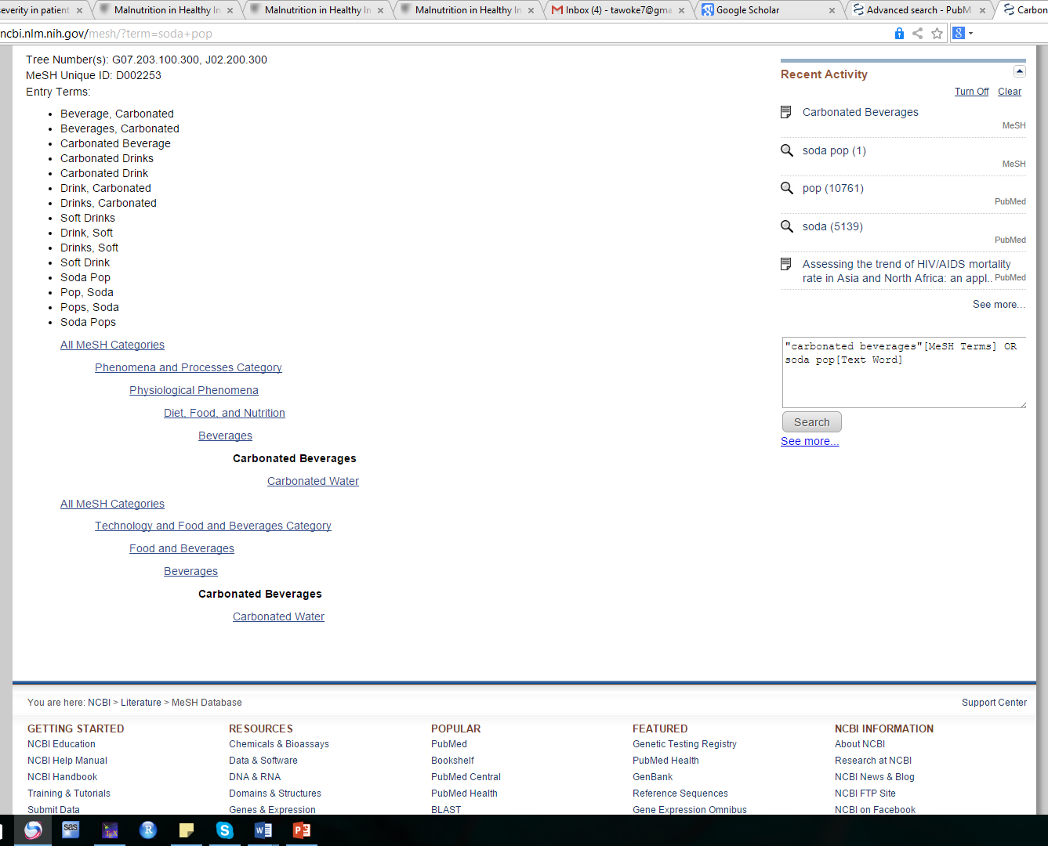
Entry Term
We need the entry term to find newly published papers
MeSH only searches those which are assigned to MeSH
Then we have to use the entry term to find newly published papers
Entry term
MeSH tree

Slide 91
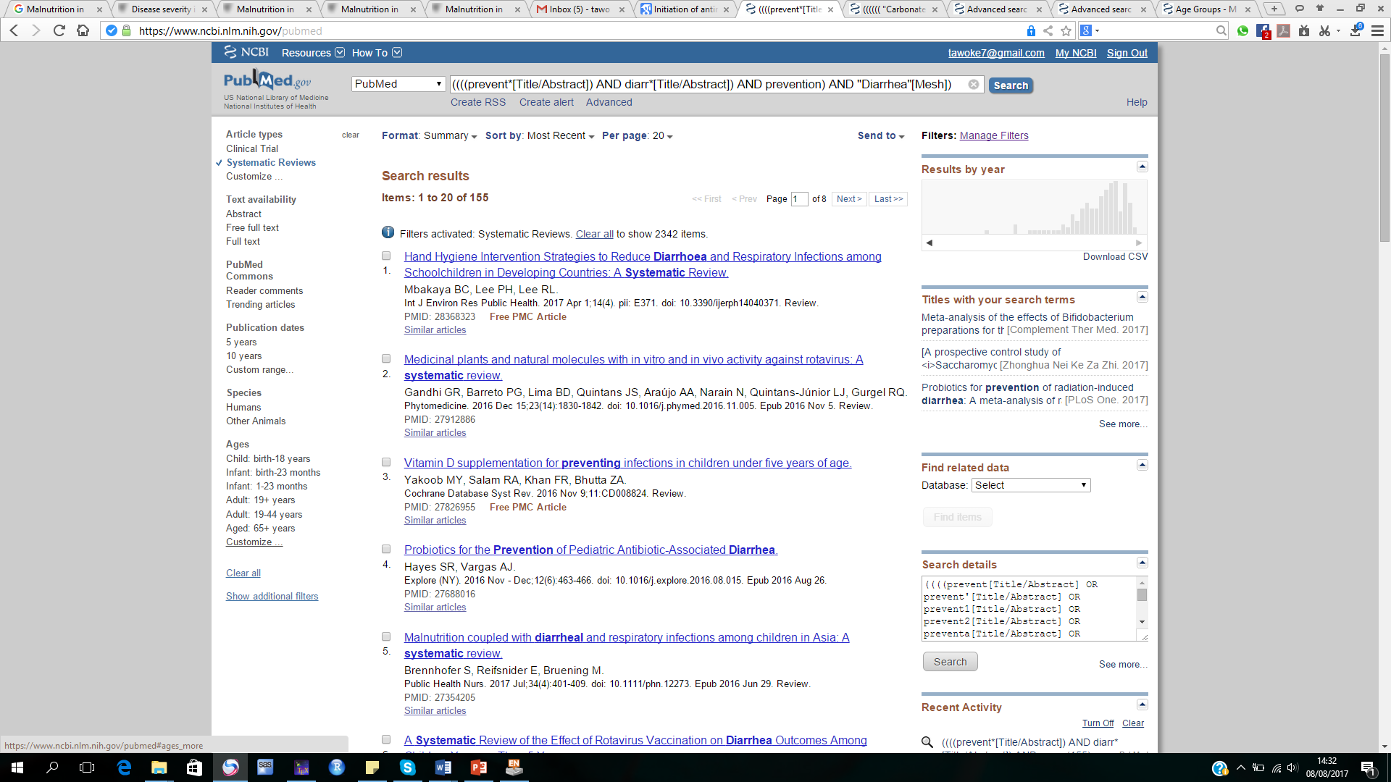
Refining the search
To refine your search, you can use different options
Article type
Text availability
PubMed
Publication date
Species
Age
Customize and Show additional filter will also give you other options to filter

Slide 92
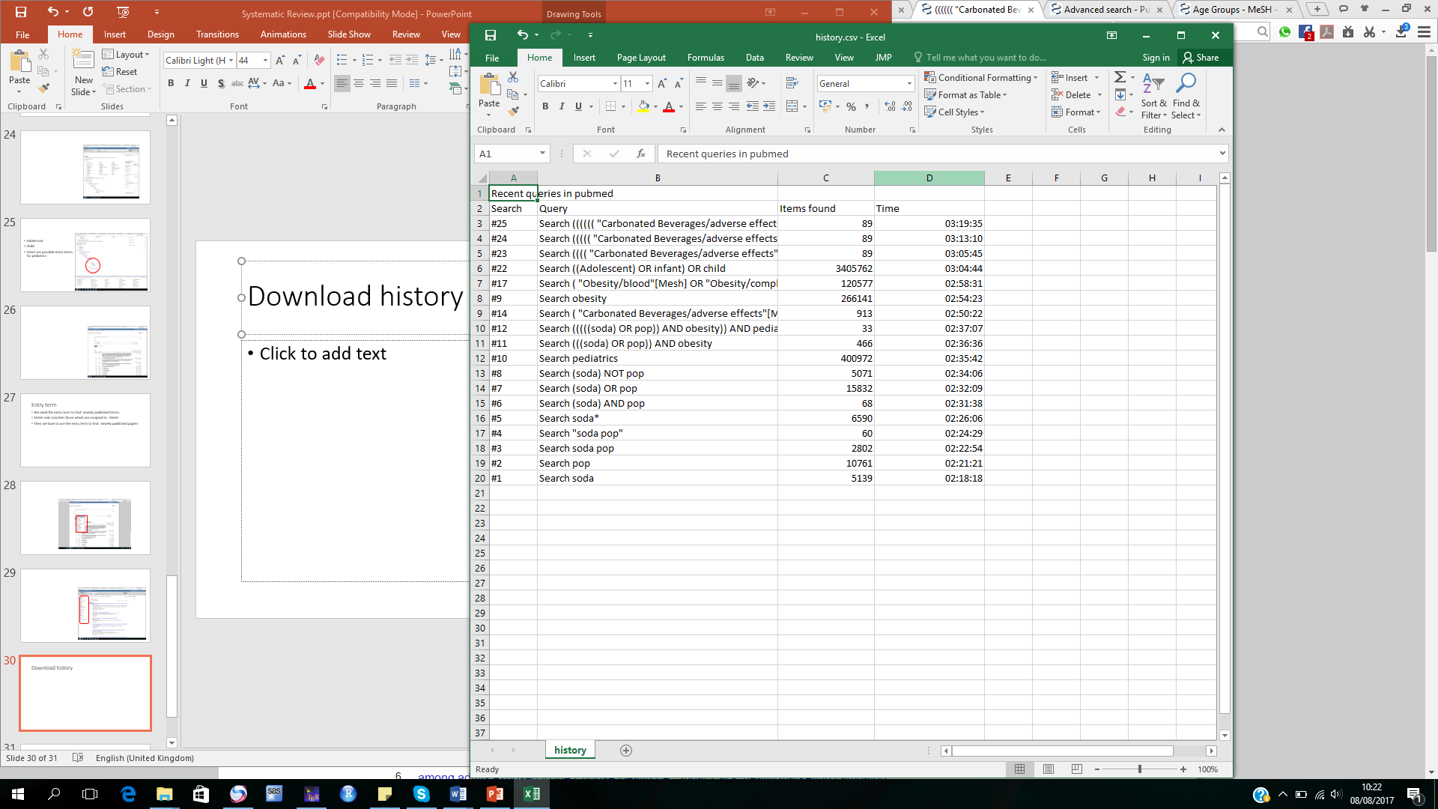
Download history
This is the search history

Slide 93
Exporting articles to EndNote
Click review → select the articles you want to export
Click “send to”
Choose file
Under format, select Medline
Click “create file”
Open endnote
Go to file and click “import” → select “file”
Choose the file you created
in the import option, choose PubMed

Slide 94
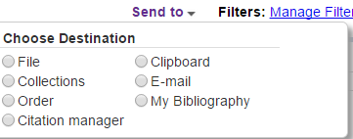
Send to EndNote first
There are different ways to send to endnote
If “citation manager” then only 200 papers will be exported
If you want to take all the articles in PubMed, use “file”
Then all available articles will be saved in .txt format.
To take this to EndNote, you can use “import”. Then choose pubMed

Slide 95
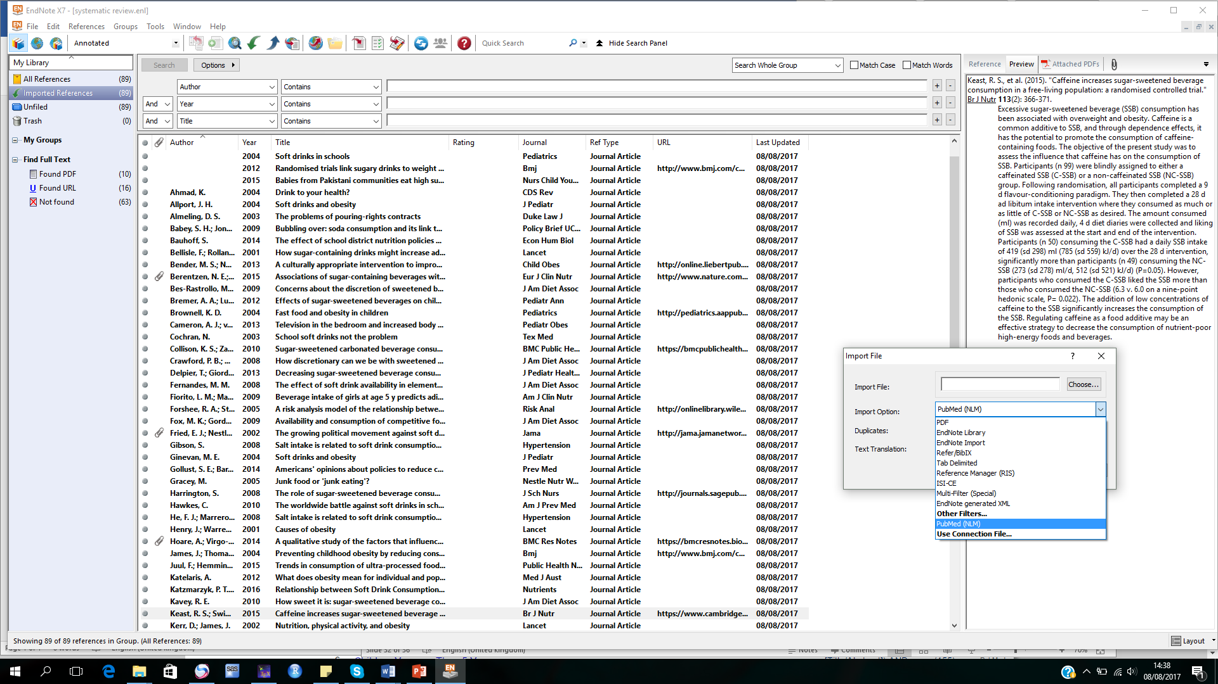
Import
If PubMed is not available in the list, click “other files” and look for PubMed(NLM)
Then open

Slide 96
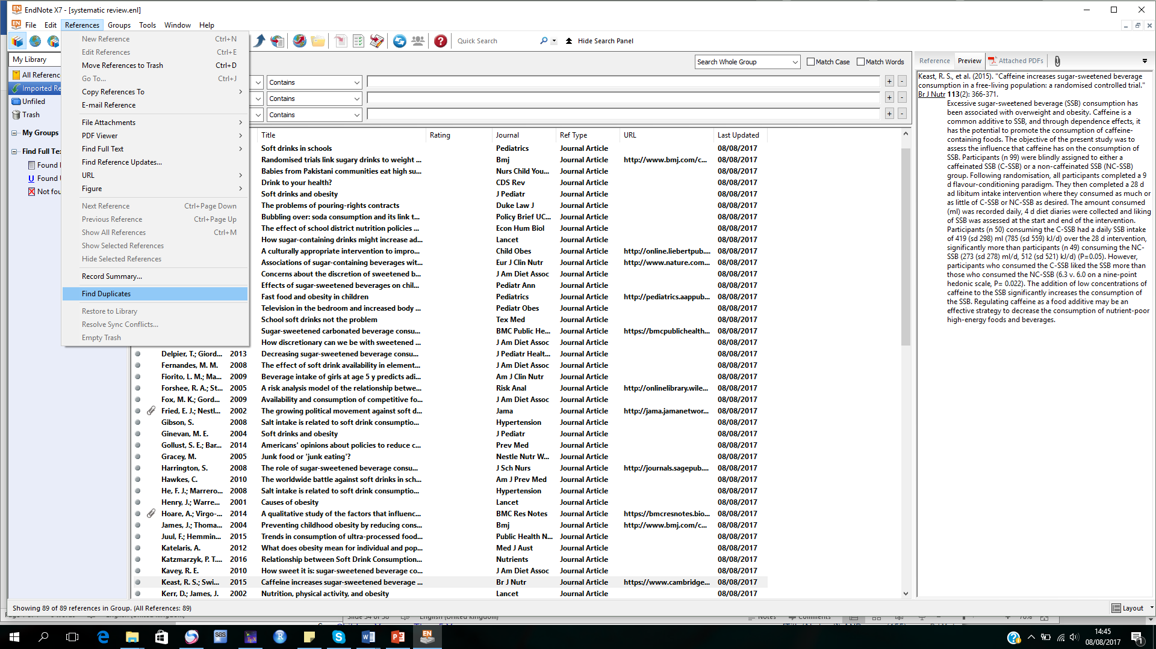
Removing duplicates
Refining paper
Duplicate removal
Removal by title
Title and abstract
Full paper review
Approval

Slide 97
CABI Database
CAB Abstracts is the leading English-language bibliographic information service providing access to the world's applied life sciences literature
It incorporates two bibliographic databases: CAB Abstracts and Global Health
CAB Direct is an access point for multiple bibliographic databases produced by CABI

Slide 98
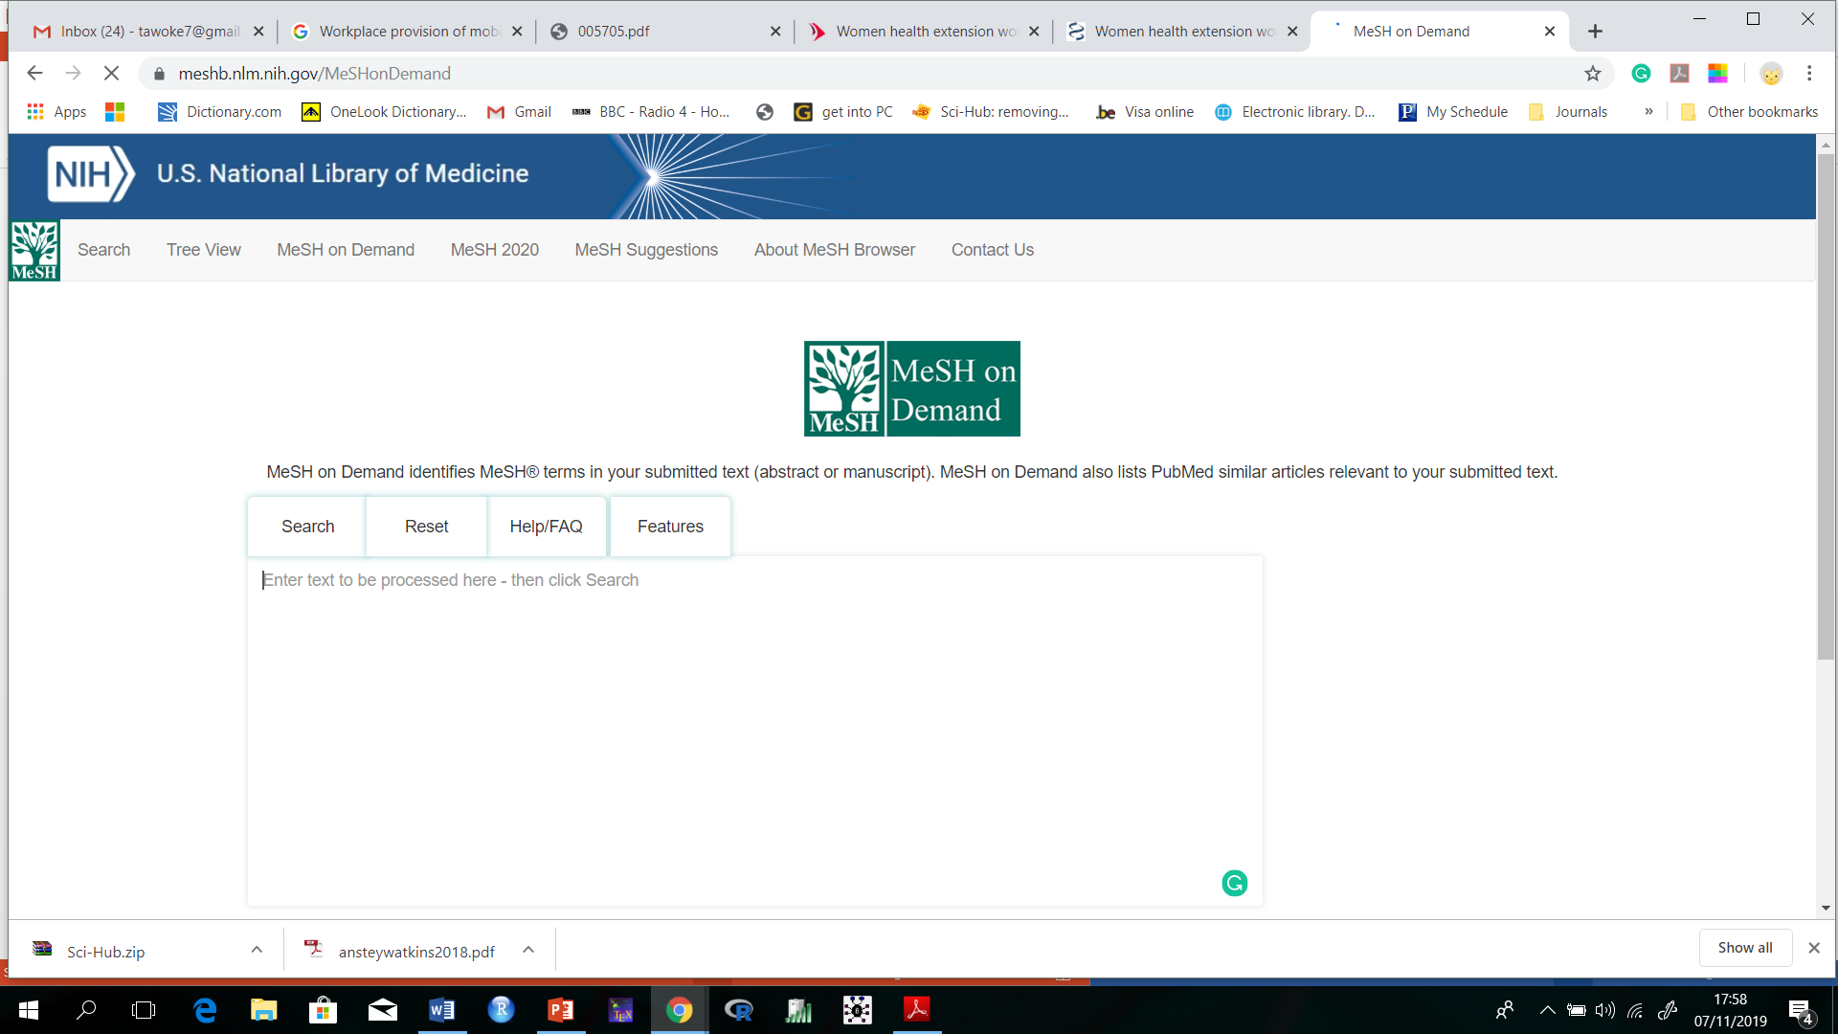
MeSH demand
MeSH Demand
https://meshb.nlm.nih.gov/MeSHonDemand
Copy and paste the
Title or abstract here
Click search to get the MeSH terms

Slide 99

When the article is not free, where can we find it?
There are ways to locate the articles
Science hub: https://sci-hub.tw/
Bookzz: https://b-ok.org/
Copy and paste the URL to the box and search

Slide 100
Study Selection Process
Aims to select only those studies that address the review question and that match the inclusion criteria documented in your protocol
Selection should be transparent and reproducible
Consider resource implications
Issues may arise during study selection that require discussion/clarification between assessors
Discuss how disagreements will be resolved
E.g. will a third reviewer be used?
Assessors may want to pilot some papers before undertaking full study selection
Notes:
SLIDE EXPLANATION:
When selecting studies, aim to select only those that are specific to your review question. If your question relates to adults with mucositis, a paper detailing the effects of a mucositis therapy for children is not applicable. The results may be interesting, but not relevant. Aim to be inclusive and selective, it is a difficult balance. The decision of whether to retrieve studies/papers must be made with the review question in mind. The inclusion and exclusion criteria described in the review protocol provide this information. Like searching, study selection should be transparent and reproducible.
While it might be ‘nice’ to retrieve all papers, there are considerable resource implications with this. For example papers may need to be photocopied or requested from other libraries at considerable expense. There is also the impact of the time required for these activities to occur.
REFERENCES:
EXAMPLES:
DISCUSSION POINTS AND QUESTIONS FOR THE CLASS:

Slide 101
Study Selection Process
Scan titles and abstracts
Some common problems with identifying studies/papers:
Duplication of studies
Unclear titles
Lack of abstract
If uncertain? Retrieve - scan full text
Is the article published in the stated years?
Does the population studied meet the criteria?
E.g. adults or children or both?
Is it the correct study design?
E.g. RCT or meta-analysis
Notes:
101
SLIDE EXPLANATION:
When conducting your search you will come across some common problems in regards to the identification of possible studies/papers. Firstly there may be duplication of studies such that the authors have published a number of papers based on one study and it may take some detective work to differentiate between (you may need to contact the authors). It is also likely that some studies will be indexed across multiple databases and you will see duplication of studies in your search results when you import them into your reference management software. Most reference management software have an option to ‘remove duplicates’ however there may be some circumstances where you may need to do this yourself, particularly when details of a reference are incomplete or slightly different (e.g. information for a particular field is in the wrong spot or missing for one of the records).
Ideally the title of a paper/study will provide sufficient information to the reader and you can determine instantly if it is of interest to your review question. This is rarely the case. Some authors take pride in developing catchy titles that have little to do with the actual topic. In these circumstances you will need to look further to the abstract in order to determine if the study/paper may be suitable for inclusion. This is not always possible however as some references do not provide an abstract. This means you need to make a decision as to whether to retrieve the full text or not. In these circumstances we suggest to err on the side of caution and if uncertain retrieve the full text for further information.
REFERENCES:
EXAMPLES:
DISCUSSION POINTS AND QUESTIONS FOR THE CLASS:

Slide 102
Study Selection process
Study selection is an initial assessment that occurs following the review search
It addresses the question “should the full text of the paper be retrieved?”
It is essential to use two assessors in the selection process to limit the risk of error and bias.
This should be done independently
Notes:
SLIDE EXPLANATION:
Study selection is the initial assessment that occurs following the review search. It addresses the question “should the paper be retrieved?” It essentially involves judgement and is extremely influential on the outcomes of the review. Reviewers must be strategic when selecting studies/papers for retrieval - we don’t want to retrieve all of the results from our search, only the relevant papers. It is essential to use two assessors in study selection to limit the risk of error and bias. This should be done independently.
REFERENCES:
EXAMPLES:
DISCUSSION POINTS AND QUESTIONS FOR THE CLASS:

Slide 103
Study Selection Process
Stages of Study Selection:
Collect all results
Remove duplicates
Screen title and abstract for potential retrieval of full text
Screen full text for inclusion / exclusion in the review
Screen reference lists of included studies
Studies excluded at the full text phase require a reason for exclusion
Notes:
SLIDE EXPLANATION:
The study selection process takes place after the searching has been completed. All results should ideally be collated into one repository. Duplicates should then be removed (and this number recorded). The titles and abstracts of all citations should then be screened for potential retrieval of full text. Once you have your full text studies, these should be screened again. Reference lists of included studies should then be screened. Excluded studies at the full text phase require a reason for their exclusion.
REFERENCES:
EXAMPLES:
DISCUSSION POINTS AND QUESTIONS FOR THE CLASS:

Slide 104
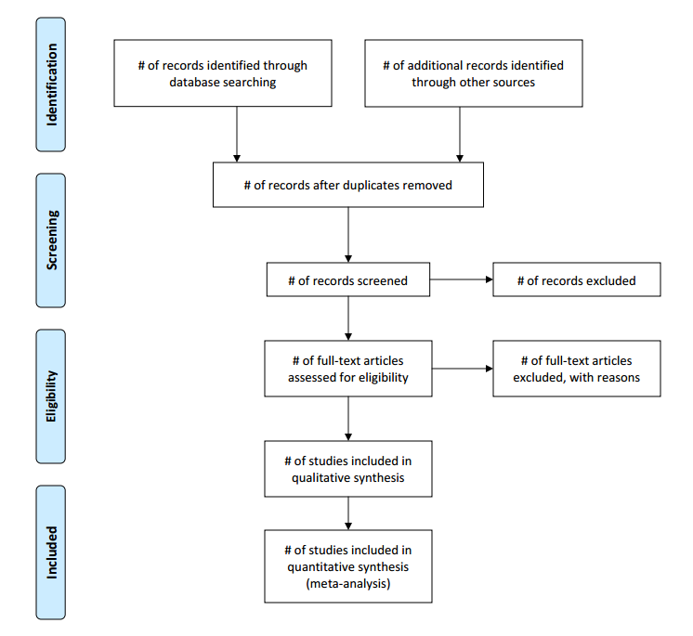
PRISMA Searching Process
PRISMA 2009 Flow Diagram
Notes:
SLIDE EXPLANATION:
In your review results the type and number of papers identified by the search strategy and the number of papers that were included and excluded should be stated. The description should be accompanied by a flowchart such as this one (The PRISMA flowchart for reporting is the required format for JBI systematic reviews) with the following stages of identifying and retrieving studies for inclusion:
Number of studies identified
Number of studies retrieved for detailed examination
Number of studies excluded on the basis of title and abstract
Number of full text articles retrieved
Number of studies excluded on the basis of full text and an overview of reasons for exclusion
Number of appraised studies
Number of studies excluded following critical appraisal and;
Numbers of included studies
Please note the last three stages will be discussed in detail in modules 2 and 3.
REFERENCES:
EXAMPLES:
DISCUSSION POINTS AND QUESTIONS FOR THE CLASS:

Slide 105
Activity 4
Search articles from PubMed
Use the MeSH term and Boolean operators
Filter your search
Export the search result to Endnote

Slide 106
Critical Appraisal

Slide 107
Critical Appraisal
A process that assesses the methodological quality of a study and determines the extent to which the study has addressed the risk of bias in its design, conduct and analysis
Required in all systematic reviews
Also referred to as:
Assessment of risk of bias
Assessment of methodological quality
Notes:
SLIDE EXPLANATION:
The main objective of critical appraisal is to assess the methodological quality of a primary study and to determine the extent to which a study has addressed the risk of bias in its design, conduct and analysis. If a study has not excluded the possibility of bias, then its results are questionable and could well be invalid. Therefore, part of the systematic review process is to evaluate how well the potential for bias has been excluded from a study. This is required in all systematic reviews.
REFERENCES:
Porritt K, Gomersall K & Lockwood C. Study Selection and Critical Appraisal. AJN American Journal of Nursing 2014; 114(6): 47-52.
The Joanna Briggs Institute. The Joanna Briggs Institute Reviewers’ Manual: 2014 Edition. Adelaide: The Joanna Briggs Institute 2014.
EXAMPLES:
DISCUSSION POINTS AND QUESTIONS FOR THE CLASS:

Slide 108
Why is it Important?
Combining results of poor quality research may lead to biased or misleading results
Aim is to establish validity (Internal and External)
Ensures that the review is credible and useful for informing health care policy, clinical practice and future research
Facilitates deeper knowledge of the included studies
Notes:
SLIDE EXPLANATION:
So why is this important? Inclusion of poor quality research may lead to biased or misleading results and the conclusions/recommendations that are subsequently drawn from these results. By looking into the primary research studies critically, and exploring potential sources of bias, we try to establish the ‘validity’ of the study being examined. Whether and how critical appraisal is conducted and reported is a significant indicator of quality in systematic reviews. It assists in ensuring that the review is credible and useful for informing health care policy, clinical practice and future research.
Critical appraisal also facilitates a deeper knowledge of the included studies.
REFERENCES:
Porritt K, Gomersall J & Lockwood C. JBI's Systematic Reviews: Study Selection and Critical Appraisal. AJN The American Journal of Nursing, 2014;114(6): 47-52.
The Joanna Briggs Institute. The Joanna Briggs Institute Reviewers’ Manual: 2014 Edition. Adelaide: The Joanna Briggs Institute 2014.
EXAMPLES:
DISCUSSION POINTS AND QUESTIONS FOR THE CLASS:

Slide 109
Bias
A bias is a systematic error, or deviation from the truth, in results or inferences
Studies may be at risk of bias due to issues with the conceptualization, design, conduct or interpretation of the study
There are many different types of bias that can arise in research
Major sources of bias which may affect internal validity:
Selection bias
Performance bias
Detection bias
Attrition bias
Notes:
SLIDE EXPLANATION:
A bias is a systematic error, or deviation from the truth, in results or inferences. (Higgins & Altman, 2008) In research it may lead to misleading estimates of effect. Bias either exaggerates or underestimates the ‘true’ effect of an intervention or exposure. Studies may be at risk of bias due to issues with the conceptualization, design, conduct or interpretation of the study. There are many different types of bias that can arise in research.
We will briefly examine a handful of the most important or common sources of bias now, and some of these we will revisit in a bit more detail later when we discuss specific types of study design which may be more susceptible to particular biases.
REFERENCES:
Higgins JP & Altman DG. Assessing Risk of Bias in Included Studies, in Cochrane Handbook for Systematic Reviews of Interventions: Cochrane Book Series (eds J. P. Higgins and S. Green), John Wiley & Sons, Ltd, Chichester, UK. 2008 doi: 10.1002/9780470712184.ch8.
EXAMPLES:
DISCUSSION POINTS AND QUESTIONS FOR THE CLASS:

Slide 110
Appraisal Tools
Differs based on the study design
Experimental studies
Quasi-experimental studies
Observational studies
Cohort
Case control
Analytic cross-sectional
…

Slide 111
JBI Critical Appraisal Tool
JBI Critical Appraisal-Checklist for Analytical Cross Sectional Studies
JBI Critical Appraisal-Checklist for Case Control Studies
JBI Critical Appraisal-Checklist for Cohort Studies
JBI Critical Appraisal-Checklist for Diagnostic Test Accuracy Studies
JBI Critical Appraisal-Checklist for Economic Evaluations
JBI Critical Appraisal-Checklist for Prevalence Studies
JBI Critical Appraisal-Checklist for Qualitative Research
JBI Critical Appraisal-Checklist for Systematic Reviews
JBI Critical Appraisal-Checklist for Text and Opinion
JBI Quasi-Experimental Appraisal Tool
JBI RCTs Appraisal Tool
https://nursing.lsuhsc.edu/jbi/resources.aspx

Slide 112
JBI Cohort Study Critical Appraisal Tool
Were the groups similar and recruited from the same population?
Were the exposures measured similarly to assign people to both exposed and unexposed groups?
Was the exposure measured in valid and reliable way?
Were confounding factors identified?
Were strategies to deal with confounding factors stated?
Were the groups/participants free of the outcome at the start of the study (or at the moment of exposure)?
Were the outcomes measured in a valid and reliable way?
Was the follow up time reported and sufficient to belong enough for outcomes to occur?
Was follow-up complete, and if not, were the reasons to loss to follow-up described and explored?
Were strategies to address incomplete follow-up utilized?
Was appropriate statistical analysis used?
Notes:
SLIDE EXPLANATION:
We will now run through some of the JBI tools. The JBI critical appraisal tool for cohort studies consists of 11 questions:
1. Were the groups similar and recruited from the same population?
Check the paper carefully for descriptions of participants to determine if patients within and across groups have similar characteristics in relation to exposure (e.g. risk factor under investigation). The two groups selected for comparison should be as similar as possible in all characteristics except for their exposure status, relevant to the study in question. The authors should provide clear inclusion and exclusion criteria that they developed prior to recruitment of the study participants.
2. Were the exposures measured similarly to assign people to both exposed and unexposed groups?
A high quality study at the level of cohort design should mention or describe how the exposures were measured. The exposure measures should be clearly defined and described in detail. This will enable reviewers to assess whether or not the participants were exposed to the exposure of interest.
3. Was the exposure measured in a valid and reliable way?
The study should clearly describe the method of measurement of exposure. Assessing validity requires that a 'gold standard' is available to which the measure can be compared. The validity of exposure measurement usually relates to whether a current measure is appropriate or whether a measure of past exposure is needed. Reliability refers to the processes included in an epidemiological study to check repeatability of measurements of the exposures. These usually include intra-observer reliability and inter-observer reliability.
4. Were confounding factors identified?
Confounding has occurred where the estimated intervention exposure effect is biased by the presence of some difference between the comparison groups (apart from the exposure investigated/of interest). Typical confounders include baseline characteristics, prognostic factors, or concomitant exposures (e.g. smoking). A confounder is a difference between the comparison groups and it influences the direction of the study results. A high quality study at the level of cohort design will identify the potential confounders and measure them (where possible). This is difficult for studies where behavioral, attitudinal or lifestyle factors may impact on the results.
REFERENCES:
EXAMPLES:
DISCUSSION POINTS AND QUESTIONS FOR THE CLASS:

Slide 113
JBI Case-Control Study Critical Appraisal Tool
Were the groups comparable other than presence of disease in cases or absence of disease in controls?
Were cases and controls matched appropriately?
Were the same criteria used for identification of cases and controls?
Was exposure measured in a standard, valid and reliable way?
Was exposure measured in the same way for cases and controls?
Were confounding factors identified?
Were strategies to deal with confounding factors stated?
Were outcomes assessed in a standard, valid and reliable way for cases and controls?
Was the exposure period of interest long enough to be meaningful?
Was appropriate statistical analysis used?
Notes:
SLIDE EXPLANATION:
There are 10 questions in the JBI critical appraisal tool for case-control studies.
1. Were the groups comparable other than presence of disease in cases or absence of disease in controls?
The control group should be representative of the source population that produced the cases. This is usually done by individual matching; wherein controls are selected for each case on the basis of similarity with respect to certain characteristics other than the exposure of interest. Frequency or group matching is alternative method. Selection bias may result if the groups are not comparable.
2. Were cases and controls matched appropriately?
As in item 1, the study should include clear definitions of the source population. Sources from which cases and controls were recruited should be carefully looked at. For example, cancer registries may be used to recruit participants in a study examining risk factors for lung cancer, which typify population-based case-control studies. Study participants may be selected from the target population, the source population, or from a pool of eligible participants (such as in hospital-based case-control studies).
3. Were the same criteria used for identification of cases and controls?
It is useful to determine if patients were included in the study based on either a specified diagnosis or definition. This is more likely to decrease the risk of bias. Characteristics are another useful approach to matching groups, and studies that did not use specified diagnostic methods or definitions should provide evidence on matching by key characteristics. A case should be defined clearly. It is also important that controls must fulfil all the eligibility criteria defined for the cases except for those relating to diagnosis of the disease.
REFERENCES:
EXAMPLES:
DISCUSSION POINTS AND QUESTIONS FOR THE CLASS:

Slide 114
Activity 5
Critically apprise the articles you select using your search
Compare your result with your colleague
Compute the measure of agreement

Slide 115
Data extraction tools

Slide 116
Data extraction tools
Data extraction is the process by which researchers obtain the necessary information about study characteristics and findings from the included studies
requirements vary from review to review,
extraction forms should be tailored to the review question
The first stage of any data extraction is
plan the type of analyses
list the tables that will be included in the report
This will help to identify which data should be extracted
A sample data extraction form and details of the data extraction process should be included in the review protocol

Slide 117
Data extraction tools
General guidance on the process is given here
However, the specific details will clearly depend on the individual review topic
The extraction of data is linked to assessment of study quality in that both processes are often undertaken at the same time
Standardised data extraction forms can provide consistency in a systematic review, whilst reducing bias and improving validity and reliability

Slide 118
Data extraction tools
Participant characteristics
Characteristics of participants at the beginning of the study (Age, Gender, Socioeconomic status, Disease characteristics, Comorbidities …)
Number of participants in intervention and control group(s) or mean/median characteristic values (record whether it is the number eligible, enrolled, or randomised that is reported in the study)
Description of the intervention(s) and control(s)
e.g. dose, route of administration
number of cycles, duration of cycle, care provider,
how the intervention was developed, theoretical basis (where relevant))
Description of co-interventions

Slide 119
Data extraction tools
Outcome data/results
Unit of assessment/analysis
Statistical techniques used
For each prespecified outcome:
Definition used in study
Measurement tool or method used
Unit of measurement (if appropriate)
Length of followup,
number and/or times of followup
Measurements
For all intervention and control group(s):
Number of participants enrolled
Number of participants included in analysis
Number of withdrawals, exclusions, lost to followup

Slide 120
Data extraction tools
Type of analysis used in study (e.g. intention to treat, per protocol)
Results of study analysis e.g.
Dichotomous: odds ratio, risk ratio and confidence intervals, pvalue
Continuous: mean difference, confidence intervals
If subgroup analysis is planned the above information on outcome data or results will need to be extracted for each patient subgroup
Additional outcomes
Record details of any additional relevant outcomes reported
Data extraction tool_Cochrane.pdf

Slide 121
Data Extraction
Two phases:
1. Extraction of study characteristics
Citation details
Study design and method
Setting/Context
Population characteristics
Intervention/Comparator/Condition/Exposure/Tests
2. Extraction of results data
Outcome data and effect sizes
Difficulties related to the extraction of data include:
poor reporting or missing data
Contact the authors
reliability of data extraction (i.e. between reviewers)
Notes:
SLIDE EXPLANATION:
Data extraction is a multi-phase process, one tends to begin with the general study characteristics and move to the particular data of interest in a later process.
A large amount of data related to each study is extracted in this step. This data may be bibliographical, methodological, population characteristics, geographical or the actual results. Only data related to the research question and conditions of interest needs to be extracted.
Elements of data extraction for all studies are similar as the aim is to identify and extract data specific to a particular outcome of interest. The data extraction begins with extraction of descriptive data relating to the method, the setting/context, the characteristics of the participants and the intervention/comparator/condition/exposure/tests (whatever is relevant to your type of review). When data extraction of study background detail is complete, the extraction becomes highly specific to the nature of the outcome data of interest and the question being asked in the review.
REFERENCES:
EXAMPLES:
DISCUSSION POINTS AND QUESTIONS FOR THE CLASS:

Slide 122
Minimizing errors in Data Extraction
When extracting data, it is critical to be precise
Strategies to minimize the chance of error in data extraction include:
Using a pre-determined and standardized data extraction form
Piloting the data extraction form with all review team members prior to use
Training and assessing data extractors
Having two independent data extractors
Notes:
SLIDE EXPLANATION:
When extracting data, it is critical to be precise. Even an error as a typo during data extraction can cause serious problems if the data is altered. Reviewers must therefore implement strategies during data extraction to minimize the chance of error. Some strategies that are routinely used in the conduct of quality systematic reviews are:
Using a pre-determined and standardized data extraction form that contains clear fields for all data that is to be extracted
Piloting the data extraction form with all review team members prior to use to ensure that all reviewers know how to use the form and will use it consistently
Training data extractors and assessing their extraction prior to commencing data extraction
Having two people extract data independently, and then cross check their results
REFERENCES:
Munn Z, Tufanaru C, Aromataris E. JBI's Systematic Reviews: Data Extraction and Synthesis. AJN The American Journal of Nursing, 2014;114(7): 49-54.
The Joanna Briggs Institute. The Joanna Briggs Institute Reviewers’ Manual: 2014 Edition. Adelaide: The Joanna Briggs Institute 2014.
EXAMPLES:
DISCUSSION POINTS AND QUESTIONS FOR THE CLASS:

Slide 123
Phase 1
Extraction of study characteristics
Citation
Study design and method
Setting/Context
Population characteristics
Intervention/Comparator/Condition/Exposure/Tests
Notes:
SLIDE EXPLANATION:
First is the extraction of study characteristics. This should include all aspects of the included studies and all relevant details related to the intervention/comparator/condition/exposure or test of interest (dependent on your review type) that are needed to understand and interpret the results of the study. Information on interventions should include treatment modalities and the amount, duration, frequency and intensity of the intervention.
The study design and specific methods should be stated (including any details on the duration of the study or follow-up of the participants) and also the setting and context (e.g. geographical details such country, city and the environment where the study was conducted). Population characteristics, such as the number of participants and demographic information such as age, gender, and any information relevant to the specific review question (e.g. past medical history, diagnosis, co-morbidities) must be provided. This information will be presented in the final systematic review, usually as an appendix. It is important to extract the details that inform the primary studies generalizability and context.
REFERENCES:
EXAMPLES:
DISCUSSION POINTS AND QUESTIONS FOR THE CLASS:

Slide 124
Phase 2
Extraction of results data
Type of outcome data varies depending on the type of review you are undertaking and the specific review question
Extract data only relevant to your review question
Data may be dichotomous or continuous
Dichotomous = yes/no
Continuous = scales, interval or ratio data
Notes:
SLIDE EXPLANATION:
The second aspect of data extraction is extracting the outcome data from the included studies. Data to be extracted include not only the outcomes but also the name of the instrument, the methods used to obtain the outcomes, and the validity and reliability of those methods.
Statistical data is required to calculate effect measures, therefore it is important that recorded data should include number of people (usually N) assigned to the treatment and control comparison groups and all statistical tests used to test differences between the two groups. Data may be either dichotomous or continuous. Data for continuous measures includes means and standard deviations and data for dichotomous measures includes number of cases that experienced an event (in both treatment and control groups) and total number of cases in each group (N).
Remember to only extract data relevant to your review question – it is likely that there will be data in the study that although of interest to you does not directly answer your review question/s.
Let’s take a look at dichotomous data first.
REFERENCES:
Munn Z, Tufanaru C, Aromataris E. JBI's Systematic Reviews: Data Extraction and Synthesis. AJN The American Journal of Nursing, 2014;114(7): 49-54.
EXAMPLES:
DISCUSSION POINTS AND QUESTIONS FOR THE CLASS:

Slide 125
Dichotomous outcomes
Only two possibilities or events
Dead or alive
Lung cancer or no cancer
Most commonly reported in terms of risk or odds
Notes:
SLIDE EXPLANATION:
Outcome data is in the form of numerical data. Generally there are two types of outcome data that you will encounter: dichotomous and continuous data. Dichotomous data, also known as binary data, refers to data where there are only two possible outcomes. This can include the outcome of mortality where the possible outcomes are dead or alive. Another example could be presence of illness or disease – for example the presence or absence or a tumor, or HIV positive or negative.
REFERENCES:
EXAMPLES:
DISCUSSION POINTS AND QUESTIONS FOR THE CLASS:

Slide 126
Risk
Risk is defined as the probability that an event will occur
# times something happens
# opportunities for it to happen
100 patients have chronic disease ill and are treated with a new treatment. 80 of the 100 patients are cured of their illness
Risk (probability) of being cured:
80/100
.8
80%
Notes:
SLIDE EXPLANATION:
Risk is defined as the probability that an event will occur. Risk can be referred to as the absolute risk to differentiate it from relative risk which we will discuss shortly. Possible values for risk are from zero to 1 (or 0% to 100%). Suppose that 100 patients are treated with a new intervention and that 80 patients are cured of their disease and 20 patients are not cured of their disease. The probability (risk) of being cured is 80/100 that is 80%. The probability (risk) of not being cured is 20/100 that is 20%. Suppose that 100 patients are treated with a control intervention and that 50 patients are cured of their disease and 50 patients are not cured of their disease. The probability (risk) of being cured is 50/100 that is 50%. The probability of not being cured is 50/100 that is 50%.
REFERENCES:
EXAMPLES:
DISCUSSION POINTS AND QUESTIONS FOR THE CLASS:

Slide 127
Odds
The odds refers to the the probability an event will occur against the probability that it will not occur
# times something happens
# times it does not happen
100 patients have a disease and are treated with a new treatment. 80 of the 100 patients are cured of their illness
Odds of being cured:
80/20
4
Notes:
SLIDE EXPLANATION:
Odds are the ratio of the probabilities of the two possible states of a binary variable. The odds refers to the the probability an event will occur against the probability that it will not occur # times something happens/# times it does not happen
100 patients have a disease and are treated with a new treatment. 80 of the 100 patients are cured of their illness.
Odds of being cured: 80/20 = 4.
REFERENCES:
EXAMPLES:
DISCUSSION POINTS AND QUESTIONS FOR THE CLASS:

Slide 128
Risk and Odds
Interpreting risk and odds should be done carefully – the two are not interchangeable
When an event is rare, the difference between odds and risk is small
Example:
In a group of 100 patients given a drug, 10 had an adverse reaction
Risk is 10/100, or 0.1
Odds is 10/90, or 0.11
When events are common, the difference between odds and risk is large
Example:
In a group of 100 patients given a drug, 80 had an adverse reaction
Risk is 80/100, or 0.8
Odds is 80/20, or 4
Notes:
SLIDE EXPLANATION:
Interpreting risk and odds should be done carefully, as the two are not interchangeable. When an event is rare, the difference between odds and risk is small. Consider 10 people in a group of 100 who experienced a myocardial infarction (MI). 10/100 can be considered a low event rate, and we can calculate that the risk was 0.1 and the odds were 0.11. The event rate is low and the risk and odds are similar.
When events are common however, the difference between odds and risk is large. Consider for example if 80 out of 100 participants experienced a MI. Calculating the risk, this is 80 out of the total number of participants 100, to give 0.8. Odds however is calculated by dividing the total number of MI events by the number of times the event did not happen. The odds of having a MI in this example is 4.
REFERENCES:
EXAMPLES:
DISCUSSION POINTS AND QUESTIONS FOR THE CLASS:

Slide 129
2x2 Table
A two by two table is a useful tool for viewing study results and calculating effect measures for comparing groups
This can be done with relative or absolute effect measures
 | Outcome YES | Outcome NO | Total
Intervention Group | a | b | a + b
Control Group | c | d | c + d
Total | a + c | b + d | a + b + c + d
Notes:
SLIDE EXPLANATION:
A two by two table is a useful tool for viewing study results and calculating effect measures. We are going to build on a simple example of an controlled trial study design, where there are two groups, an experimental group that receives an intervention and a control group. One dichotomous outcome is measured, and is either present (YES) or absent (NO). We will use this example to work through the concepts or risk, odds, relative risk and odds ratio.
REFERENCES:
EXAMPLES:
DISCUSSION POINTS AND QUESTIONS FOR THE CLASS:

Slide 130
Risk
Risk is a proportion of events that occurred out of a total number of opportunities for the event to occur
Risk of outcome in the experimental group is often referred to as the experimental event rate (EER)
EER = a / a + b
Risk of outcome in the control group is often referred to as the control event rate (CER)
CER = c / c + d
 | Outcome YES | Outcome NO | Total
Experimental Group | a | b | a + b
Control Group | c | d | c + d
Total | a + c | b + d | a + b + c + d
Notes:
SLIDE EXPLANATION:
Risk is a proportion of events that occur out of a total number of opportunities for an event to occur. In other words, it is the number of participants who had an outcome over the total number of participants.
Risk of an outcome in the experimental group is often referred to as the experimental event rate (EER). From the table, we can see that this can be calculated by taking the number of participants who received the intervention and achieved an outcome (a) over the total number of participants in the intervention group (a + b).
Risk of outcome in the control group is often referred to as the control event rate (CER). This can be similarly derived by taking the number of participants who received a control intervention and who achieved an outcome (c) over the total number of participants in the control group (c + d).
It is important to note that despite our negative connotations with the word risk, which in everyday use means risk of harm, risk here can also be used to describe a positive outcome, for example cure or remission.
REFERENCES:
EXAMPLES:
DISCUSSION POINTS AND QUESTIONS FOR THE CLASS:

Slide 131
Risk
Example: What is the effectiveness of Drug A compared with Drug B on myocardial infarction (MI) in at-risk patients?
EER = a / a + b
In a group of 100 patients given Drug A, 10 patients had a MI
The risk/EER is 0.1 (10/100 patients)
This can be expressed as a percentage – there is a 10% risk of MI in patients given the drug
CER = c / c + d
In the control group of 100 patients given Drug B, 22 people had a MI
The risk/CER is 0.22 (22/100 patients)
There is a 22% risk of MI in patients given Drug B
 | Outcome YES | Outcome NO | Total
Experimental Group | a | b | a + b
Control Group | c | d | c + d
Total | a + c | b + d | a + b + c + d
 | Outcome MI | Outcome NO MI | Total
Drug A | 10 | 90 | 100
Drug B | 22 | 78 | 100
Total | 32 | 168 | 200
Notes:
SLIDE EXPLANATION:
Building on our example, imagine a trial investigating the effectiveness of one drug (Drug A) compared with a second drug (Drug B) on myocardial infarction (MI) events in at-risk patients. Please note that the example used throughout this section is entirely hypothetical and is not meant to reflect effect sizes seen in real trials!
There are 100 patients in each group. In the group of patients given drug A, 10 patients experience a MI.
To calculate the EER, we take the number of patients with the event and divide by the total number of patients in the experimental group. The risk of MI in patients treated with Drug A is 0.1, which can also be expressed as a percentage and interpreted as a 10% risk of MI in patients given Drug A.
In the group of patients given Drug B, 22 patients experienced a MI. Following through the same calculation, we can see that there is a 22% risk of MI in patients given Drug B.
REFERENCES:
EXAMPLES:
DISCUSSION POINTS AND QUESTIONS FOR THE CLASS:

Slide 132
Odds
Odds are the probability that an event will occur against the probability that it will not occur
Regarding health-related outcomes, this is the number of people who achieved an outcome against the number of people who did not achieve an outcome
Odds = a / b
Example:
In a group of 100 patients given Drug A, 10 patients had a myocardial infarction
Odds are 10/90, or 0.11
 | Outcome YES | Outcome NO | Total
Intervention Group | a | b | a + b
Control Group | c | d | c + d
Total | a + c | b + d | a + b + c + d
 | Outcome MI | Outcome NO MI | Total
Drug A | 10 | 90 | 100
Drug B | 22 | 78 | 100
Total | 32 | 168 | 200
Notes:
SLIDE EXPLANATION:
Odds are the probability than an event will occur against the probability than an event will not occur. Regarding health-related outcomes, this is the number of participants given an intervention or control that achieve an outcome over the number of participants in the same group who do not achieve the outcome.
Looking at our example, we can see that for the intervention group, the odds can be calculated by the number of people who achieved the outcome (a) over the number of people who received the intervention and did not achieve the outcome (b).
In a group of 100 patients given Drug A, 10 patients had a MI. Therefore, if 10 people had an MI and 90 people did not, the odds of having an MI after taking Drug A are 10/90, or 0.11.
REFERENCES:
EXAMPLES:
DISCUSSION POINTS AND QUESTIONS FOR THE CLASS:

Slide 133
Relative Risk (RR)
Relative risk (RR, also known as the risk ratio) is the ratio of risk in one group (for example, intervention group) divided by the risk in another group (for example, control group)
RR is a relative type of effect size
Minimum possible value for RR is zero
Maximum possible value for RR is plus infinity
A value of 1 for RR indicates no difference between compared groups
Notes:
SLIDE EXPLANATION:
Relative risk (RR, also known as the risk ratio) is the ratio of risk in one group (for example, intervention group) divided by the risk in another group (for example, control group). RR is used for dichotomous outcomes. RR is a relative type of effect size. The minimum theoretical possible value for RR is zero. The maximum theoretical possible value for RR is plus infinity. A value of 1 for RR indicates no difference between compared groups. It is important to know whether relative or absolute risk is being presented as this influences the way in which it is interpreted.
REFERENCES:
Tufanaru C, Munn Z, Stephenson M, Aromataris E. Fixed or random effects meta-analysis? Common methodological issues in systematic reviews of effectiveness, International Journal of Evidence-Based Healthcare. 2015;13(3), 196-207.
EXAMPLES:
DISCUSSION POINTS AND QUESTIONS FOR THE CLASS:

Slide 134
Relative Risk
The relative risk (RR) is the ratio of risk of an event happening in one group and the risk of an event happening in another group
It is an estimate of the relative effect size of an intervention or treatment
RR = (a / a + b) / (c / c + d)
RR = EER/CER
Example:
RR = (10/100) / (22/100)
RR = 0.45
Patients who take Drug A are 55% less likely to have a MI than patients who take Drug B
 | Outcome YES | Outcome NO | Total
Intervention Group | a | b | a + b
Control Group | c | d | c + d
Total | a + c | b + d | a + b + c + d
 | Outcome MI | Outcome NO MI | Total
Drug A | 10 | 90 | 100
Drug B | 22 | 78 | 100
Total | 32 | 168 | 200
Notes:
SLIDE EXPLANATION:
To measure the relative effect of an intervention, the risk or odds of an outcome in an intervention group must be compared with the risk or odds of an outcome in a control group. These measures of effect are called relative risk and odds ratio, respectively. First, we will look at the relative risk. The relative risk is the ratio of risk of an event happening in one group and the risk of an event happening in another group. In healthcare, this will be the ratio between the risk of outcome in an intervention group and the risk of the outcome in the control group, or the experimental event rate over the control event rate.
In our example, we already calculated both the EER and the CER. So calculating the RR gives a value of 0.45. This can be interpreted as patients who take Drug A are 55% less likely to have a MI than patients who take Drug B.
REFERENCES:
EXAMPLES:
DISCUSSION POINTS AND QUESTIONS FOR THE CLASS:

Slide 135
Risk Difference (RD)
Risk difference (RD) is defined as the difference between the risk in one group and the risk in the other group
RD is an ‘absolute’ type of effect size
Minimum possible value for RD is -1
Maximum possible value for RD is +1
A value of zero for RD indicates no difference between compared groups
From the previous example comparing Drug A and Drug B:
Risk of MI in patients treated with Drug A = 10/100 = 0.10
Risk of MI in patients treated with Drug B = 22/100 = 0.22
Risk difference = - 0.12
 | Outcome MI | Outcome NO MI | Total
Drug A | 10 | 90 | 100
Drug B | 22 | 78 | 100
Total | 32 | 168 | 200
Notes:
SLIDE EXPLANATION:
Risk difference (RD) is defined as the difference between the risk in one group and the risk in the other group. RD is used for dichotomous outcomes. RD is an absolute type of effect size. The minimum theoretical possible value for RD is -1. The maximum theoretical possible value for RD is +1. A value of zero for RD indicates no difference between compared groups.
From the previous example comparing Drug A with Drug B on MI in at-risk patients we saw that the risk of MI in patients treated with Drug A was 0.1. and the risk of MI in patients given Drug B was 0.22. The risk difference is therefore -0.12. This can be interpreted as the absolute risk of MI was 12% less in the group receiving Drug A than in the group receiving Drug.
REFERENCES:
EXAMPLES:
DISCUSSION POINTS AND QUESTIONS FOR THE CLASS:

Slide 136
Odds Ratio (OR)
Odds ratio (OR) is the ratio of the odds in two groups of subjects
The OR is a ‘relative’ type of effect size
The OR of the outcome being present is the ratio of the odds of the outcome being present in the intervention group and the odds of the outcome being present in the control group
Minimum possible value for OR is zero
Maximum possible value for OR is plus infinity
A value of 1 for OR indicates no difference between compared groups
Notes:
SLIDE EXPLANATION:
Odds ratio (OR) is the ratio of the odds for a binary variable in two groups of subjects. The OR of the outcome being present is the ratio of the odds of the outcome being present in the intervention group and the odds of the outcome being present in the control group. The minimum theoretical possible value for OR is zero and the maximum theoretical possible value for OR is plus infinity. A value of 1 for OR indicates no difference between compared groups.
REFERENCES:
Tufanaru C, Munn Z, Stephenson M, Aromataris E. Fixed or random effects meta-analysis? Common methodological issues in systematic reviews of effectiveness. International Journal of Evidence-Based Healthcare. 2015;13(3), 196-207.
EXAMPLES:
DISCUSSION POINTS AND QUESTIONS FOR THE CLASS:

Slide 137
Odds Ratio
The odds ratio (OR) is the ratio of odds of an event in one group and the odds of an event in another group
It is an estimate of the relative effect size of an intervention or treatment
OR = (a/b)/(c/d)
Example:
OR = (10/90)/(22/78)
OR = 0.39
Patients who take Drug A are 61% less likely to have a MI patients who take Drug B
 | Outcome YES | Outcome NO | Total
Intervention Group | a | b | a + b
Control Group | c | d | c + d
Total | a + c | b + d | a + b + c + d
 | Outcome MI | Outcome NO MI | Total
Drug A | 10 | 90 | 100
Drug B | 22 | 78 | 100
Total | 32 | 168 | 200
Notes:
SLIDE EXPLANATION:
Similarly, the odds ratio (OR) is the ratio of the odds of an event or outcome in one group and the odds of an event or outcome in another group. So in our example, it is the ratio of the odds of MI in the intervention group (Drug A) to the odds of MI in the control group (Drug B). We can see that the OR is 0.39, which can be interpreted as people who take Drug A are 61% less likely to have a MI than patients who take Drug B.
REFERENCES:
EXAMPLES:
DISCUSSION POINTS AND QUESTIONS FOR THE CLASS:

Slide 138
Interpreting RR and OR
When the RR or OR is 1 (the null value), there is no difference between two groups – the risk of the outcome is the same in both groups
When the RR or OR is less than 1, the outcome occurs less in the intervention group than the control group
When the RR or OR is greater than 1, the outcome occurs more in the intervention group than the control group
Outcome less in intervention vs control
Outcome greater in intervention vs control
RR/OR ≤ 1
1
RR/OR ≥ 1
Notes:
SLIDE EXPLANATION:
Because the RR and OR are ratios, when they equal 1 (the null value), there is no difference between the two groups – and the risk or the odds of an outcome are the same in intervention and control groups. When the RR and OR are not equal to 1, this indicates that there is a difference between outcome in intervention and control groups. When the RR or OR is less than 1, the outcome occurs less in the intervention group than the control group. When the RR or OR is greater than 1, the outcome occurs more in the intervention group than the control group.
REFERENCES:
EXAMPLES:
DISCUSSION POINTS AND QUESTIONS FOR THE CLASS:

Slide 139
Interpreting RR and OR
RR and OR are usually presented with 95% Confidence Intervals (CIs) and a p value.
When the 95%CIs cross the null value, the result is not statistically significant. When the 95%CI do not cross the null value and p ≤ 0.05, the difference is statistically significant.
From our example:
RR 0.45 (95%CI 0.23 - 0.91; p ≤ 0.05)
OR 0.39 (95%CI 0.18 - 0.88; p ≤ 0.05)
Not statistically significant:
RR/OR ≤ 1
1
RR/OR ≥ 1
Statistically significant:
RR/OR ≤ 1
1
RR/OR ≥ 1
Notes:
SLIDE EXPLANATION:
To indicate whether an effect is statistically significant, RR and OR will usually be presented with 95% Confidence Intervals (CIs) and a p value. Confidence intervals describe the degree of uncertainty around that effect. A range of values within which we can be reasonably sure that the true effect actually lies is calculated. When the 95% CIs cross the null value, the result is not statistically significant. When the 95% CIs do not cross the null value and p ≤ 0.05, the difference is statistically significant.
We won’t go into how to calculate confidence intervals in this course, however from our example the 95% CIs are presented on the slide. We can see that our results show a statistically significant decrease in the event of MI in patients given Drug A compared to Drug B.
REFERENCES:
EXAMPLES:
DISCUSSION POINTS AND QUESTIONS FOR THE CLASS:

Slide 140
Choosing an effect size
Relative or absolute?
Relative risk or odds ratio?
The relative risk is easy to interpret
Relative risk can be misleading
Odds ratio has superior statistical properties
Reviewer decision
We recommend either of the below approaches:
Odds ratio
Relative risk and risk difference
Notes:
SLIDE EXPLANATION:
If you are able to conduct meta-analysis, you will need to decide what effect measure to use for dichotomous data.
Relative effect sizes such as the RR are easily misleading in the absence of appropriate contextual information regarding the risk (probability) of the outcome in absence of any intervention, and the absolute difference of the risk (probability) of the outcome between those receiving an intervention and those receiving a different intervention or control. The RR only indicates the risk (probability) in the intervention group compared with the control group, for example, an RR of 0.5 indicates that the risk (probability) is reduced by half in the intervention group. The RD assists to put the RR into context. For example, an RR of 0.5 may mean the risk (probability) has reduced from 80% in the control group to 40% in the experimental group corresponding to a considerable RD of 40%. Alternatively, an RR of 0.5 could mean that the risk has reduced from 0.8% in the control group to 0.4% in the experimental group, an RD of only 0.4%.
Fleiss discussed the statistical properties of the OR and concluded that the OR is the preferred effect size for the computation phase of the meta-analysis of binary data regardless of the design of the studies. We agree with this position that OR should be used as the preferred effect size whenever possible for the computation phase of the meta-analysis of binary data. However, there is no universal agreement on this issue, and others prefer the RR over OR.
Reviewers should be aware that OR is not easily interpretable, and they should be mindful of providing accurate and explicit interpretation of the ORs computed in meta-analysis. If reviewers do choose to use the RR, ideally they should also report the absolute RD effect size.
REFERENCES:
Tufanaru C, Munn Z, Stephenson M, Aromataris E. Fixed or random effects meta-analysis? Common methodological issues in systematic reviews of effectiveness, International Journal of Evidence-Based Healthcare. 2015;13(3): 196-207.
EXAMPLES:
DISCUSSION POINTS AND QUESTIONS FOR THE CLASS:

Slide 141
Continuous data
Continuous data are where an outcome is a value in a range
For example: weight, length of stay, blood pressure etc.
Typically measured as a mean ± standard deviation
The mean difference (or the difference in means) measures the absolute difference between the mean value of an outcome in two groups
Notes:
SLIDE EXPLANATION:
Now that we have covered dichotomous data, we will discuss continuous data. Continuous data refer to outcomes where data can be any value along a given range. For example, weight measured in kg or as BMI, length of stay in a hospital, or blood pressure are all continuous outcomes. To estimate the effect of an intervention on a continuous outcome, the mean value of the outcome for all participants in a group are measured and the dispersion around the mean is calculated, usually as a standard deviation.
One way of measuring the difference of a continuous outcome between an experimental group and a control group is to calculate the difference in the mean values of the outcome in each group. The mean difference gives an estimate of the amount that an outcome is changed by an intervention compared with a control.
REFERENCES:
EXAMPLES:
If we refer to our previous example that investigated the effectiveness of Drug A compared with Drug B on myocardial infarction in at-risk patients, lets say that the trial also investigating the effectiveness of Drug A compared with Drug B on serum triglyceride levels – which is a continuous outcome. The serum triglyceride levels of participants in each group can be measured, and the mean value of 100 patients in each group calculated along with the standard deviation.
DISCUSSION POINTS AND QUESTIONS FOR THE CLASS:

Slide 142
Weighted mean difference (MD)
Weighted mean difference (MD) or difference of means is used for continuous outcomes if all studies included in meta-analysis measure the same outcome on the same measurement instrument
The results are expressed in the natural (clinical) units used for the measurement instrument
Notes:
SLIDE EXPLANATION:
Weighted mean difference (WMD) or difference of means is used for continuous outcomes if all studies included in meta-analysis measured the same outcome on the same measurement instrument. The results are expressed in the natural (clinical) units used for the measurement instrument.
REFERENCES:
EXAMPLES:
All studies measured depression using the Beck Depression Beck Depression Inventory
DISCUSSION POINTS AND QUESTIONS FOR THE CLASS:

Slide 143
Standardized mean difference (SMD)
The standardized mean difference (SMD) is used for continuous outcomes if studies included in meta-analysis measured the same outcome but on different measurement instruments
The results are expressed in units of standard deviation
Notes:
SLIDE EXPLANATION:
The standardized mean difference (SMD) is used for continuous outcomes if studies included in meta-analysis measured the same outcome but on different measurement instruments. The results are expressed in units of standard deviation.
REFERENCES:
EXAMPLES:
A variety of measurement instruments were used e.g. Beck Depression Inventory, Hamilton Depression Rating Scale, Geriatric Depression Scale (GDS)
DISCUSSION POINTS AND QUESTIONS FOR THE CLASS:

Slide 144
WMD and SMD
Both WMD and SMD are absolute types of effect sizes
Minimum possible value for both WMD and SMD is minus infinity
Maximum possible value for both WMD and SMD is plus infinity
A value of zero for both WMD and SMD indicates no difference between compared groups
Notes:
SLIDE EXPLANATION:
Both WMD and SMD are absolute types of effect sizes. The minimum theoretical possible value for both WMD and SMD is minus infinity. The maximum theoretical possible value for both WMD and SMD is plus infinity. A value of zero for both WMD and SMD indicates no difference between compared groups.
REFERENCES:
EXAMPLES:
DISCUSSION POINTS AND QUESTIONS FOR THE CLASS:

Slide 145
Limitation and Mitigation Strategy
Strength
Limitation
Strategies to overcome the limitation
Conclusion and other information
Key conclusions of study authors

Slide 146
Challenges in Data Extraction
Problems in data reporting
Inconsistencies in published papers
Data reported in graphs
Notes:
Challenges in Data Extraction We will not discuss the additional common issues in any detail. We will illustrate examples in the following slides, and then briefly go through additional common issues.

Slide 147
Activity 7
Develop data extraction tool
Extract data from critical appraised articles
Enter the data using Excel spreadsheet
Compare your result with your colleague
Notes:
SLIDE EXPLANATION:
Now that we have discussed some of the concepts of synthesis and analysis of extracted data for a systematic review, we will attempt to try and do a meta-analysis with some of the data we started to extract yesterday. Before we attempt the meta-analysis though we will need to complete phase two data extraction first. Refer participants to Activity 5 in the workbook. Logon to JBI SUMARI (as a team using one username and password) and using the papers from activity 2 extract the data relevant to the outcome ‘Clinical Cure (Day 3)’. Using the results of both papers undertake a meta-analysis. Review the funnel plot and determine if results were statistically significant and whether statistical heterogeneity was present.
Trainers: Allow 30 minutes for participants to undertake this exercise. At the end of the exercise the trainer should facilitate a short discussion on the significance and heterogeneity associated with the meta-analysis.
REFERENCES:
EXAMPLES:
DISCUSSION POINTS AND QUESTIONS FOR THE CLASS:

Slide 148
Data synthesis
Qualitative Synthesis
Systematic review
Quantitative synthesis
Meta analysis

Slide 149
Data Synthesis
Approaches to synthesis
Narrative
Meta-analysis
Graphical
Tabular
All systematic reviews must include a narrative synthesis
Essential Requirements:
Description of the search and study inclusion process
Descriptive summary of the included studies
Indication of study quality
Findings of the review
Notes:
SLIDE EXPLANATION:
With all systematic reviews, there are various approaches to synthesizing and presenting the results including meta-analysis, narrative synthesis, or a graphical or tabular summary. A synthesis can essentially either be descriptive (narrative summary) or statistical (meta-analysis).
It is important to remember that all systematic reviews must include a narrative however some reviews may contain more narrative then others (for example when no meta-analysis was able to be undertaken). This will be discussed further in the next session. Regardless of the approach used, the findings of the review should flow logically from the review objective/question i.e. they must ultimately answer the question! It may be appropriate to use all of these approaches.
REFERENCES:
EXAMPLES:
DISCUSSION POINTS AND QUESTIONS FOR THE CLASS:

Slide 150
The synthesis
The key element of a systematic review is the synthesis:
Brings together the findings from the set of included studies in order to draw conclusions based on the body of evidence
Two main approaches are
Quantitative (statistical pooling) and narrative
Sometimes both approaches are used to synthesise the same set of data
All systematic reviews must include a narrative synthesis

Slide 151
Presenting Systematic Review Results
The systematic review results should be organized into the following headings:
Description of studies
Assessment of methodological quality
Review results
Meta-analysis of quantitative research findings (where performed)
Notes:
SLIDE EXPLANATION:
Now that you have synthesized your data you need to be able to organize and present the information in a meaningful way based on the objectives of the review and the criteria for considering studies. Your review results should be organized into the following headings:
Description of studies
Assessment of methodological quality
Review results
Meta-analysis of quantitative research findings (where performed)
Once results are complete you will need to develop the:
Discussion
Conclusions
Implications for practice
Implications for research
We will briefly go over what should be included under each of these headings.
REFERENCES:
The Joanna Briggs Institute. The Joanna Briggs Institute Reviewers’ Manual: 2014 Edition. Adelaide: The Joanna Briggs Institute 2014.
EXAMPLES:
DISCUSSION POINTS AND QUESTIONS FOR THE CLASS:

Slide 152
Synthesis of Review Results: Description of studies
Description of studies includes:
The type and number of papers identified by the search and the numbers of studies that were included and excluded from the review
A PRISMA flowchart outlining the stages
Details of all full text articles that were retrieved for critical appraisal
Separate appendices for details of included and excluded studies (incl reasons for exclusion)
Details of included studies
Notes:
SLIDE EXPLANATION:
The description of studies section should state the type and number of papers identified by the search strategy and the number of papers that were included and excluded. The description should be accompanied by a PRISMA flowchart with the following stages of identifying and retrieving studies for inclusion:
Number of studies identified
Number of studies retrieved for detailed examination
Number of studies excluded on the basis of title and abstract
Number of full text articles retrieved
Number of studies excluded on the basis of full text
Number of appraised studies
Number of excluded studies following critical appraisal and an overview of reasons for exclusion
Numbers of included studies
Details of all full text articles that were retrieved for critical appraisal should be given. There should be separate appendices for details of included and excluded studies. For excluded studies, details should also be given for why they were excluded. The description of studies may also incorporate details of included studies e.g. characteristics of the participants and types of interventions. Where a systematic review has several foci, the results should be presented in a logical, structured way, relevant to the specific questions. Adding extensive detail on studies in the results section may ‘crowd’ the findings, making them less accessible to readers, hence the use of tables, graphs and in text reference to specific appendices is encouraged.
REFERENCES:
The Joanna Briggs Institute. The Joanna Briggs Institute Reviewers’ Manual: 2014 Edition. Adelaide: The Joanna Briggs Institute 2014.
EXAMPLES:
DISCUSSION POINTS AND QUESTIONS FOR THE CLASS:

Slide 153
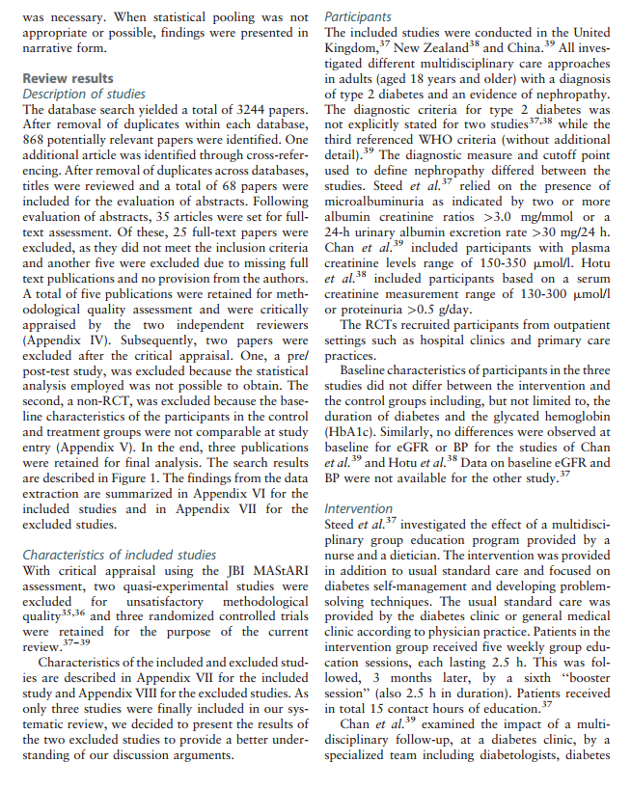
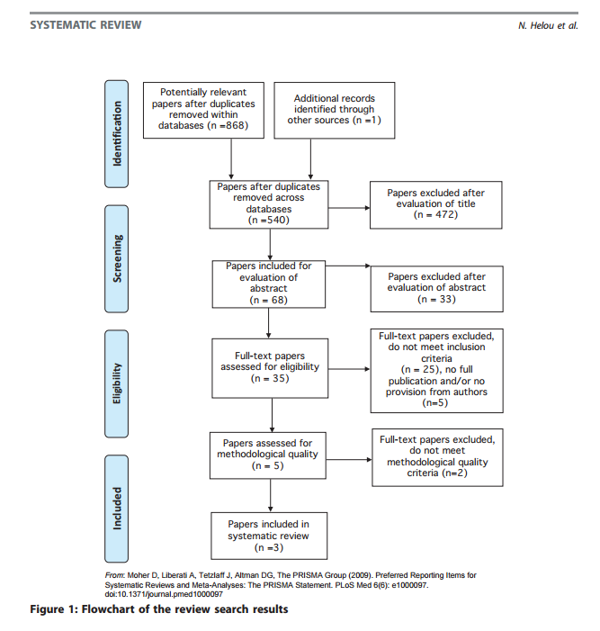
Synthesis of Review Results: Description of studies
From Helou et al 2016
Notes:
SLIDE EXPLANATION: (Trainer to point out these items on screen)
This is a JBI review published in the JBI Database of Systematic Reviews and Implementation Reports that we will use an example to demonstrate how the report should be presented. As you can see it displays all the points covered in the previous slide. It outlines:
The type and number of papers identified by the search and the numbers of studies that were included and excluded from the review
A PRISMA flowchart outlining the stages
Details of all full text articles that were retrieved for critical appraisal
Refers to appendices for details of included and excluded studies
Details of included studies
REFERENCES:
EXAMPLES: Helou N, Dwyer A, Shaha M, Zanchi A. Multidisciplinary management of diabetic kidney disease: a systematic review and meta-analysis. JBI Database of Systematic Reviews and Implementation Reports. 2016;14(7): 169-207.
DISCUSSION POINTS AND QUESTIONS FOR THE CLASS:

Slide 154
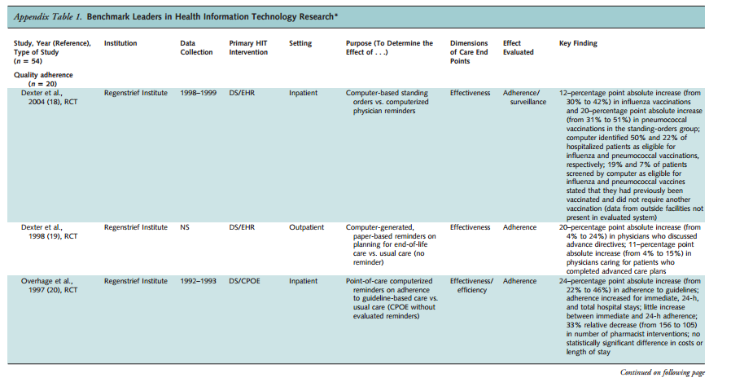
Synthesis of Review Results: Description of studies

Slide 155
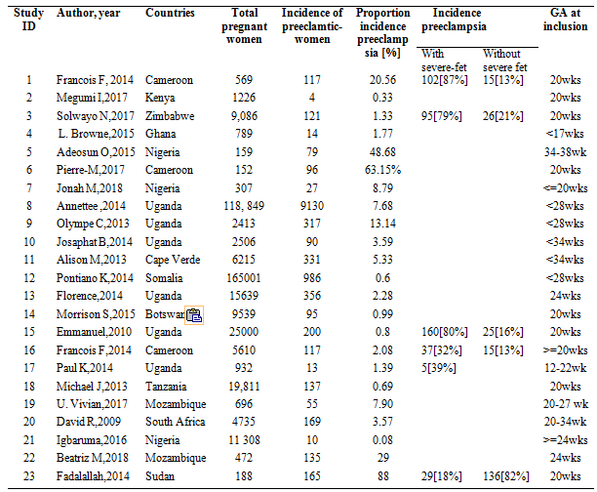
Results..Systematic review incidence preeclampsia in SSAs

Slide 156
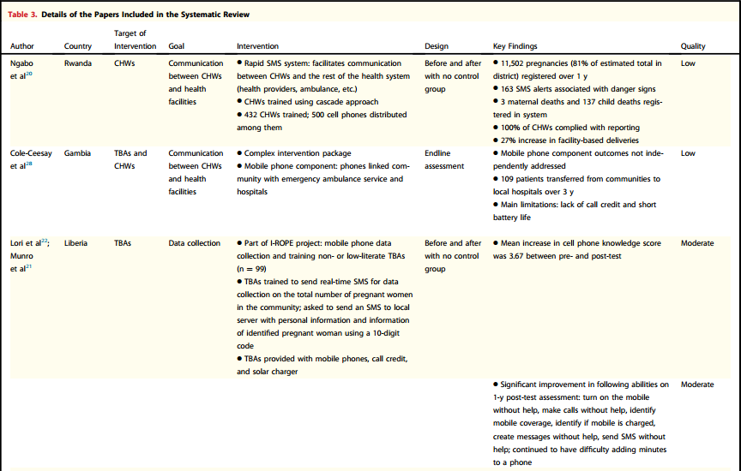
Synthesis of Review Results : Methodological quality

Slide 157
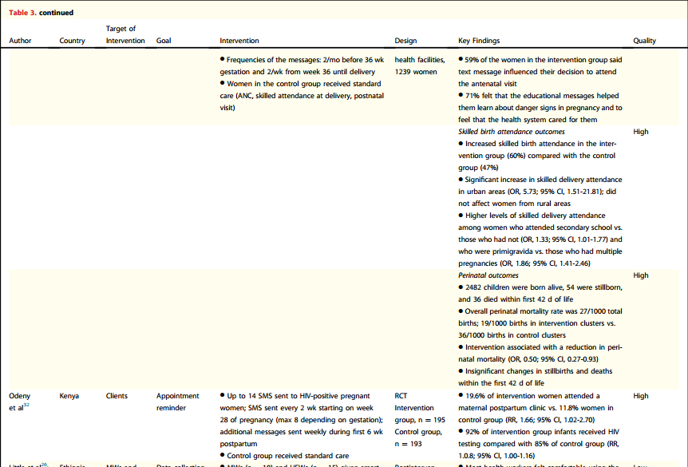
Synthesis of Review Results : Methodological quality

Slide 158
Synthesis of Review Results: Review results
Review results:
Include a detailed description of the results of the review
No standardized approach so consider whether the specific review question can be used to structure the results section
If findings can be reported under the outcomes or if findings can be reported by study design (e.g. RCT-based data, non-RCT data)
Generally findings are discussed textually and supported with forest plots, tables and figures as appropriate

Slide 159
Meta-Analysis
Quantitative Synthesis

Slide 160
Dataset
Extraction tool (Questionnaire)
Dataset in Excel
S.N | Question |  |  | Answer
1 | General information
 | Study ID
 | First Author and year
 | Study site (setting)
 | Enrolment and follow up period
2 | Study Characteristics
 | Study design
 | Inclusion criteria of the study
 | Exclusion criteria of the study
3 | Sample size |  | n=__________, n_{EFV}=_________, n_{NVP}=_______
 | Sampling methods
 | Intervention/exposed group
 | Control/unexposed group
4 | Statistical analysis
5 | Result
 | Length of follow up
 | Participants include in the analysis
 | Lost to follow up/drop
 | Number of total person-years
6 | Participants characteristics
 | Categorical variables n(%) | Efavirenz (EFV),n(%) |  |  | Nevirapine (NVP) n(%)
 | Gender: Male = Female= | Male = Female= |  |  | Male = Female=
study | Author | Year | design | country | Event | N | EFVcases | EFV | NVPcases | NVP | Nfemale
6 | Stringer JS, et al | 2010 | Prospective Cohort | Multicenter | Treatment Failure | 878 | 15 | 58 | 231 | 820 | 878
7 | Kwobah CM, et al | 2012 | case-control | Kenya | Treatment Failure | 3233 | 155 | 427 | 894 | 2633 | 1992
8 | Nachega JB, et al | 2008 | Cohort | South Africa | Treatment Failure | 2817 | 251 | 1822 | 203 | 995 | 1771
9 | Boulle A, et al 2007 | 2007 | Cohort | South Africa | NNRTI substitution | 2679 | 25 | 1612 | 63 | 1067 | 1896
10 | Shearer K, et al | 2014 | Cohort | South Africa | Treatment Failure | 8854 | 307 | 8211 | 43 | 643 | 5668
10 | Shearer K, et al | 2014 | Cohort | South Africa | Death | 12840 | 1006 | 11,962 | 55 | 878 | 7962
11 | Sarfo FS, et al | 2014 | Retrospective Observational | Ghana | Treatment Failure | 3990 | 633 | 2369 | 495 | 1621 | 2717
11 | Sarfo FS, et al | 2014 | Retrospective Observational | Ghana | Death | 3990 | 208 | 2369 | 110 | 1621 | 2717
11 | Sarfo FS, et al | 2014 | Retrospective Observational | Ghana | NNRTI Substituation | 3990 | 219 | 2369 | 254 | 1621 | 2717

Slide 161
Software for Meta-Aanalysis
Softwares which can be used for Meta-analysis are:
RevMan
CMA
Stata
R
SAS
Open Meta analysis Software
…

Slide 162
Meta-Analysis using Stata

Slide 163
Introduction to STATA
Basics of Stata
Data Entry
Data management
Editing
Coding
Renaming
Generating
Outlier observations
Missing Observations
Data analysis
Descriptive statistics
Inferential Statistics
Estimation
Hypothesis testing

Slide 164
Meta analysis using stata
Stata using metan commend
Considering STATA, either we must have STATA version 11 or install STATA packages that analyze meta data
Steps to install the package will be given

Slide 165
Installing meta-analysis in STATA
Normally, there is no menu in stata which can perform meta analysis
We have to use “metan” command without installing the menu or we can also bring the menu under “user” main menu
There are different options to install “packages” for meta analysis

Slide 166
Option I
As a first step make sure that your installation is uptodate by typing update all in the command window
Stata will automatically connect to www.stata.com and update the core package.
It will also download brief descriptions of all user-written commands published in the Stata Technical Bulletin
Those relating to meta-analysis can be displayed by typing search meta.
The most convenient way to install user-written commands is from within Stata.
Go into the “Help” menu and
Click on “SJ and User-Written Programs” option
click “STB” option.
Now click on http://www.stata.com and then on stb (for Stata Technical Bulletins).
The meta-analysis routines described in this chapter can then be downloaded as follows:

Slide 167
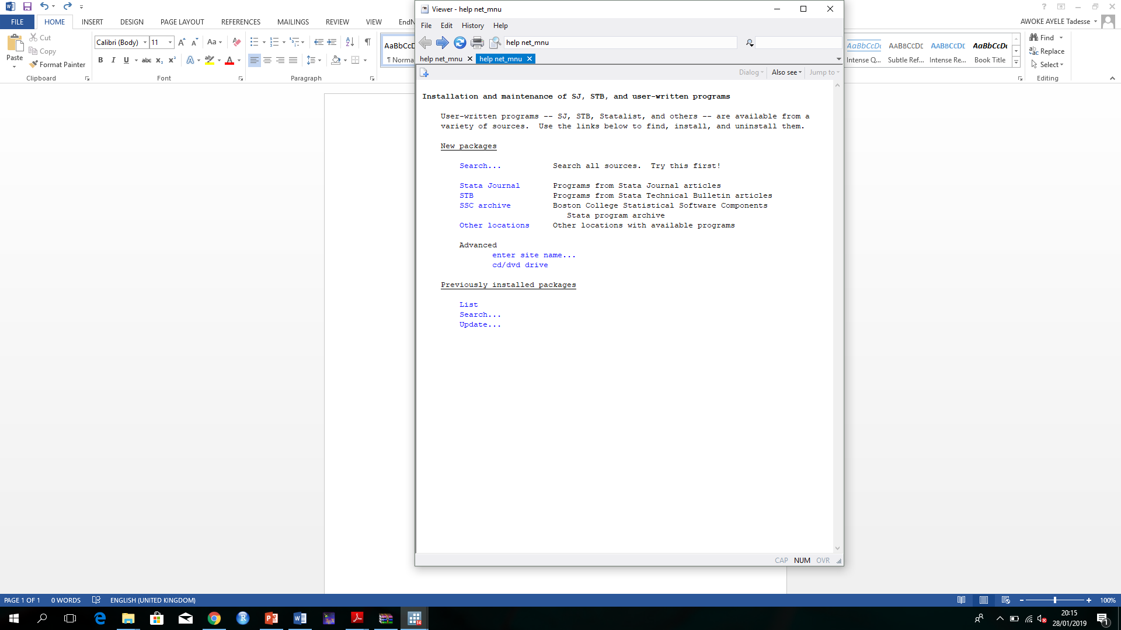
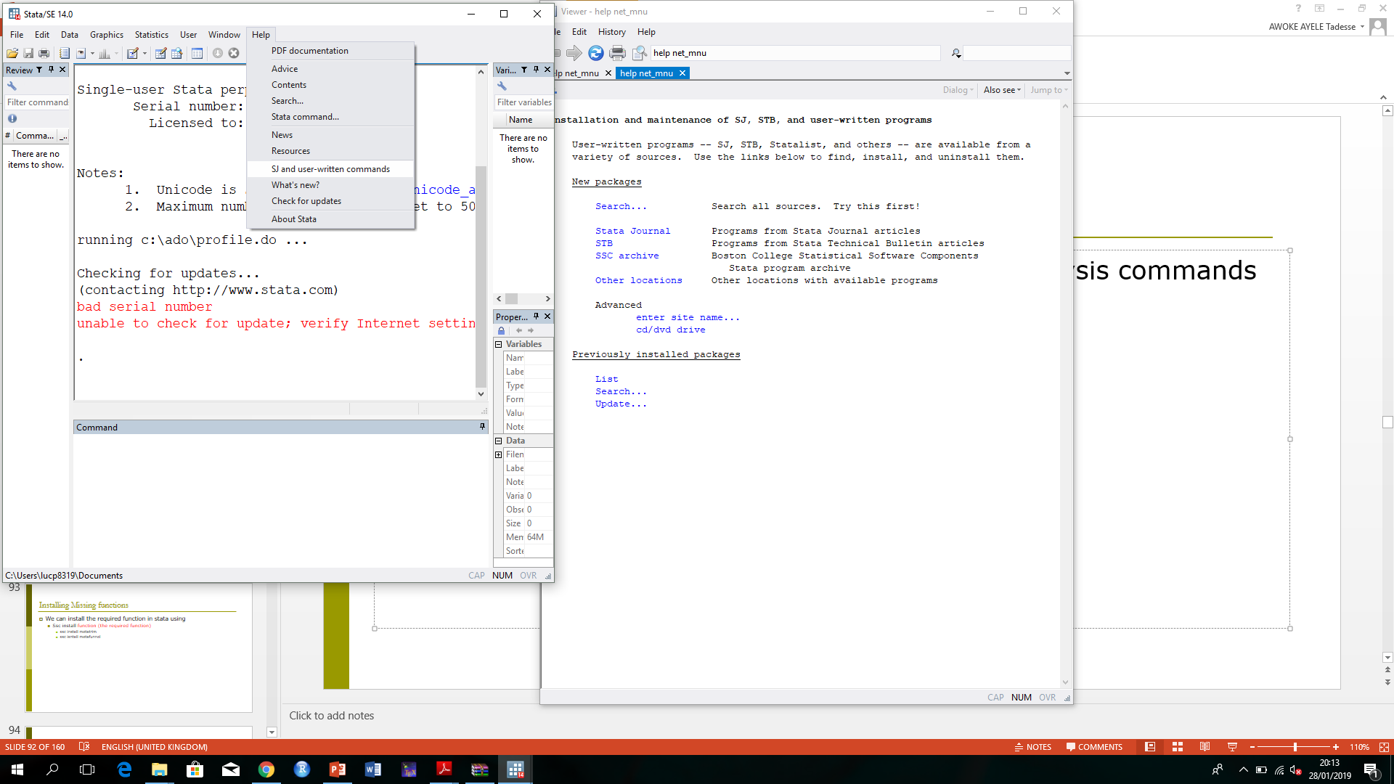
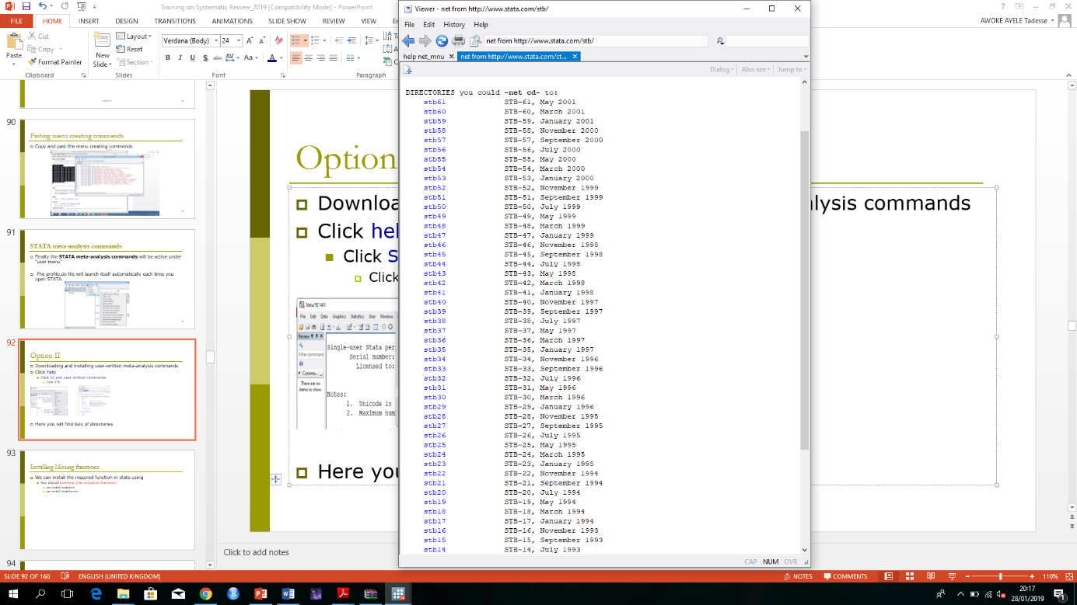
Option I
Downloading and installing user-written meta-analysis commands
Click help
Click SJ and user written commands
Click STB
Step 1
Step 2
Step 3
Find the package of each meta function here
Step 4

Slide 168
Main functions to install
On the DIRECTORIES list, find the following and follow the row
You should check whether updated versions or new commands have become available (update all, search meta).

Slide 169
Installing Missing functions
When there is error “no function”
Then we can install the required function using
ssc install function (the required function)
ssc install metatrim
ssc isntall metafunnel
Option I is better and simple to install the packages

Slide 170
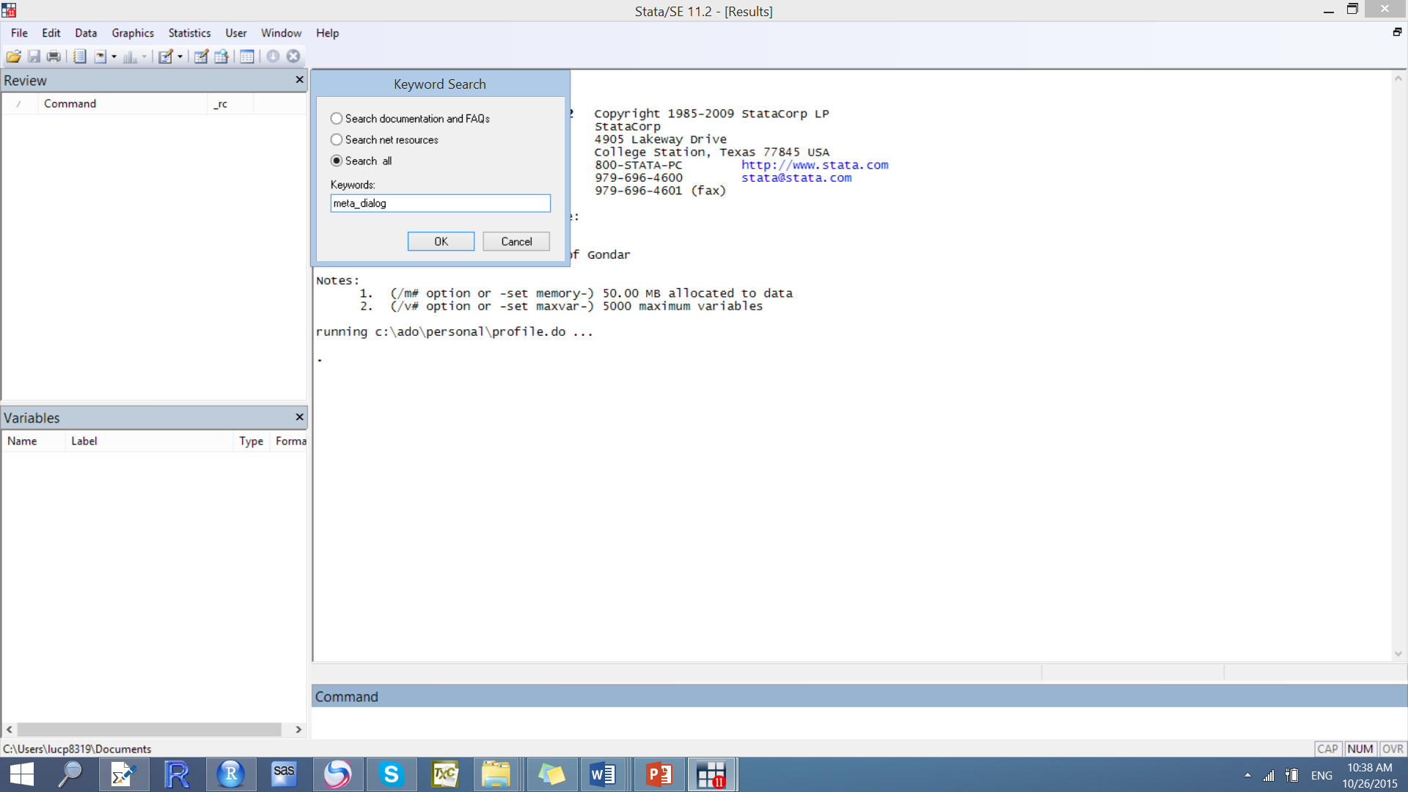
Option II
Pull down the help menu in STATA;
select “search”; and search for “meta_dialog” with the “search all” option checked.
Install the meta_dialog module

Slide 171
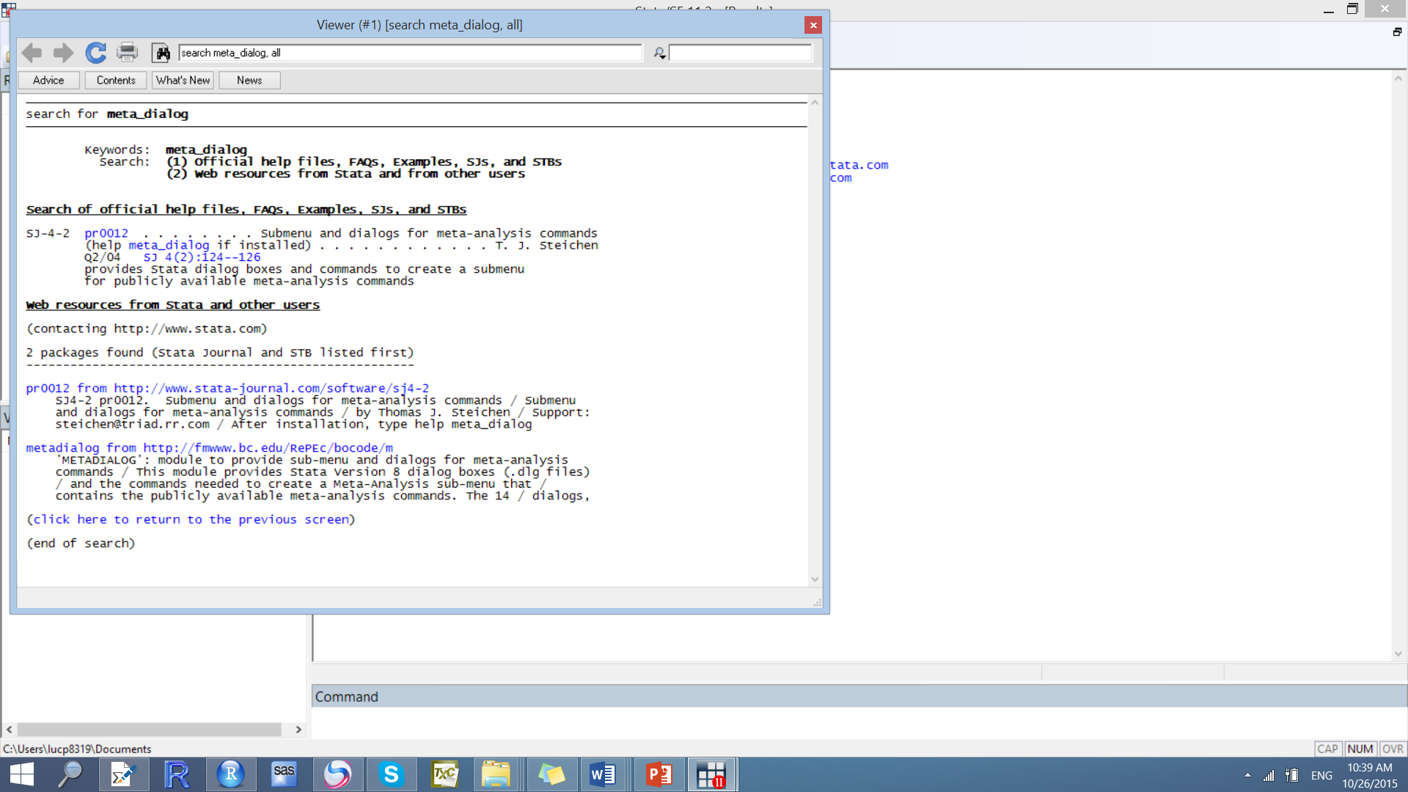
Installing the package
Click here

Slide 172

Installing the package
Step 1: Click here to install
Step 2: meta_dialog.hlp to find “menu creation commands”

Slide 173

Finding the menu creation command
Menu creation command

Slide 174
Steps of including meta analysis…
Create a profile.do file and add it to your STATA do file list.
To create open empty do file, and save the file in some path that STATA will recognize at the time of initialization:
C:\data\STATA\profile.do OR
C:\ado\personal\profile.do by the file name of “profile.do” (This can be found in C:\ where you install stata).

Slide 175

Creating the profile.do file

Slide 176
Steps of including meta analysis …
Copy and pest the program below “Menu Creation Commands” in to the profile.do file created above and save it there.
Run the command and then “Meta analysis” will appear in the menu.
The menu creation command can be obtained in the file we opened during the search

Slide 177

Pasting menu creating commends
Copy and past the menu creating commends

Slide 178

STATA meta-analysis commands
Finally the STATA meta-analysis commands will be active under “user menu”
The profile.do file will launch itself automatically each time you open STATA.

Slide 179
Basic principles of meta-analysis
Meta-analysis is typically a two-stage process:
A summary statistic is calculated for each study, to describe the observed intervention effect
The summary statistics are usually
risk ratios
odds ratios or
risk differences for event data,
differences in means for continuous data
hazard ratios for survival time data
Notes:
SLIDE EXPLANATION:
All commonly used methods for meta-analysis follow the following basic principles.
1. Meta-analysis is typically a two-stage process. In the first stage, a summary statistic is calculated for each study, to describe the observed intervention effect. For example, the summary statistic may be a relative risk if the data are dichotomous or a difference between means if the data are continuous.
2. In the second stage, a summary (pooled) intervention effect estimate is calculated as a weighted average of the intervention effects estimated in the individual studies. A weighted average is defined as:
Weighted average = sum of (estimate x weight)/ sum of weights
3. The combination of intervention effect estimates across studies may optionally incorporate an assumption that the studies are not all estimating the same intervention effect, but estimate intervention effects that follow a distribution across studies. This is the basis of a random-effects meta-analysis. Alternatively, if it is assumed that each study is estimating exactly the same quantity a fixed-effect meta-analysis is performed. We will discuss this is more detail shortly.
4. The standard error of the summary (pooled) intervention effect can be used to derive a confidence interval, which communicates the precision (or uncertainty) of the summary estimate, and to derive a P value, which communicates the strength of the evidence against the null hypothesis of no intervention effect.
The overall estimate of effect is a weighted average of study outcomes. Weight indicates the influence of a study, or in other terms, studies are weighted by the amount of information they contribute to the overall analysis. This is calculated statistically by the inverse-variance of the effect estimate. Put simply, if there is little variance or dispersion, the inverse of this will be large, and hence the study will carry more weight, so the more precise the study, with narrower CI’s, the more weight it will carry.
Studies with greater sample sizes and also those which measure more of the effect of interest will carry more weight, as they contribute more information in the overall analysis.
REFERENCES:
Higgins JPT, Green S (editors). Cochrane Handbook for Systematic Reviews of Interventions Version 5.1.0 [updated March 2011]. The Cochrane Collaboration, 2011. Available from www.cochrane-handbook.org.
EXAMPLES:
DISCUSSION POINTS AND QUESTIONS FOR THE CLASS:

Slide 180
Basic principles of meta-analysis
In the second stage the overall (pooled) treatment effect is calculated as a weighted average of these summary statistics
The weights are chosen to reflect the amount of information that each trial contains
Weighted average = sum of (estimate x weight)
sum of weights
In practice the weights are often the inverse of the variance (the square of the standard error) of the treatment effect, which relates closely to sample size
The precision (confidence interval) and statistical significance of the overall estimate are also calculated
Notes:
SLIDE EXPLANATION:
All commonly used methods for meta-analysis follow the following basic principles.
1. Meta-analysis is typically a two-stage process. In the first stage, a summary statistic is calculated for each study, to describe the observed intervention effect. For example, the summary statistic may be a relative risk if the data are dichotomous or a difference between means if the data are continuous.
2. In the second stage, a summary (pooled) intervention effect estimate is calculated as a weighted average of the intervention effects estimated in the individual studies. A weighted average is defined as:
Weighted average = sum of (estimate x weight)/ sum of weights
3. The combination of intervention effect estimates across studies may optionally incorporate an assumption that the studies are not all estimating the same intervention effect, but estimate intervention effects that follow a distribution across studies. This is the basis of a random-effects meta-analysis. Alternatively, if it is assumed that each study is estimating exactly the same quantity a fixed-effect meta-analysis is performed. We will discuss this is more detail shortly.
4. The standard error of the summary (pooled) intervention effect can be used to derive a confidence interval, which communicates the precision (or uncertainty) of the summary estimate, and to derive a P value, which communicates the strength of the evidence against the null hypothesis of no intervention effect.
The overall estimate of effect is a weighted average of study outcomes. Weight indicates the influence of a study, or in other terms, studies are weighted by the amount of information they contribute to the overall analysis. This is calculated statistically by the inverse-variance of the effect estimate. Put simply, if there is little variance or dispersion, the inverse of this will be large, and hence the study will carry more weight, so the more precise the study, with narrower CI’s, the more weight it will carry.
Studies with greater sample sizes and also those which measure more of the effect of interest will carry more weight, as they contribute more information in the overall analysis.
REFERENCES:
Higgins JPT, Green S (editors). Cochrane Handbook for Systematic Reviews of Interventions Version 5.1.0 [updated March 2011]. The Cochrane Collaboration, 2011. Available from www.cochrane-handbook.org.
EXAMPLES:
DISCUSSION POINTS AND QUESTIONS FOR THE CLASS:

Slide 181
Objectives of meta-analysis
There are different, legitimate objectives for a meta-analysis:
to improve statistical power to detect a treatment effect
to increase precision
to provide the closest estimate of an unknown real effect
to identify subsets of studies (sub-groups) associated with a beneficial effect
to explore if there are differences in the size or direction of the treatment effect associated with study-specific variables
Notes:
SLIDE EXPLANATION:
There are different, legitimate objectives for a meta-analysis: to improve statistical power to detect a treatment effect, to provide the closest estimate of an unknown real effect, to identify subsets of studies (sub-groups) associated with a beneficial effect, and to explore if there are differences in the size or direction of the treatment effect associated with study-specific variables.
REFERENCES:
Tufanaru C, Munn Z, Stephenson M, Aromataris E. Fixed or random effects meta-analysis? Common methodological issues in systematic reviews of effectiveness. International Journal of Evidence Based Healthcare. 2015 Sep;13(3):196-207.
EXAMPLES:
DISCUSSION POINTS AND QUESTIONS FOR THE CLASS:

Slide 182
Meta-analysis using Stata
Any systematic review, whether it includes meta-analysis or not, should include all the procedures and results mentioned so far
Introduction
Methods
qualitative synthesis
Following Meta synthesis, aggregate data or data from set of individual studies may be pooled quantitatively
The rationale for a meta-analysis is that
By combining studies, the overall sample will increase
Improve the statistical power and precision of estimates of treatment effects

Slide 183
Meta-analysis
Meta analysis will be appropriate when:
the outcome variable is either a binary or continuous data
we have more than one study with estimated measures
the study characteristics that could potentially affect outcome variable are homogeneous in the two groups
the outcome is measured in a similar way
Only appropriate when studies are considered similar enough from a clinical and methodological point of view
Using meta analysis , we can combine measures like
risk ratio, odds ratio, risk difference,
mean difference (standardized) , p-values, correlation coefficient, and sensitivity & specificity of a diagnostic test

Slide 184
Models of Meta-Analysis
There are two models used in meta-analysis,
the fixed effect model and
the random effects model.
Main difference is in the calculation of standard errors associated with the combined effect size
Fixed effects models only assume within-study variability
Random effects model assume within and between study variability

Slide 185
Fixed and random effect estimate
Fixed effect model assumes that there is one true effect size which is shared by all the included studies.
It follows that the combined effect is our estimate of this common effect size
Random effects model we allow that the true effect could vary from study to study.
effect size might be a little higher if the subjects are
older,
or more educated,
or healthier, and so on.
The studies included in the meta-analysis are assumed to be a random sample of the relevant distribution of effects
The combined effect estimates the mean effect in this distribution.

Slide 186
Fixed and random effect estimate
Under the fixed effect model all studies are estimating the same effect size
we can assign weights to all studies based entirely on the amount of information captured by that study.
A large study would be given the lion’s share of the weight, and a small study could be largely ignored
Ti = μ + ei

Slide 187
Interpreting a fixed effects model
In the fixed effects model the summary effect computed in meta-analysis is the best estimate of the common treatment effect
In the fixed effects model the summary treatment effect is a weighted summary of the study-specific effect sizes
The weights assigned to each study depend on the study’s precision; more specifically each study’s weight is equal to the inverse of its variance
Study weights are functions of within-study variance; and confidence intervals are relatively narrow (conservative)
(Nikolakopoulou et al, 2014)
Notes:
SLIDE EXPLANATION:
In the fixed effects model the summary effect computed in meta-analysis is the best estimate of the common treatment effect. In the fixed effects model the summary treatment effect is a weighted summary of the study-specific effect sizes. The weights assigned to each study depend on the study’s precision; more specifically each study’s weight is equal to the inverse of its variance.
REFERENCES:
Nikolakopoulou A, Mavridis S, Salanti G. Demystifying fixed and random effects meta-analysis. Evidence Based Mental Health. 2014; 17(2): 53-57.
EXAMPLES:
DISCUSSION POINTS AND QUESTIONS FOR THE CLASS:

Slide 188
Fixed and random effect estimate
under the random effects model we are trying to estimate the mean of a distribution of true effects.
Large studies may yield more precise estimates than small studies
We want to be sure that all of these effect sizes are included in our estimate of the mean.
The weights assigned under random effects are more balanced.
Large studies are less likely to dominate the analysis and small studies are less likely to be ignored.
Ti = θi + ei = μ + εi + ei

Slide 189
Random effects model
Each study’s effect size is a random draw from some underlying population of effect sizes and that within each study, we use a different sample of individuals so our estimate of each study’s effect size will vary from its study mean by the sampling variance
In the random effects model the summary effect computed in meta-analysis is not the estimate of a common overall effect, but the average of a collection of possible treatment effects
Random effects gives more weight to smaller studies
Results in wider confidence intervals (Liberal)
Similar (almost identical) where heterogeneity is not present
(Khan et al, 2012; Pigott, 2012)
Notes:
SLIDE EXPLANATION:
A random effects model assumes:
there is no single underlying value of the effect in all studies included in meta-analysis, but there is a distribution of effects depending on the characteristics of the studies,
there is between-study variation in addition to within-study variation
each study’s effect size is a random draw from some underlying population of effect sizes and that within each study, we use a different sample of individuals so our estimate of each study’s effect size will vary from its study mean by the sampling variance, therefore the variance among effect size estimates in a random effects model consists of within-study sampling variance, and between-study variance
REFERENCES:
Khan K, Kunz R, Kleijnen J, Antes G. Systematic reviews to support evidence-based medicine. How to review and apply findings of healthcare research. Second edition. London: Hodder Arnold, 2011.
Pigott TD. Advances in meta-analysis. New York: Springer, 2012.
EXAMPLES:
DISCUSSION POINTS AND QUESTIONS FOR THE CLASS:

Slide 190

Fixed effects model
Random effects model
The two meta-analysis models may yield similar or contradicting results
Taken from Lee, 2008
Notes:
SLIDE EXPLANATION:
This graph represents the concepts of a fixed effects model and a random effects model. A fixed effects model assumes that there is a common 'true' treatment effect underlying studies and that each study result will vary randomly around this true effect. A random effects model assumes that there is different underlying effect for each study and that there is also an additional source of variation between studies which reflects the amount of heterogeneity between them.
REFERENCES:
Lee J. Meta-analysis. J Korean Endocr Soc. 2008 Dec;23(6):361-378. http://dx.doi.org/10.3803/jkes.2008.23.6.361
EXAMPLES:
DISCUSSION POINTS AND QUESTIONS FOR THE CLASS:

Slide 191
Analyses on Meta data
To perform meta analysis using stata, the common data structure should contain the variables:
Study ID
Study name (surname of first author followed by eta al and year of publication)
Year
Size of population 1
Event of from population 1
Non-Event of from population 1
Size of population 0
Event of from population 0
Non-Event of from population 0
Effect size with measures of precision
And other possible covariates

Slide 192
Methods in meta analysis
We use stata to:
Estimate the magnitude of true heterogeneity and test it
Perform Random and Fixed effect main meta analysis
Perform subgroup analysis (based on I² and Q)
Perform Meta regression
Produce funnel plot and Egger’s or Begg’s test to explore publication bias
Perform sensitivity analysis

Slide 193

Example 1: cholesterol reduction

Slide 194
Example 2: Consider the following review question
Observational studies
Among HIV infected adults who initiated ART (Population), were adult initiated with EFV regimen (Exposure/ intervention) at higher risk of treatment failure (Outcome) as compared to those who initiated with NVP regimen (comparison)?
Population
Intervention
Comparison
Outcome

Slide 195
Data processing
The data in to excel
study | Author | Year | design | country | Event2 | N | EFVcases | EFV | NVPcases | NVP | EFVnoncases | NVPnoncases
6 | Stringer JS, et al | 2010 | Prospective Cohort | Multicenter | Treatment Failure | 878 | 15 | 58 | 231 | 820 | 43 | 589
7 | Kwobah CM, et al | 2012 | case-control | Kenya | Treatment Failure | 3233 | 155 | 427 | 894 | 2633 | 272 | 1739
8 | Nachega JB, et al | 2008 | Cohort | South Africa | Treatment Failure | 2817 | 251 | 1822 | 203 | 995 | 1571 | 792
9 | Boulle A, et al 2007 | 2007 | Cohort | South Africa | NNRTI substitution | 2679 | 25 | 1612 | 63 | 1067
10 | Shearer K, et al | 2014 | Cohort | South Africa | Treatment Failure | 8854 | 307 | 8211 | 43 | 643 | 7904 | 600
10 | Shearer K, et al | 2014 | Cohort | South Africa | Death | 12840 | 1006 | 11,962 | 55 | 878 | 10956 | 823
11 | Sarfo FS, et al | 2014 | Retrospective Observational | Ghana | Treatment Failure | 3990 | 633 | 2369 | 495 | 1621 | 1733 | 1126
11 | Sarfo FS, et al | 2014 | Retrospective Observational | Ghana | Death | 3990 | 208 | 2369 | 110 | 1621 | 2161 | 1511
11 | Sarfo FS, et al | 2014 | Retrospective Observational | Ghana | NNRTI Substituation | 3990 | 219 | 2369 | 254 | 1621 | 2150 | 1367
13 | Shearer K2, et al | 2013 | Cohort | South Africa | Treatment Failure | 2385 | 101 | 2,254 | 16 | 131 | 2153 | 115
13 | Shearer K2, et al | 2013 | Cohort | South Africa | Death | 2385 | 107 | 2,254 | 5 | 131 | 2147 | 126
14 | Barth RE, et al | 2011 | Retrospective observational cohort | South Africa | Treatment Failure | 735 | 204 | 426 | 133 | 309 | 222 | 176
16 | Gsponer T, et al | 2012 | Collaborative analysis | sub-Saharan Africa | Treatment Failure | 2404 | 25 | 186 | 298 | 2218 | 161 | 1920
23 | Sarfo FS2, et al | 2014 | Retrospective cohort study | Ghana | NNRTI Substituation | 3999 | 123 | 2,378 | 158 | 1621 | 2255 | 1463
24 | Keiser O, et al | 2010 | Case control | sub-Saharan Africa | Treatment Failure | 4281 | 295 | 1,951 | 370 | 2325 | 1661 | 1955
25 | Anlay DZ, et al | 2016 | Retrospective follow up | Ethiopia | NNRTI Substituation | 410 | 28 | 289 | 60 | 121 | 261 | 161
26 | van Zyl GU, et al | 2011 | Cross-sectional | South Africa | NNRTI Substituation | 167 | 69 | 82 | 68 | 85 | 13 | 15
27 | Abah IO, et al | 2015 | Cohort | Nigeria | NNRTI Substituation | 6309 | 443 | 558 | 4183 | 5751 | 115 | 1568
29 | Bock P, et al | 2013 | Multicentre cohort | South Africa | NNRTI Substituation | 27350 | 1631 | 19441 | 1277 | 7909 | 17810 | 6629
29 | Bock P, et al | 2013 | Multicentre cohort | South Africa | Death | 27350 | 1294 | 19441 | 299 | 7909 | 18147 | 7610
30 | Tirfe ZM, et al | 2013 | Retrospective cohort study | Ethiopia | Treatment Failure | 492 | 91 | 246 | 82 | 246 | 154 | 164

Slide 196

Data processing
Import or export data to STATA

Slide 197

Example 3: Diagnostic test accuracy
Data from 17 studies of lymphangiography for the diagnosis of lymph node metastasis in women with cervical cancer. The total number of patients in each study ranges from 21 to 300.

Slide 198
Diagnostic test accuracy
Bivariate model
Models the sensitivity and specificity more directly
It assumes that logit (log-odds) transforms have a bivariate normal distribution between studies
The logit-transformed sensitivities are assumed to have a mean of μA and a variance of σ2A
the logit-transformed specificities have a mean of μB and a variance of σ2B
The trade-off between sensitivity and specificity is allowed for by also including a correlation, ρAB

Slide 199
HSROC model
assumes that there is an underlying ROC curve in each study with parameters α and β that characterize the accuracy and asymmetry of the curve
The accuracy parameter has a mean of Λ and a variance of σ2α, while the positivity parameter θ has a mean of Θ (capital theta) and a variance of σ2θ
When no covariates are included in an HSROC model, there are therefore five parameters: Λ, Θ, β, σ2α , and σ2θ .

Slide 200

Graphical displays for meta-analysis
Forest plots are the most familiar method for presenting results of meta-analyses
Forest plots display effect estimates and their confidence intervals for each study and the results of the meta-analysis. They are plotted along a vertical line of no effect
Notes:
SLIDE EXPLANATION:
Forest plots, also known as ‘blobograms’ are the most familiar method for presenting results of meta-analyses. A forest plot displays effect estimates and their confidence intervals for each study and the results of the meta-analysis itself normally at the bottom of the graph. These are plotted on a graph with a vertical line running up the center indicating no difference in effect.
Typical examples are odds ratios (or log odds ratios), standardized mean differences (often called ‘effect sizes’), correlations (of transformations thereof), proportions (or transformations thereof), risk ratios (or log risk ratios), hazard ratios (or log hazard ratios), means, and differences in means.
REFERENCES:
EXAMPLES:
Example on slide showing the effect of multidisciplinary management of Diabetic Kidney Disease on glycemic control by measurement of HbA1c. From: Helou N, Dwyer A, Shaha M, Zanchi A. Multidisciplinary management of diabetic kidney disease: a systematic review and meta-analysis. JBI Database of Systematic Reviews and Implementation Reports. 2016;14(7):169-207.
DISCUSSION POINTS AND QUESTIONS FOR THE CLASS:

Slide 201
When is meta-analysis appropriate?
Only appropriate when studies are considered similar enough from a clinical and methodological point of view (homogenous studies) and
There is no publication bias
If studies are heterogeneous from a clinical
e.g. population, intervention, comparator and outcome)
Methodological (i.e. study design and risk of bias point of view)
If there is significant publication bias
Then it is uncertain if it is appropriate to synthesize the respective studies with meta-analysis
Notes:
SLIDE EXPLANATION:
Meta-analysis is only appropriate when studies are considered similar enough from a clinical and methodological point of view (homogenous studies). If studies are heterogeneous from a clinical (e.g. population, intervention, comparator and outcome) or methodological (i.e. study design and risk of bias) point of view then it is uncertain if it is appropriate to synthesize the respective studies with meta-analysis.
REFERENCES:
Tufanaru C, Munn Z, Stephenson M, Aromataris E. Fixed or random effects meta-analysis? Common methodological issues in systematic reviews of effectiveness. International Journal of Evidence Based Healthcare. 2015 Sep;13(3):196-207.
EXAMPLES:
DISCUSSION POINTS AND QUESTIONS FOR THE CLASS:

Slide 202
Heterogeneity
Clinical heterogeneity refers to differences between studies in the characteristics of their populations, interventions and outcomes
Methodological heterogeneity refers to differences between studies in their study designs and quality
Statistical heterogeneity refers to the variation of effects between studies. It may be due to clinical heterogeneity or methodological heterogeneity or chance
(Khan et al, 2012)
Notes:
SLIDE EXPLANATION:
Clinical heterogeneity refers to differences between studies in the characteristics of their populations, interventions and outcomes (or other like elements dependent on the type of review such as condition or context). Methodological heterogeneity refers to differences between studies in their study designs and quality. Statistical heterogeneity refers to the variation of effects between studies. It may be due to clinical heterogeneity or methodological heterogeneity or chance.
REFERENCES:
Khan K, Kunz R, Kleijnen J, Antes G. Systematic reviews to support evidence-based medicine. How to review and apply findings of healthcare research. Second edition. London: Hodder Arnold, 2011.
Munn Z, Tufanaru C, Aromataris E. Data extraction and synthesis. American Journal of Nursing. 2014 114(7): 49-54.
Tufanaru C, Munn Z, Stephenson M, Aromataris E. Fixed or random effects meta-analysis? Common methodological issues in systematic reviews of effectiveness. International Journal of Evidence Based Healthcare. 2015 Sep;13(3):196-207.
EXAMPLES:
Clinical heterogeneity may be present when some studies looking at exercise interventions in the elderly include active elderly people living in the community while other studies include elderly nursing home residents with and without dementia
Methodological heterogeneity may result when some trials examining the effectiveness of a drug for hypertension against a placebo blind those assessing outcomes while in other trials outcome assessors are not blinded and know which treatment the participants received
Statistical heterogeneity may result when some studies looking at the effect of administering fluids for preventing post-dural puncture headache produce a positive beneficial effect while others result in a negative or harmful effect
DISCUSSION POINTS AND QUESTIONS FOR THE CLASS:

Slide 203
Test of heterogeneity
Clinical and methodological heterogeneity
Common sense: are the patients, interventions and outcomes in each of the included studies sufficiently similar?
are study designs and quality similar?
Statistical heterogeneity
Graphic aid (visually)
Forest plot, overlapping confidence intervals
Statistical tests
chi-squared test (Cochran Q test)
I square statistic (I²)
Notes:
SLIDE EXPLANATION:
The presence of heterogeneity between studies should be carefully investigated. How do you determine if studies are clinically or methodologically heterogeneous? In many circumstances common sense can be applied when considering whether the patients, interventions, outcomes, study designs and quality in each of the included studies are sufficiently similar.
For statistical heterogeneity, you can start by visually inspecting the forest plot/graphical display. If confidence intervals for the results of individual studies have poor overlap, this generally indicates the presence of statistical heterogeneity. More formally, statistical tests for heterogeneity are available such as the standard chi-squared test (Cochran Q) and the I square statistic.
REFERENCES:
Higgins JPT, Green S (editors). Cochrane Handbook for Systematic Reviews of Interventions Version 5.1.0 [updated March 2011]. The Cochrane Collaboration, 2011. Available from www.cochrane-handbook.org.
Munn Z, Tufanaru C, Aromataris E. JBI's systematic reviews: data extraction and synthesis. AJN The American Journal of Nursing, 2014;114(7):49-54.
The Joanna Briggs Institute. The Joanna Briggs Institute Reviewers’ Manual: 2014 Edition. Adelaide: The Joanna Briggs Institute 2014.
EXAMPLES:
DISCUSSION POINTS AND QUESTIONS FOR THE CLASS:

Slide 204
Standard chi-squared test (Cochran Q test)
Tests the statistical hypothesis that the true treatments effects (the effect size parameters) are the same in all the primary studies included in meta-analysis
If results of the test are statistically significant (P-value <0.05)
the statistical hypothesis that the true treatments effects are the same in all the primary studies included in meta-analysis (the hypothesis of homogeneity) is rejected
Therefore, it is considered that there is statistical heterogeneity
Notes:
SLIDE EXPLANATION:
Common tests for heterogeneity assume the null hypothesis that all the apparent variability between individual study results is due to chance. The standard chi-squared test (Cochran Q test) for statistical heterogeneity tests the statistical hypothesis that the true treatments effects (the effect size parameters) are the same in all the primary studies included in meta-analysis. It generates a probability, presented as a P value, that between-study differences in results are equal to or greater than those observed are likely to occur simply by chance. If results of the test are statistically significant (P-value <0.05), the statistical hypothesis that the true treatments effects are the same in all the primary studies included in meta-analysis (the hypothesis of homogeneity) is rejected, therefore, it is considered that there is statistical heterogeneity.
REFERENCES:
The Joanna Briggs Institute. Joanna Briggs Institute Reviewers’ Manual: 2016 edition/supplement: Systematic Reviews of Effectiveness Evidence. The Joanna Briggs Institute 2016 (in press).
EXAMPLES:
DISCUSSION POINTS AND QUESTIONS FOR THE CLASS:

Slide 205
Standard chi-squared test (Cochran Q test)
The statistical power of the test is in most cases very low due to the small number of studies;
Where Wi is the study weight, Yi is the study effect size, M is the summary effect, and the k is number of studies.
heterogeneity may be present even if the Q statistic is not statistically significant at conventional levels of significance such as 0.05.
It is not appropriate to decide the meta-analysis model based only on the results of the Chi-squared statistical test (Q test) for heterogeneity
Notes:
SLIDE EXPLANATION:
The statistical power of the test is in most cases very low due to the small number of studies; heterogeneity may be present even if the Q statistic is not statistically significant at conventional levels of significance such as 0.05. A cut-off significance level of 0.10 rather than the usual 0.05 was advocated. With a small number of studies (< 20), the Q test should be interpreted very cautiously. It is not appropriate to decide the meta-analysis model based only on the results of the Chi squared statistical test (Q test) for heterogeneity.
REFERENCES:
Higgins JPT, Green S (editors). Cochrane Handbook for Systematic Reviews of Interventions. Chichester (UK): John Wiley & Sons, 2008.
Huedo-Medina TB, Sánchez-Meca J, Marín-Martínez F, Botella J. Assessing heterogeneity in meta-analysis: Q statistic or I² index?. Psychological Methods. 2006;11(2):193.
Sutton AJ, Abrams KR, Jones DR, Sheldon TA, Song F. Methods for meta-analysis in medical research. New York: Wiley, 2000.
The Joanna Briggs Institute. Joanna Briggs Institute Reviewers’ Manual: 2016 edition/supplement: Systematic Reviews of Effectiveness Evidence. The Joanna Briggs Institute 2016 (in press).
EXAMPLES:
DISCUSSION POINTS AND QUESTIONS FOR THE CLASS:

Slide 206
Between-studies variance (tau-square)
Is defined as the variance of the true effect sizes
To yield this estimate we start with the difference (Q – df) which represents the dispersion in true effects on a standardized scale
Where df=number of studies - 1
With a p-value less than 0.05 leading us to reject the null, and conclude that the studies do not share a common effect size

Slide 207
I-square statistic (I²)
A statistic used for quantifying inconsistency in meta-analysis
I² is a percentage and its value lies between 0% and 100%
A value of 0% indicates no observed heterogeneity, and larger values show increasing heterogeneity . If I² = 0% this means that all variability in effect size estimates is due to sampling error within studies
If I²= 50% it means that half of the total variability among effect sizes is caused not by sampling error but by true heterogeneity between studies
With a small number of studies (< 20), the I² test should be interpreted very cautiously
Notes:
SLIDE EXPLANATION:
The I square statistic (I2) is a test of heterogeneity used for quantifying inconsistency in meta-analysis. It describes the percentage of the variability in effect estimates that is due to heterogeneity. I2 can be calculated from Cochrane Q. Any negative values of I2 are considered equal to 0, so that the range of I2 values is between 0% and 100%. A value of 0% indicates no observed heterogeneity, and larger values show increasing heterogeneity. If I2 = 0% this means that all variability in effect size estimates is due to sampling error within studies. If I2= 50% it means that half of the total variability among effect sizes is caused not by sampling error but by true heterogeneity between studies. With a small number of studies (< 20), the I² test should be interpreted very cautiously.
REFERENCES:
EXAMPLES:
DISCUSSION POINTS AND QUESTIONS FOR THE CLASS:

Slide 208
Subgroup analysis
Subgroup analyses may be done for subsets of participants or for subsets of studies
Subgroup analyses involve splitting the data or the studies into subgroups, often so as to make comparisons between them
False negative and false positive significance tests increase in likelihood rapidly as more subgroup analyses are performed (Higgins & Green, 2011)
Notes:
SLIDE EXPLANATION:
Subgroup analyses may be done for subsets of participants (such as males and females), or for subsets of studies (such as different geographical locations). Subgroups may relate to subsets of studies (for example, trials using different durations of intervention) or to a subdivision of the outcome (for example, short-term, medium term, long-term). False negative and false positive significance tests increase in likelihood rapidly as more subgroup analyses are performed. (Higgins & Green 2011)
REFERENCES:
Higgins JPT, Green S (editors). Cochrane Handbook for Systematic Reviews of Interventions Version 5.1.0 [updated March 2011]. The Cochrane Collaboration, 2011. Available from www.cochrane-handbook.org.
EXAMPLES:
DISCUSSION POINTS AND QUESTIONS FOR THE CLASS:

Slide 209

Example: Subgroup analysis

Slide 210
Sensitivity analysis
Sensitivity analysis refers to the repetition of an analysis under different assumptions to examine the impact of these assumptions on the results (Khan et al, 2012)
Test impact of decisions made during the review process
use both models
compute meta-analysis with and without the inclusion of poor quality studies
use both RR and OR for meta-analysis
compute meta-analysis with and without the inclusion of small sample size studies
compute meta-analysis with and without the inclusion of a mega-trial
If findings remain consistent across analyses, this means they are more robust and we can be more confident in the result
Notes:
SLIDE EXPLANATION:
Sensitivity analysis refers to the repetition of an analysis under different assumptions to examine the impact of these assumptions on the results. (Khan et al 2012) Example of sensitivity analysis include: using both models, that is, fixed effects model and random effects model for meta-analysis; computing meta-analysis with and without the inclusion of poor quality studies (regardless of how poor quality is defined); using both RR and OR for meta-analysis; computing meta-analysis with and without the inclusion of small sample size studies; or computing meta-analysis with and without the inclusion of a mega-trial.
Essentially, sensitivity analysis is done to determine whether the decisions made by reviewers (which may sometimes be arbitrary) have an impact on the results. If findings remain consistent across analyses, this means they are more robust and we can be more confident in the result. If not, then this is concerning and may mean the results should be interpreted with caution.
REFERENCES:
Khan K, Kunz R, Kleijnen J, Antes G. Systematic reviews to support evidence-based medicine. How to review and apply findings of healthcare research. Second edition. London: Hodder Arnold, 2011.
EXAMPLES:
DISCUSSION POINTS AND QUESTIONS FOR THE CLASS:

Slide 211
Example: Sensitivity analysis

Slide 212
Assessing publication biases
The model (for publication bias)
Large studies are likely to be published regardless of statistical significance because these studies involve large commitments of time and resources
Moderately sized studies are at risk of being lost, but with a moderate sample size even modest effects will be significant, and so only some studies are lost here
Small studies are at greatest risk for being lost. Because of the small sample size, only the largest effects are likely to be significant, with the small and moderate effects likely to be unpublished
The combined result of these three items is that we expect the bias to increase as the sample size goes down.

Slide 213

Publication bias
Publication and related biases in meta-analysis are often examined:
by visually checking for asymmetry in funnel plots, or
objectively testing for it using Egger’s or Begg’s technique.

Slide 214
Sources of funnel plot asymmetry
Selection biases
Publication bias and other reporting biases
Biased inclusion criteria
True heterogeneity: size of effect differs according to study size
Intensity of intervention
Differences in underlying risk
Data irregularities
Poor methodological design of small studies
Inadequate analysis
Fraud
Artifact: heterogeneity due to poor choice of effect measure
Chance

Slide 215
Egger test

Slide 216
Functions in Stata
For proportion study:
Metaprop x n (x is event of interest and n is the total sample)
Metaprop takes the outcome of interest and the total population
For prevalence study
Metan ES seES
Metan takes prevalence with standared error of prevalence
To see the trend, we can use metacum
Metacum can be also used to update meta-analysis

Slide 217
Functions in stata
For diagnostic test accuracy
Metandi tp fp fn tn (for diagnostic test accuracy)
For two groups means (intervention and control)
Metan n₁ m₁ sd₁ n₂ m₂ sd₂
For binary outcome variable when the 2X2 table is given (i.e. a, b, c, d)
Metan a b c d
For binary outcome variable when no 2X2 table
Metan SE seSE

Slide 218
Activity 8
Consider the example given above
Undertake a meta-analysis
Were results statistically significant?
Test homogeneity assumption
Test if there is publication bias
Notes:
SLIDE EXPLANATION:
Now that we have discussed some of the concepts of synthesis and analysis of extracted data for a systematic review, we will attempt to try and do a meta-analysis with some of the data we started to extract yesterday. Before we attempt the meta-analysis though we will need to complete phase two data extraction first. Refer participants to Activity 5 in the workbook. Logon to JBI SUMARI (as a team using one username and password) and using the papers from activity 2 extract the data relevant to the outcome ‘Clinical Cure (Day 3)’. Using the results of both papers undertake a meta-analysis. Review the funnel plot and determine if results were statistically significant and whether statistical heterogeneity was present.
Trainers: Allow 30 minutes for participants to undertake this exercise. At the end of the exercise the trainer should facilitate a short discussion on the significance and heterogeneity associated with the meta-analysis.
REFERENCES:
EXAMPLES:
DISCUSSION POINTS AND QUESTIONS FOR THE CLASS:

Slide 219
Summary
SR&MA is a long process which requires hard work and patience
Through practice you will know many more things
It requires team work and different resources
Identification of Review Question
Manuscript
Protocol development
PROSPERO reg.
Results
Search Strategy
Study location
Study selection
Appraisal
Extraction
Qualitative synthesis
Meta analysis

Slide 220
Summary
My proposal:
I need you to continue the review process and our plan is:
Study selection and critical appraisal will be completed by Aug. 2021
Data extraction completed by September 2021
Data analysis and synthesis (qualitative & quantitative) by October 2021
Knowledge is perishable, which requires continuous update

Slide 221
Thank you!

